Slide 1


Application Launch Webinar
October 5, 2026
Presentation will begin shortly

Slide 2
Agenda
Introduction from Governor’s Office
Program Basics
Goals
Applicant Eligibility
Eligible Costs
Funding
Post-Approval Process
Post-Construction Compliance
Sample Application Walkthrough
Other Funding Sources
Audience Q&A

Slide 3
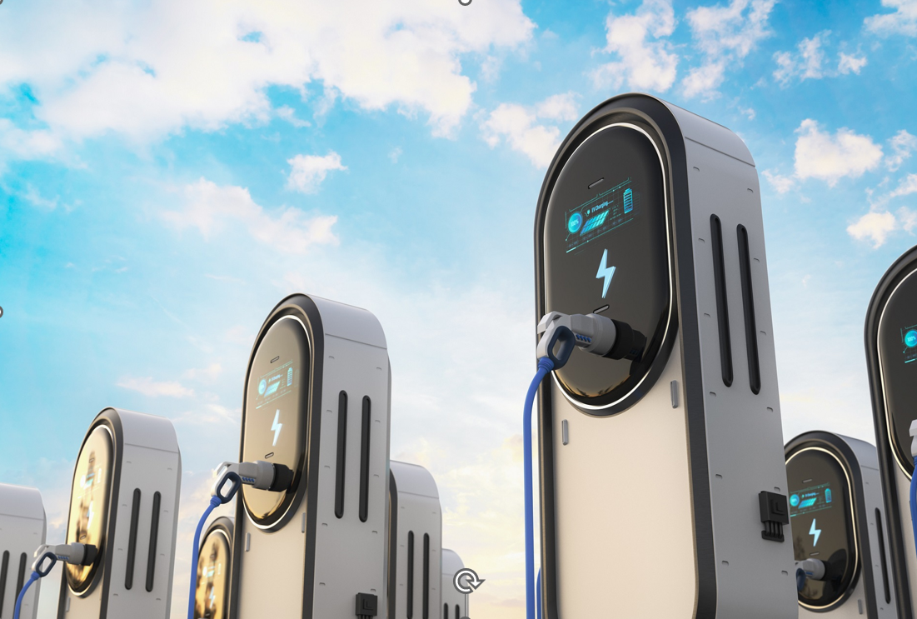

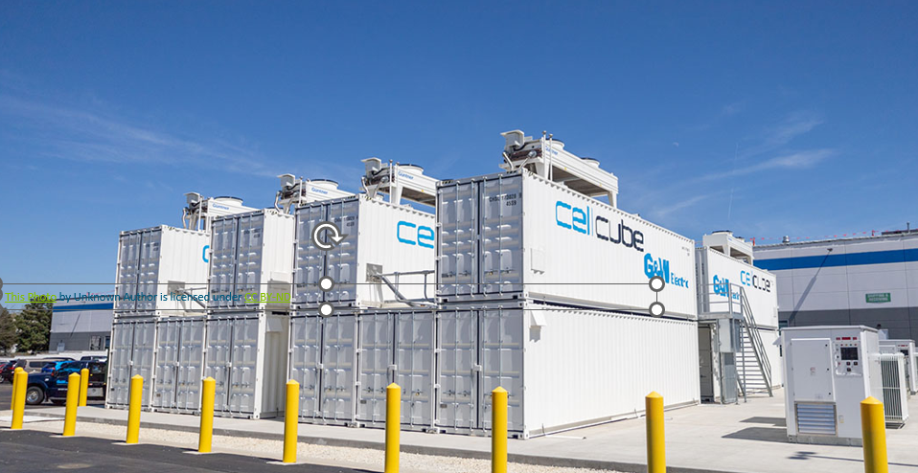

Introduction:
The Take Charge Program and
Virtual Power Plants (VPPs) in NJ
Madeline Urbish, Governor's Senior Advisor on Energy

Slide 4
Program Basics: Goals
Provide funding for electric vehicle charging infrastructure projects in New Jersey serving private (for-profit) commercial fleets
Provide funding for new renewable energy generation and/or battery storage systems to support chargers
Enable participation in VPPs and increase solar energy/energy storage capacity in New Jersey
Complement existing charger incentive program offerings currently available through DEP/BPU/Private Utilities

Slide 5
Program Basics: Applicant Eligibility
Commercial, for-profit organizations with two or more vehicles registered in NJ for commercial use
OR
Charging-as-a-service provider/property owner partnering with an eligible fleet
Project consists of installing charging infrastructure
AND
On-site renewable energy and/or storage systems on property in NJ

Slide 6
Program Basics: Eligible Costs
  Materials, labor*, and equipment, including:
    New charging stations (Level 2 or DCFC)
    Make ready upgrades (e.g., electric supply upgrades, site prep)
    On-site renewable generation/storage systems (subject to 60% cap relative to total eligible costs)
  Site assessment, engineering, and design related to the above (includes 12-month lookback; 15% cap)
  Delivery, activation fees, warranty, and network subscription costs (up to 3 years)
  Associated site upgrades (e.g.: signage, protective bollards, and pavement striping)
  Payments for the use of temporary mobile chargers and/or mobile battery storage systems**
  *All work must be by Public Work Contractors & subject to prevailing wage/affirmative action requirements
  **Eligible on the condition that permanent chargers are installed by the end of the allowable construction period

Slide 7
Program Basics: Funding
$25 million total funding pool
First-come, first-served (rolling applications)
Grant awards range from $100,000 per project to $5M total per applicant (EIN)
Grant amount is a percentage of total eligible project costs as follows:
50% base amount
+5% bonus for projects in Overburdened/Adjacent communities per State Environmental Justice Law
+5% bonus for small business applicants
Cannot be stacked with other state/federal sources, but can be stacked with utility funding up to 90% of eligible costs
Disbursement Schedule:
Reimbursement for actual expenses incurred, as follows:
Up to 15% at grant agreement execution for design work already completed (if applicable)
Up to 50% (including first disbursement) after half of total eligible costs have been incurred by Applicant
Remaining available grant funding following project completion

Slide 8
Program Basics: Post-Approval Process
Applicants have 6 months from approval to provide:
Following grant agreement execution and virtual pre-construction meeting with NJEDA’s labor compliance team, construction can commence on site
Awardees provide proof of expenses and will be reimbursed based on disbursement schedule once grant agreement is executed
Project must be completed within 24 months of grant agreement execution, with possible extensions
(1) Utility confirmation for charger capacity
After documents are provided, grant agreement can be issued and signed
→ Six-month extensions are available at the Authority’s discretion
(2) Proof of funding for total project costs + 15% contingency (bank statements, financing agreements, etc.)

Slide 9
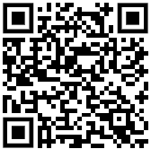
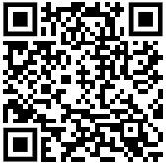
Program Basics: Post-Construction Compliance
Must provide charger usage data for 3 years using pre-qualified software from the NJDEP Compliant Network Service Provider list:
Please see the link below to apply to be added:
Must show proof of enrollment in a VPP and/or managed charging program before the end of the 3-year compliance period.

Slide 10
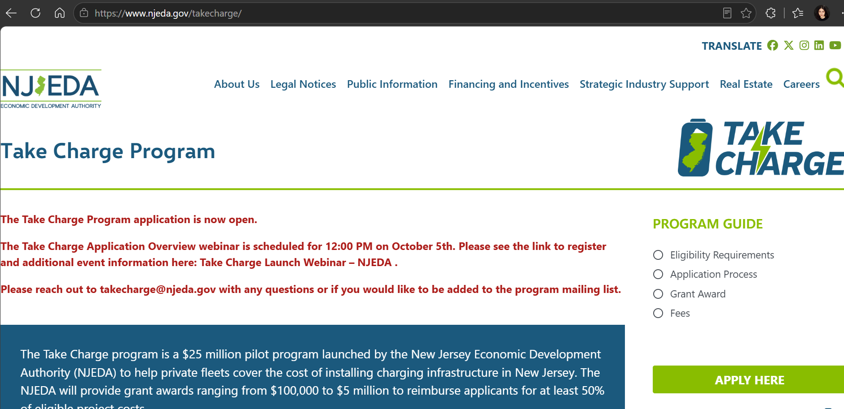
Accessing the Application

Slide 11
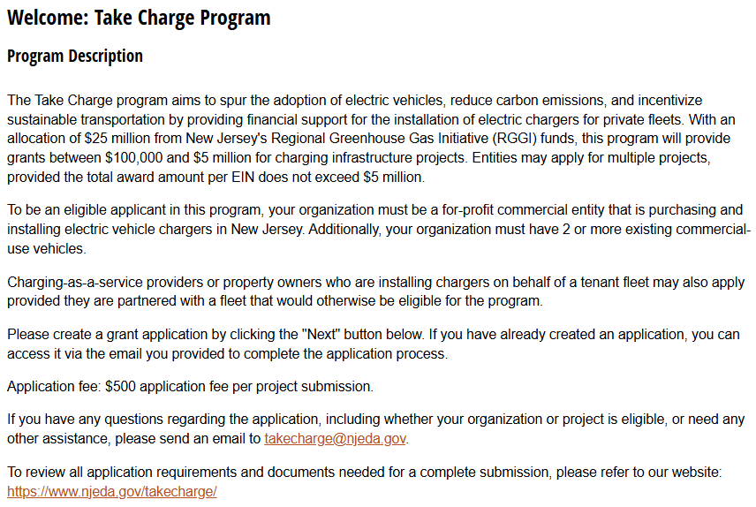
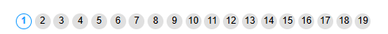
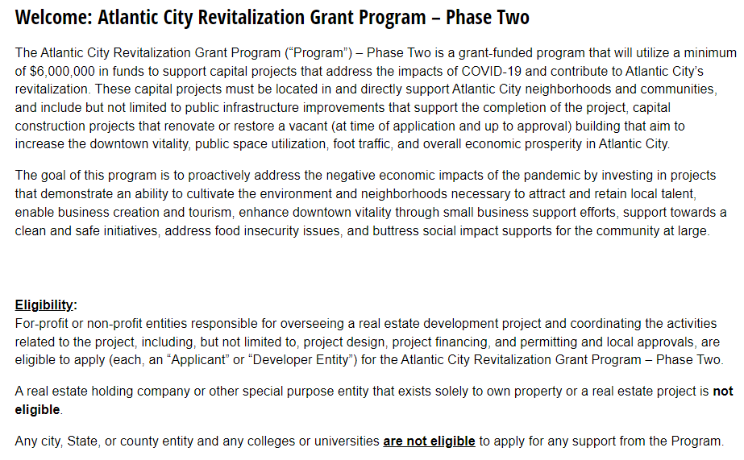
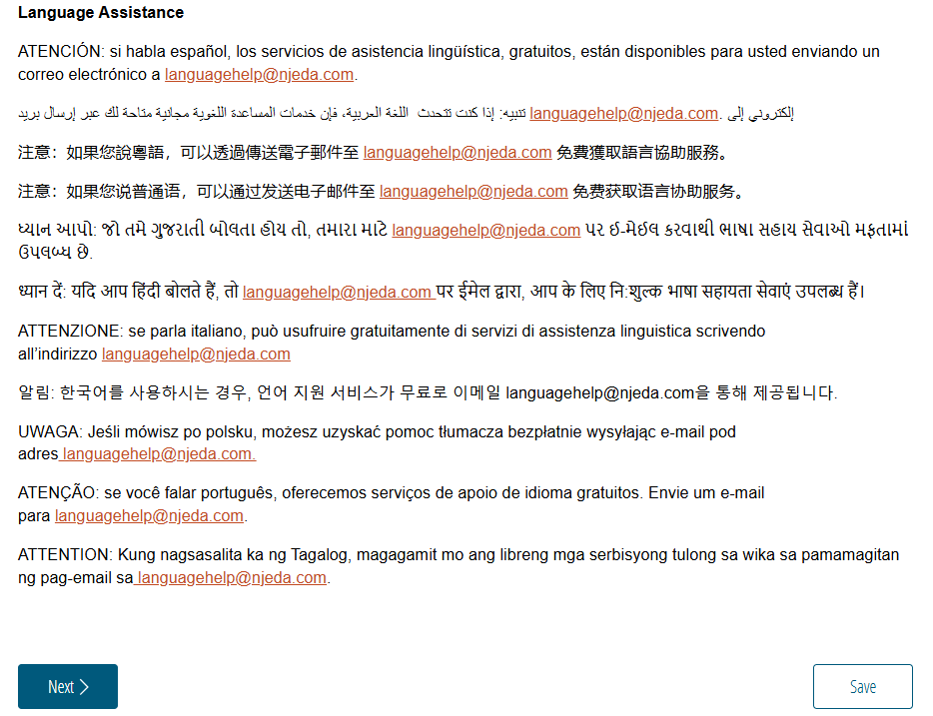
Sample Application
Welcome
Before beginning the application read through the information provided on the welcome page.
[Insert New Screenshot of Cognito Application Welcome Page]
Once ready click “Next” to begin the application
IMPORTANT TIP:
Click “Save” in the beginning to create a reusable link that will save your progress as you complete the application.

Slide 12
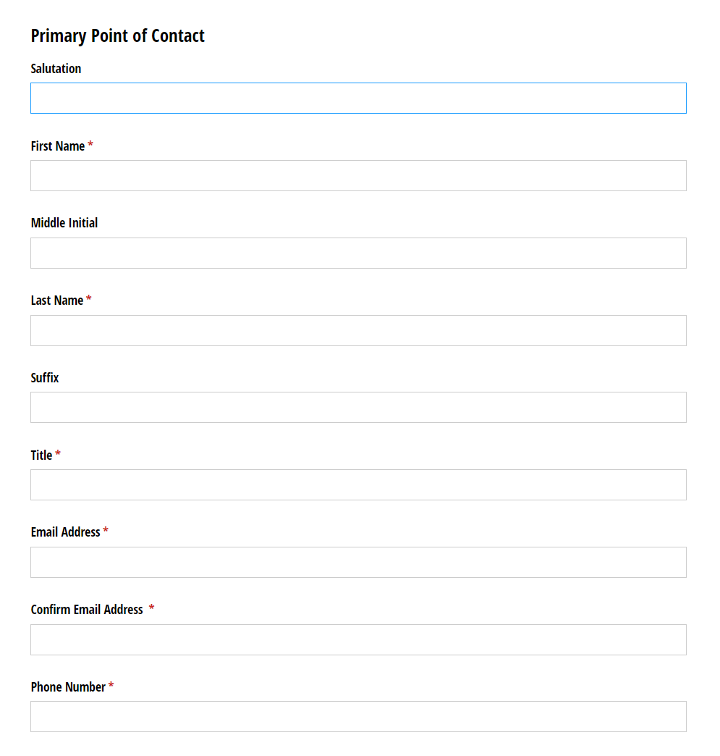
Primary Point of Contact
On this page we will collect contact information for the Primary Point of Contact for this application.
Please ensure that the email provided is the correct email for the primary point of contact on this application.
This email will be used for the fee correspondence and any other communications to the applicant team.
REMINDER
Click “Save” to create a reusable link that will save your progress as you complete the application.

Slide 13
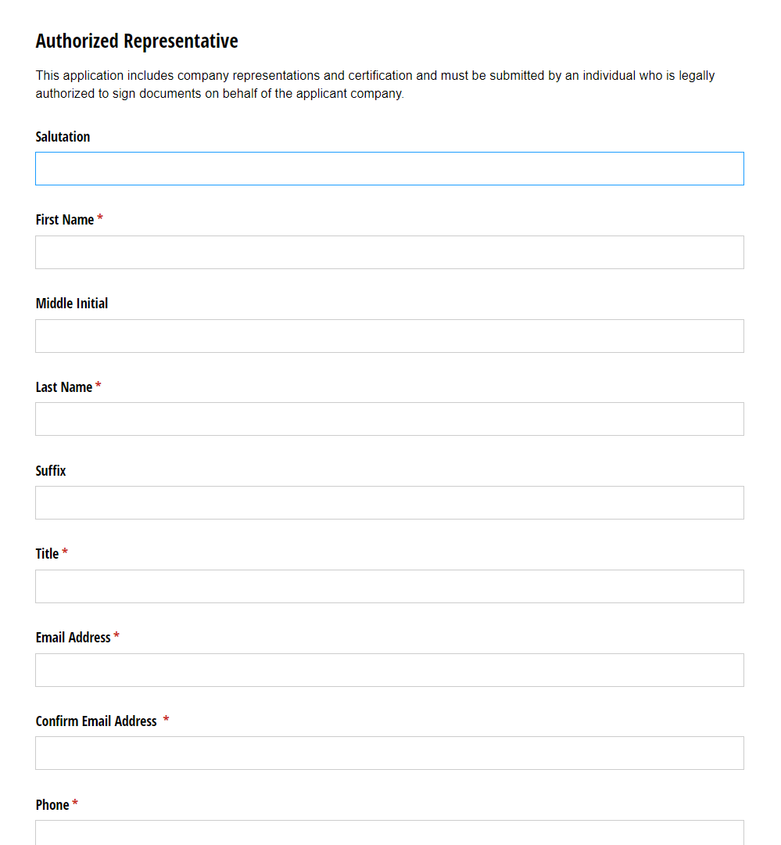
Authorized Representative*
If the primary point of contact is not an authorized representative, you will be asked to fill out the contact information for the authorized representative.
-Applicant’s General Counsel or Chief Legal Officer; or
-For a corporation: a principal executive officer at least the level of vice president
-For a partnership: a general partner
-For a sole proprietorship: the proprietor
*This page will only be visible if the individual filling out the application is not the authorized representative.

Slide 14
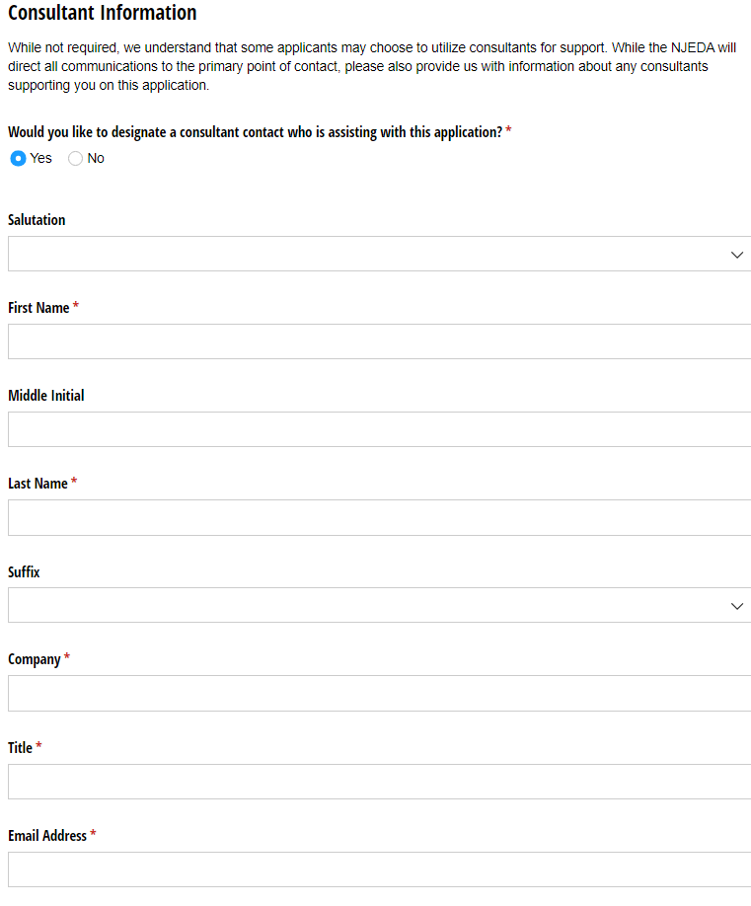
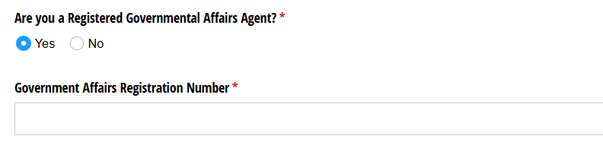
Consultant Information
While not required, some applicants may choose to utilize consultants for support on grant applications.
Are you, the applicant company, using a consultant to assist with this application?
IF YES, you will be asked to fill out the contact information for the consultant, including the question shown below, asking if the consultant is a registered governmental affairs agent.

Slide 15
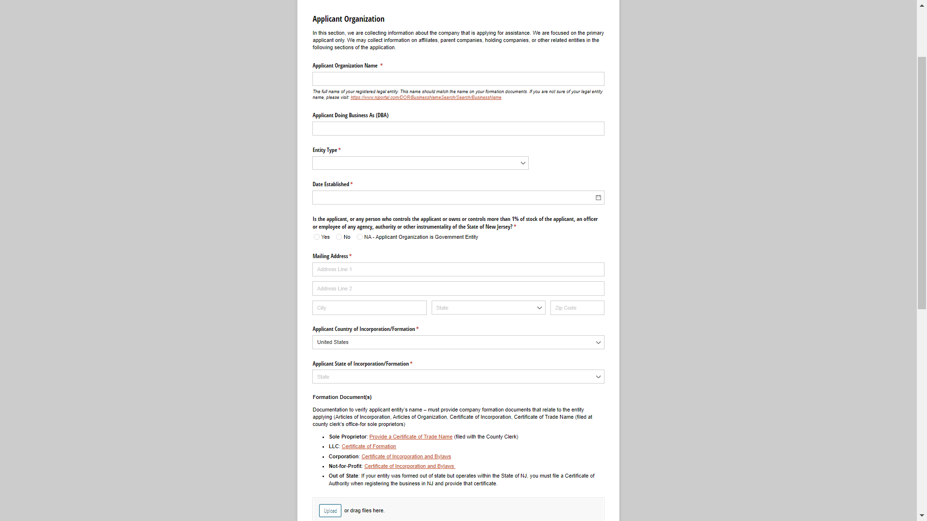
Applicant Organization
In this section, we are collecting information about the registered business that is applying for this program.
This page will request applicant organization information including, but not limited to:
Legal Business Name
Entity Type
Date Established
Entity Formation Documents
  Sole Proprietors should provide a Certificate of Trade Name
  LLCs provide a Certificate of Formation
  Corporations provide Certificate of Incorporation and Bylaws
  Nonprofits provide Certificate of Incorporation and Bylaws
Federal Tax Identification Number (FEIN)
NJ Tax Identification Number
NAICS Code
Short Organizational Description
Organization Phone Number
Organization Website
NJ Tax Clearance Certificate

Slide 16
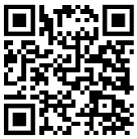
Take Charge Specific Application Questions
Many application fields are part of the EDA common application
For the Take Charge specific portion, please ensure you have read and completed the necessary documents from the list below, located on the website sidebar under “Application Materials”
    1. Utility Capacity Review
    2. Landlord Certification Form
    3. Fleet Decarbonization Plan template
    4. Project Timeline template
    5. Budget template
Take Charge Website Link

Slide 17
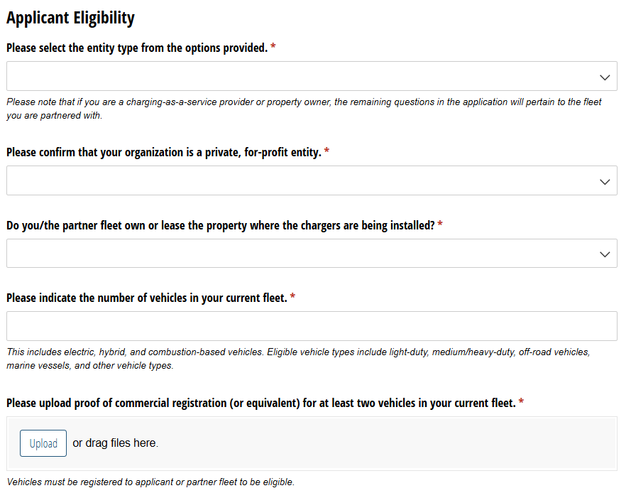
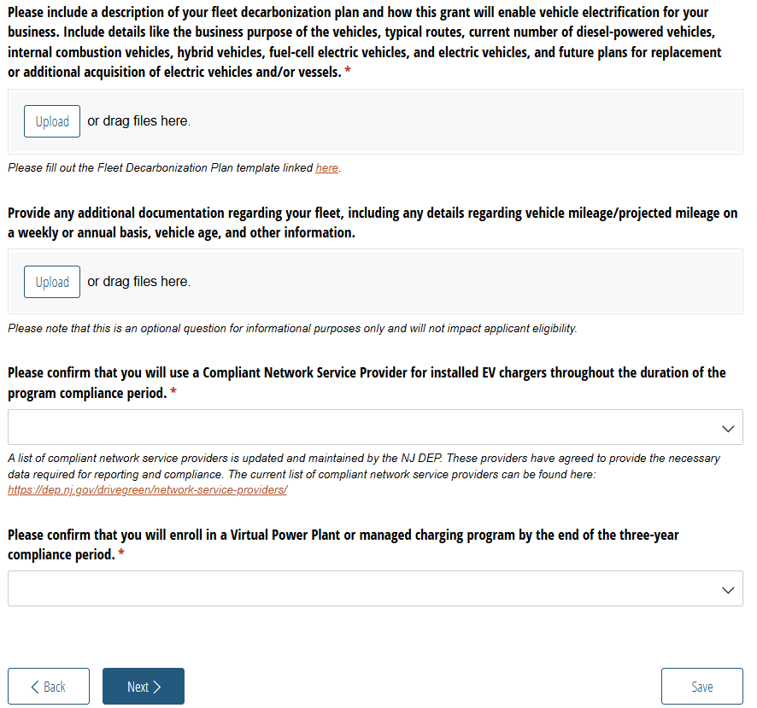
Applicant Eligibility

Slide 18
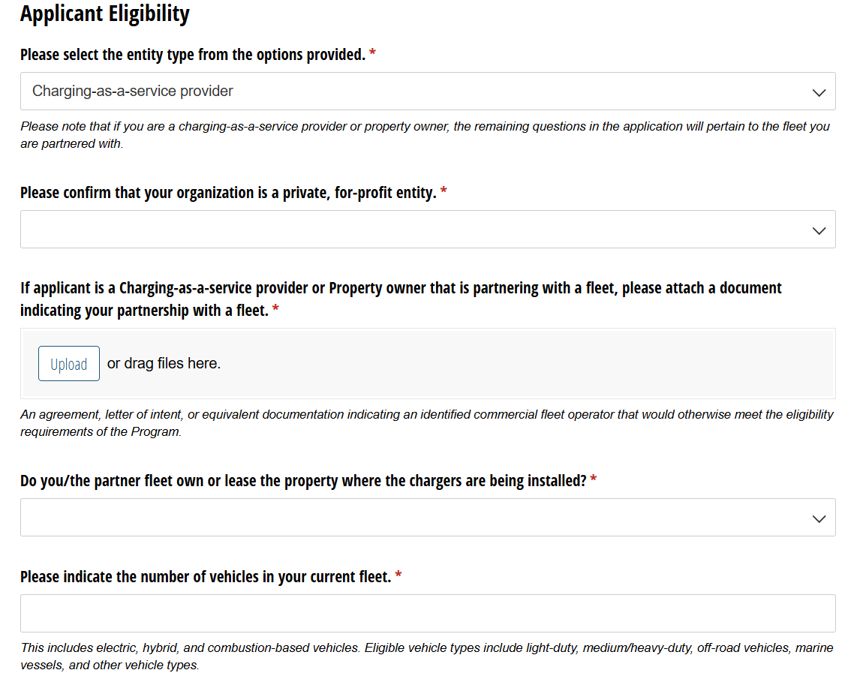
Applicant Eligibility: Non-fleet Applicants
Additional documentation needed to verify partnership.
Applicant organization must answer some of the eligibility questions on behalf of the partner fleet. Fleet decarbonization plan must also be completed by partner fleet.

Slide 19
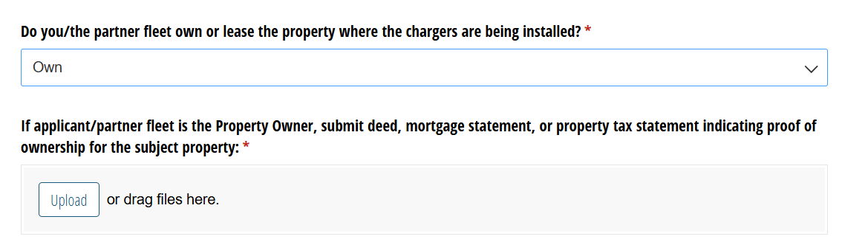
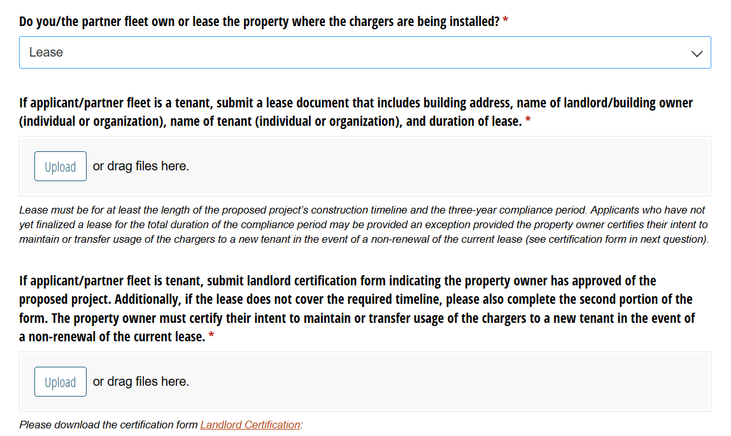
Applicant Eligibility: Project Site
Property owners and tenants will be required to submit different eligibility documents to ensure chargers will remain active through the course of the three-year compliance period.

Slide 20
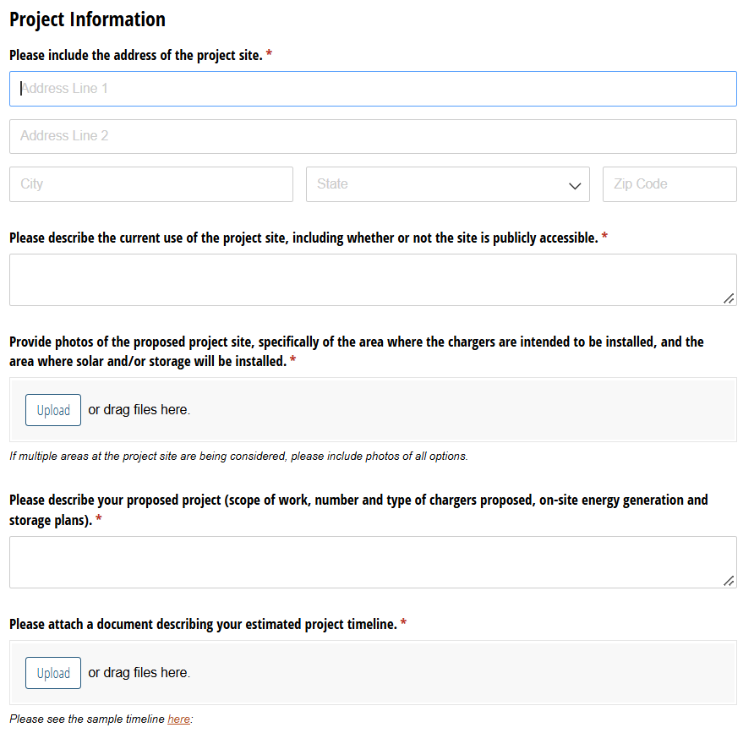
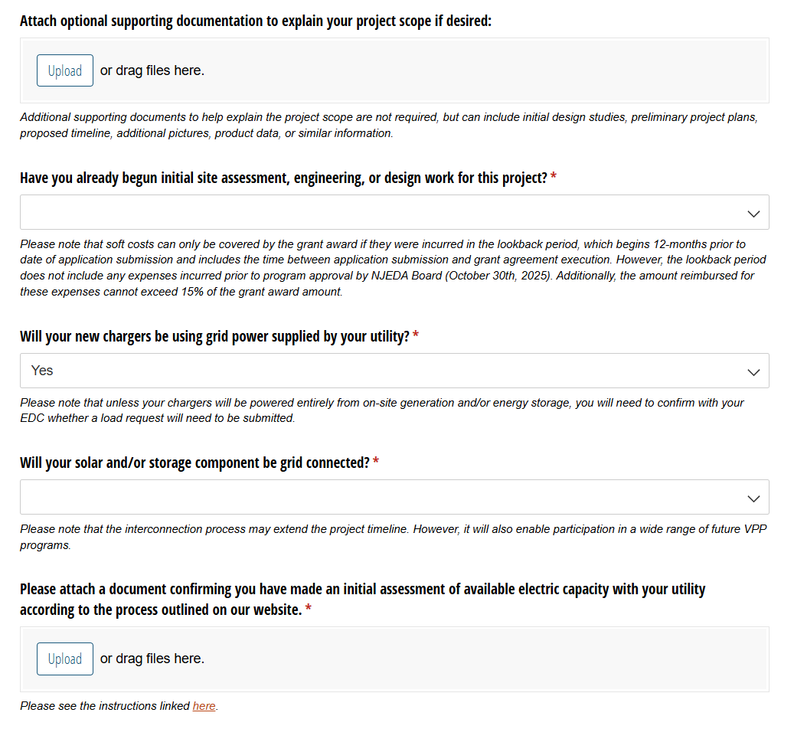
Project Information

Slide 21
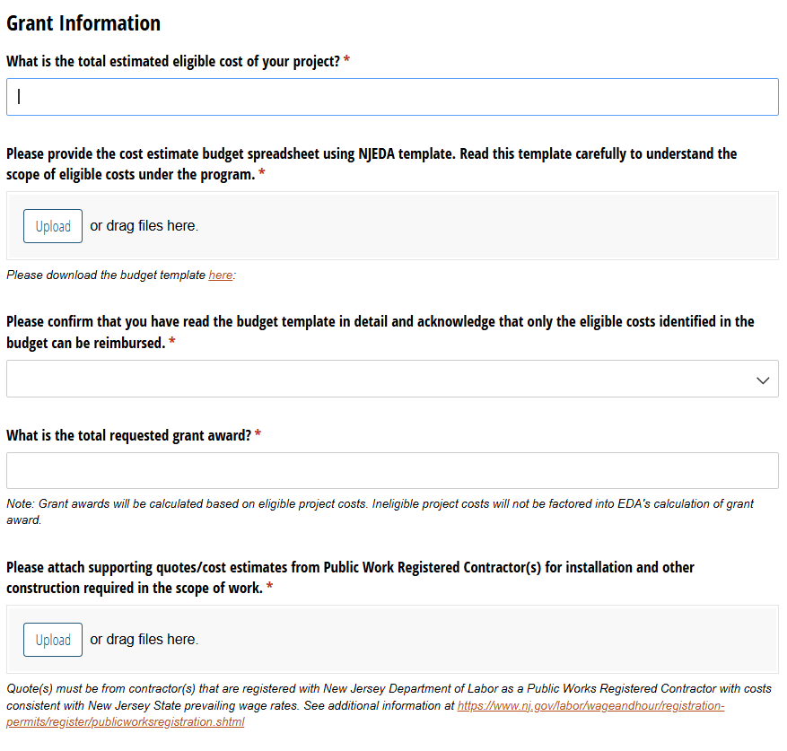
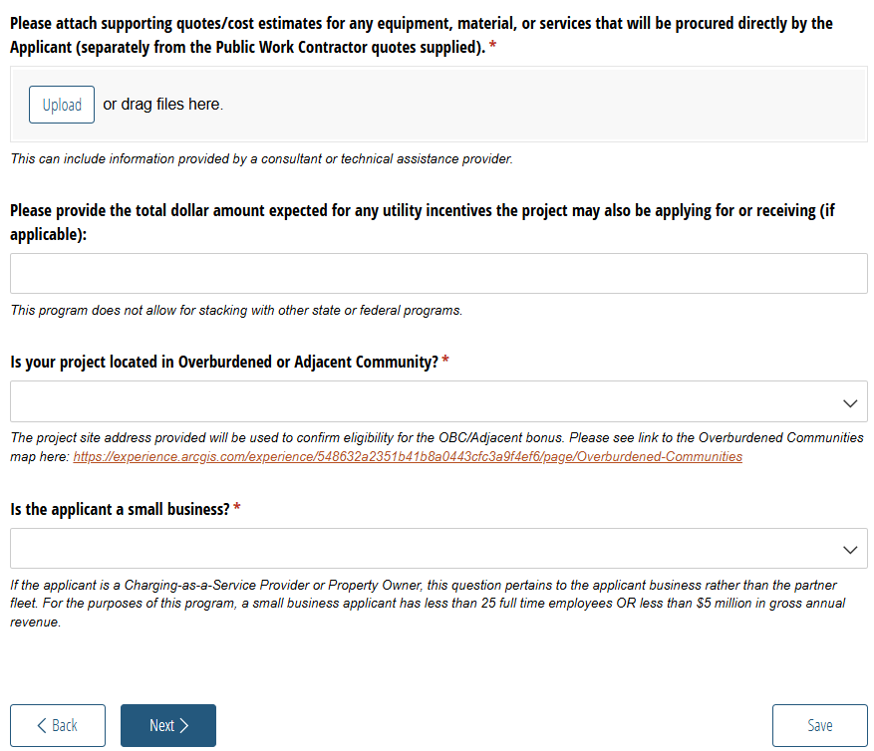
Grant Information

Slide 22
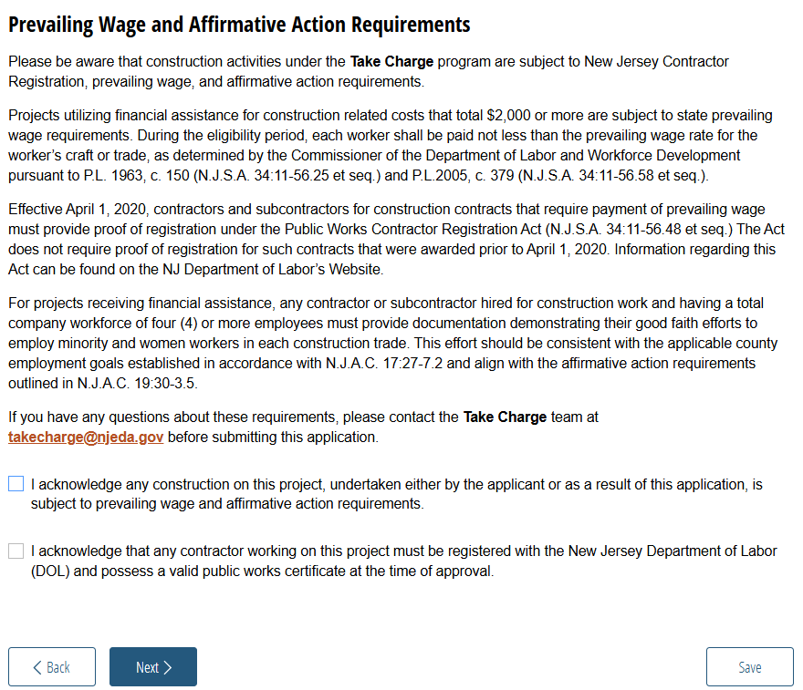
Prevailing Wage and Affirmative Action Requirements

Slide 23
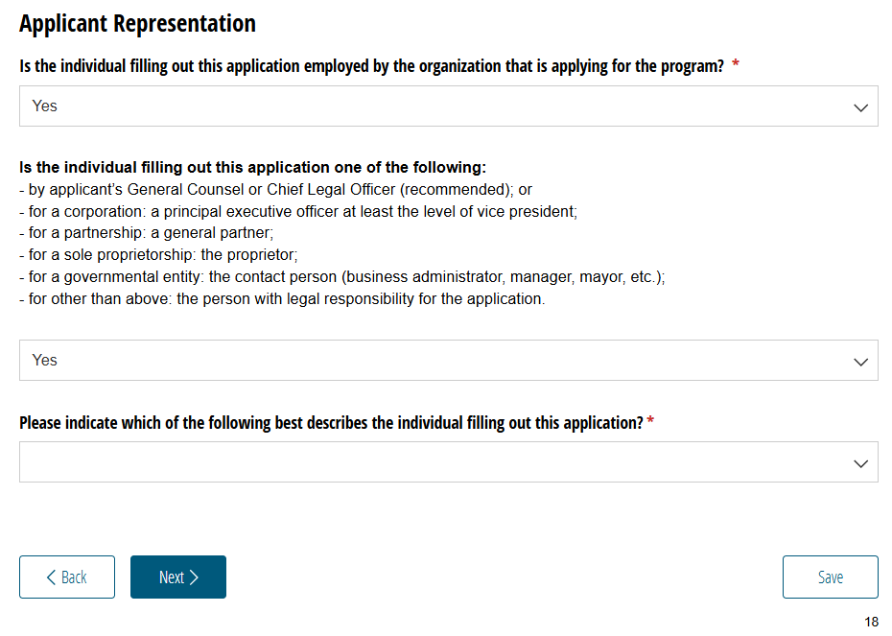
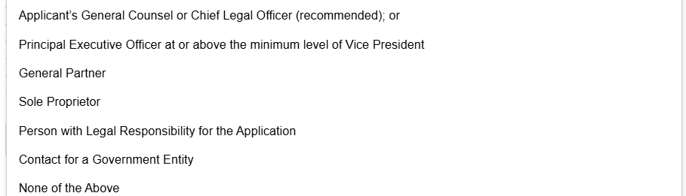
Applicant Representative for Certifications
The New Jersey Economic Development Authority requires that the Legal Questionnaire, Certification of Non-Involvement in Prohibited Activities in Russia or Belarus Pursuant to P.L. 2022, C. 3, Acknowledgments of Applicant, and Certification of Applicant, are to be completed and signed by one of the following:
by applicant's General Counsel or Chief Legal Officer (recommended); or
for a corporation: a principal executive officer at least the level of vice president;
for a partnership: a general partner;
for a sole proprietorship: the proprietor;
for other than above: the person with legal responsibility for the application.
If you are not an Authorized Representative you will be prompted to Upload the Certifications page, which will require you to download and then upload signed copies of the acknowledgments and certifications listed above.
If you are an Authorized Representative, you will be prompted to fill out these pages throughout the application.

Slide 24
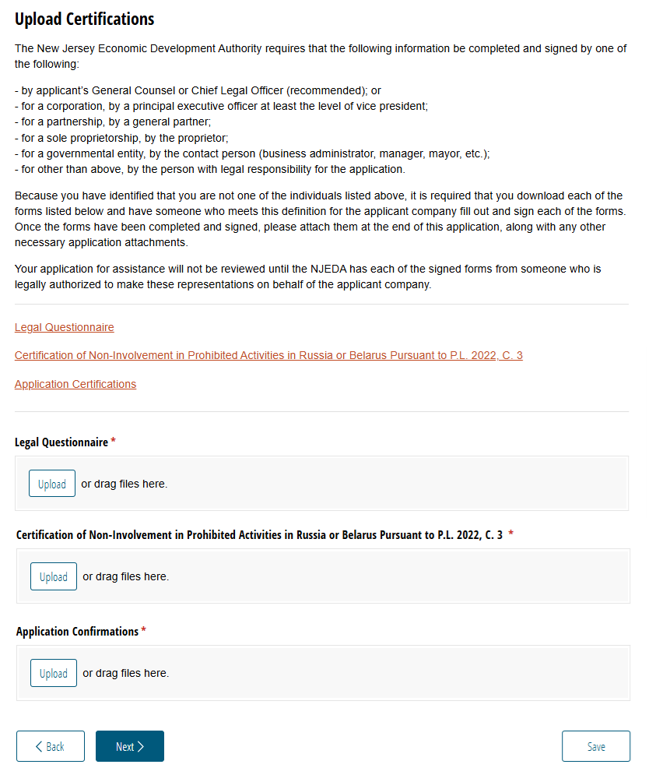
Upload Certifications
If the individual filling out the application is not an authorized representative, this page will appear so that the certifications listed below can be downloaded, completed by and authorized representative, and then uploaded as part of the application.
  Legal Questionnaire
  Certification of Non-Involvement in Prohibited Activities in Russia or Belarus Pursuant to P.L. 2022, C. 3
  Application Confirmation

Slide 25
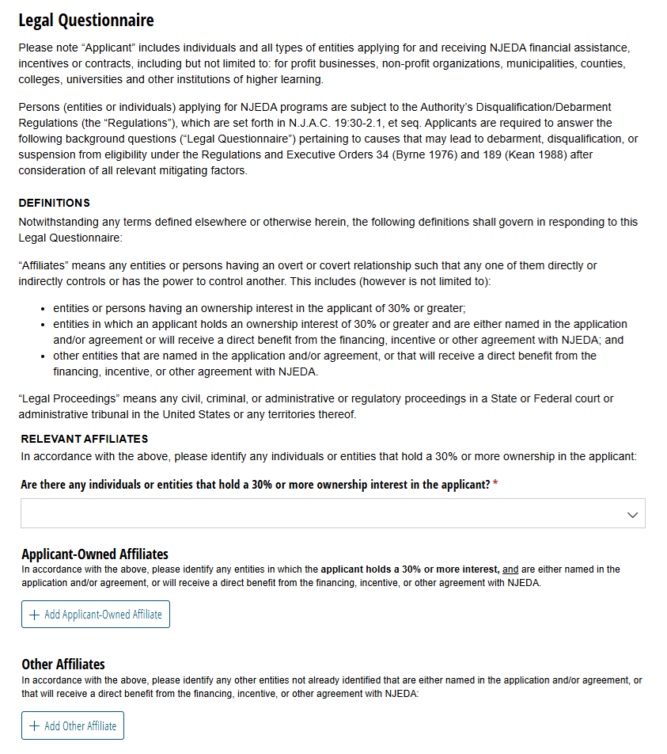
Legal Questionnaire*
In this section, applicants are required to answer background question pertaining to any causes that may lead to debarment, disqualification, or suspension from eligibility.
Additionally, applicants are required to identify any “affiliate” entities. There are two main types of Affiliates:
  First, applicants must identify any individuals or entities that hold a 30% or more ownership in the applicant.
  Second, applicants must identify any individual or entity where the applicant holds a 30% or more interest, and are either named in the application and/or agreement, or will receive a direct benefit from the financing, incentive, or other agreement with NJEDA.
Applicants should take their time and make sure to read this section carefully.
*This page will only be visible if the individual filling out the application is the authorized representative.

Slide 26
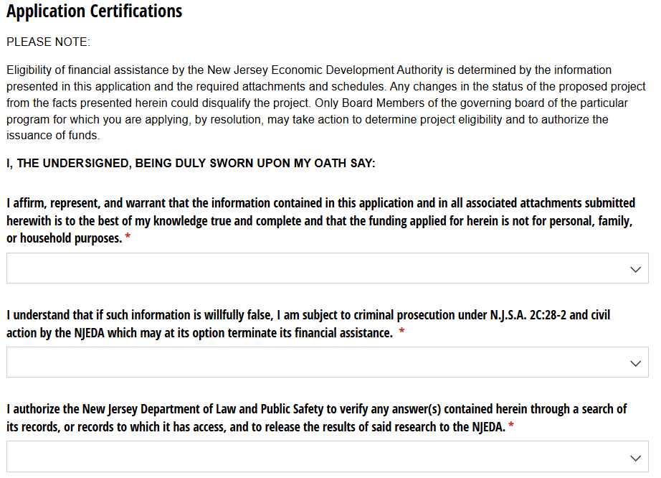
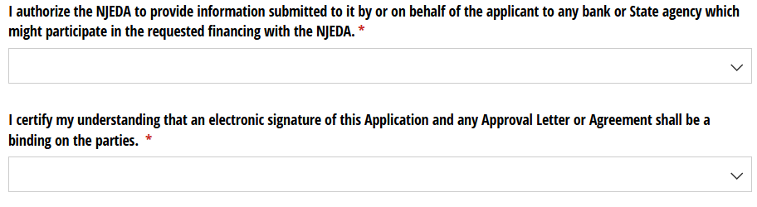
Application Certifications*
On this page, applicants will affirm the accuracy and truthfulness of the application information provided.
*This page will only be visible if the individual filling out the application is the authorized representative.

Slide 27
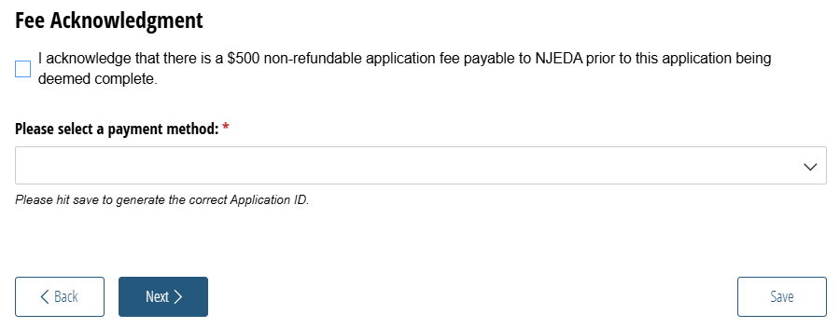
Fee Acknowledgement

Slide 28
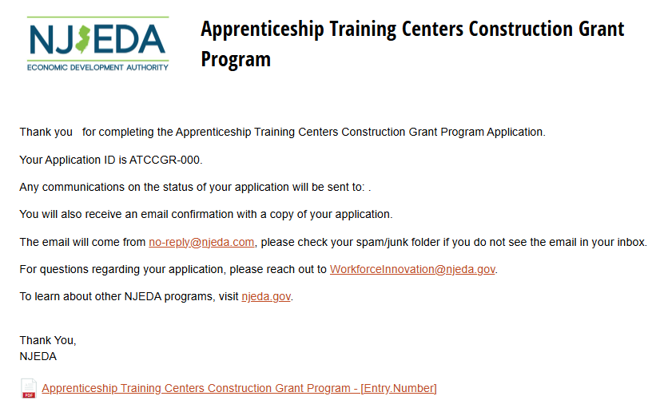
Application Submission
After successful submission, you will see the confirmation page, which will list the Applicant’s application confirmation number.
You will also receive a confirmation and copy of your application to the email address provided for the Primary Point of Contact. All future application communication will be sent to that email address.
You can download a PDF copy of your application from this page. This is the same file that will be sent by email.
[Program Name]
[Program Name]
[Program Name]

Slide 29
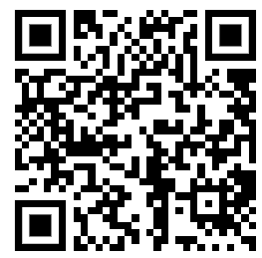
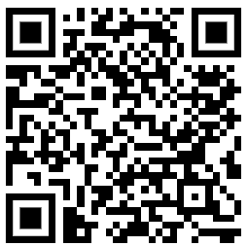
Additional Funding Opportunities
Clean Corridor Coalition (C3)
Funding for EV workforce development training
Funding for public/semi-public charging infrastructure serving MDH EVs along I-95 corridor
RFPs and additional info here:
Port Authority NY NJ Zero-Emission Incentive Programs
Funding for zero-emission drayage trucks, yard trucks, and chargers
Funding for near-port charging facilities for heavy-duty trucks
Additional info here:

Slide 30
Audience Q&A
Please raise your hand or use the Q&A function

Slide 31






Thank you!
takecharge@njeda.gov
www.njeda.gov/takecharge
@NewJerseyEDA njeda.gov 844.965.1125
31

