Slide 1


Take Charge
Sample Application
October 5, 2026

Slide 2
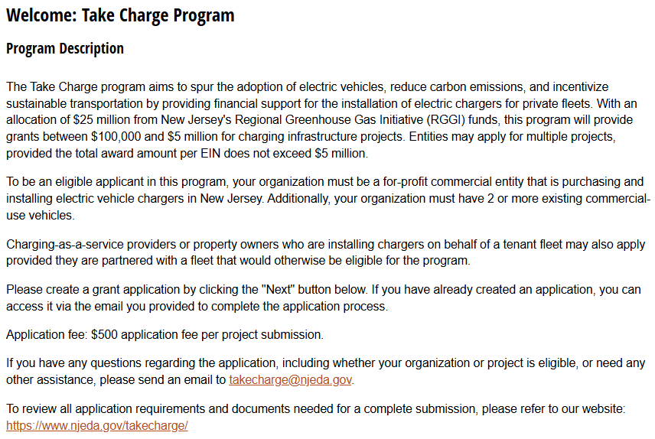
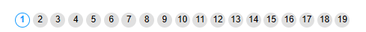
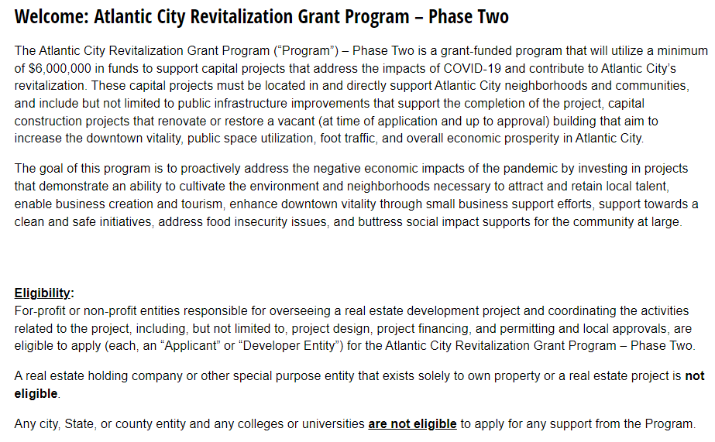
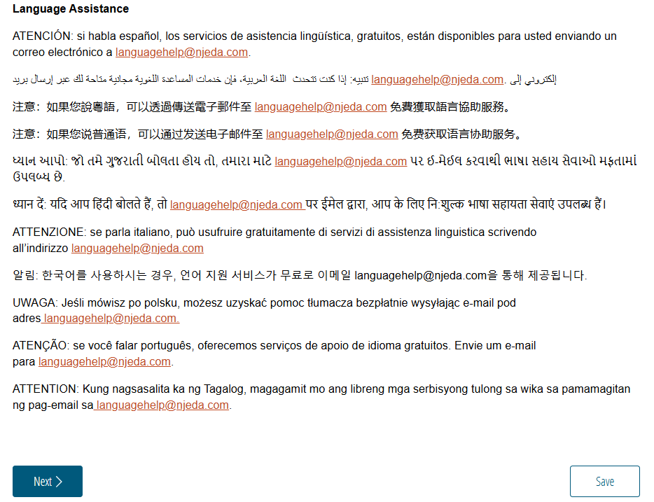
Sample Application
Welcome
Before beginning the application read through the information provided on the welcome page.
[Insert New Screenshot of Cognito Application Welcome Page]
Once ready click “Next” to begin the application
IMPORTANT TIP:
Click “Save” in the beginning to create a reusable link that will save your progress as you complete the application.

Slide 3
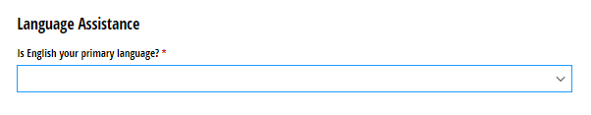
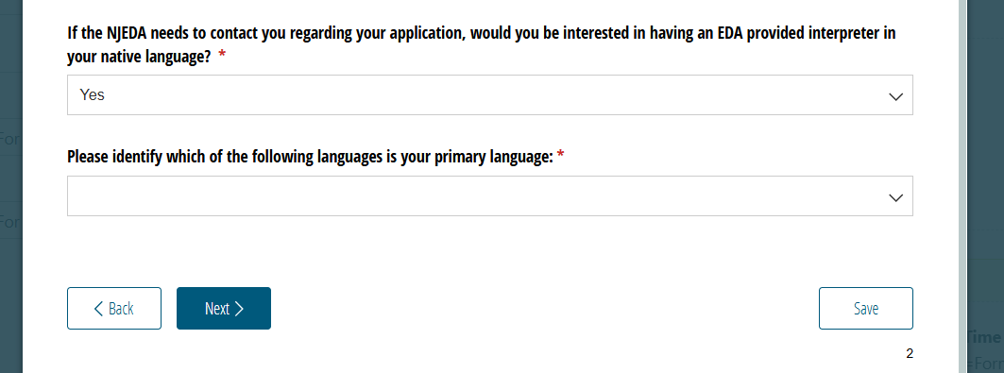
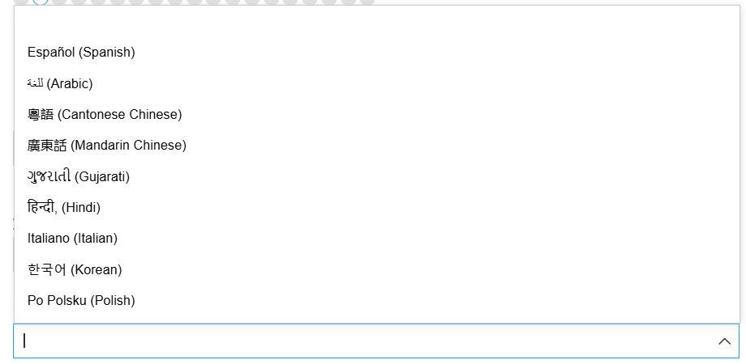
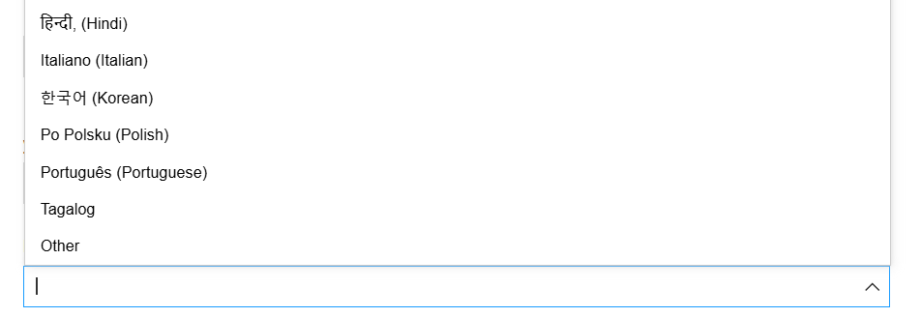
Language Access
Provide a “Yes/No” response to indicate whether English is your primary language or select “Prefer Not to Answer”.
If English is not your primary language, free language assistance services are available.
If you are interested in using an interpreter provided by EDA, please indicate your primary language.

Slide 4
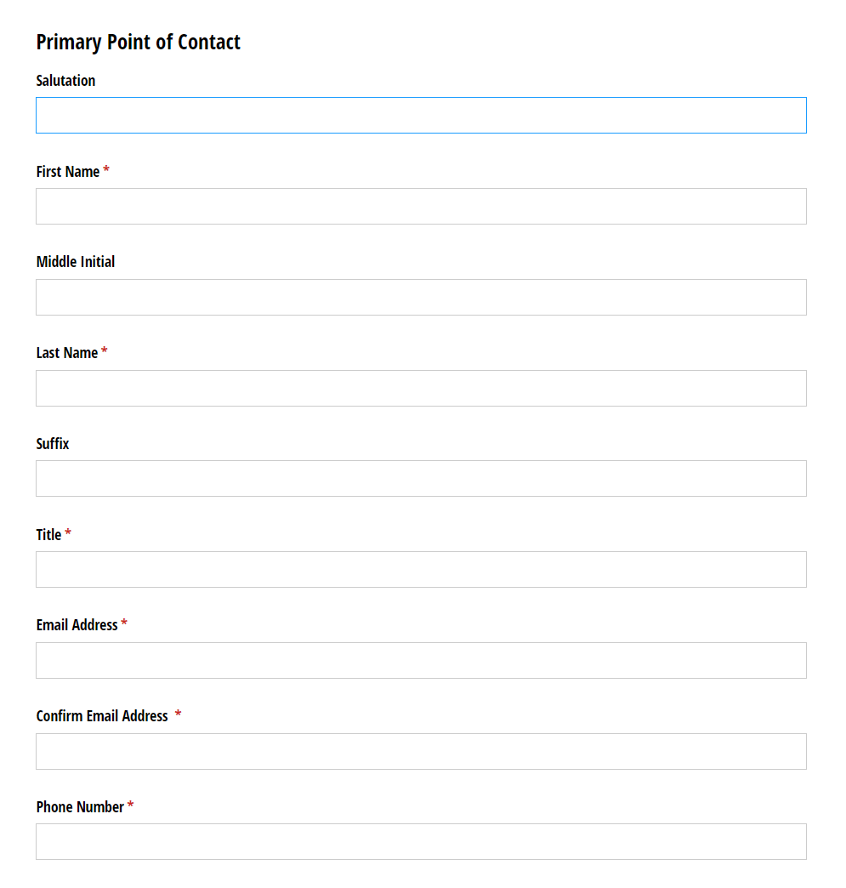
Primary Point of Contact
On this page we will collect contact information for the Primary Point of Contact for this application.
Please ensure that the email provided is the correct email for the primary point of contact on this application.
This email will be used for the fee correspondence and any other communications to the applicant team.
REMINDER
Click “Save” to create a reusable link that will save your progress as you complete the application.

Slide 5
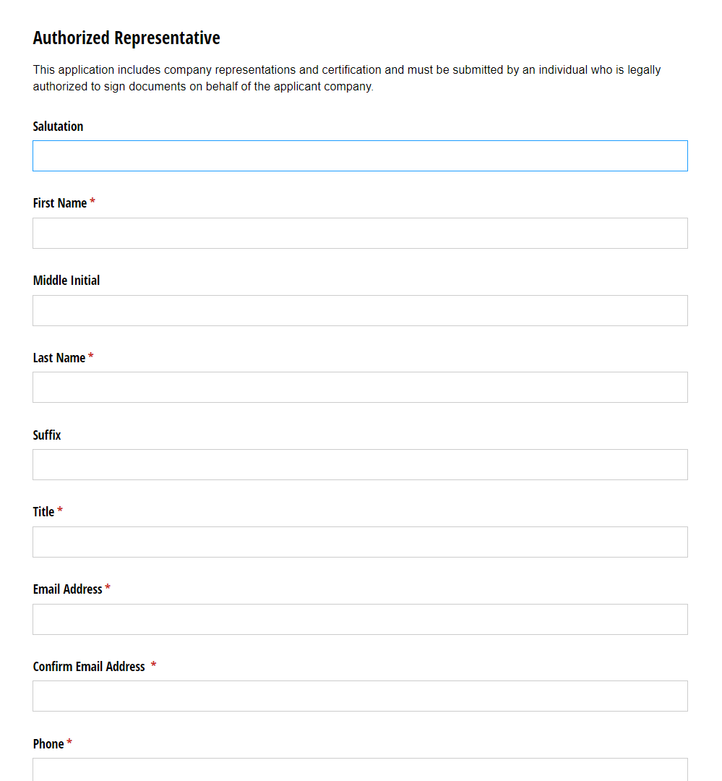
Authorized Representative*
If the primary point of contact is not an authorized representative, you will be asked to fill out the contact information for the authorized representative.
*This page will only be visible if the individual filling out the application is not the authorized representative.

Slide 6
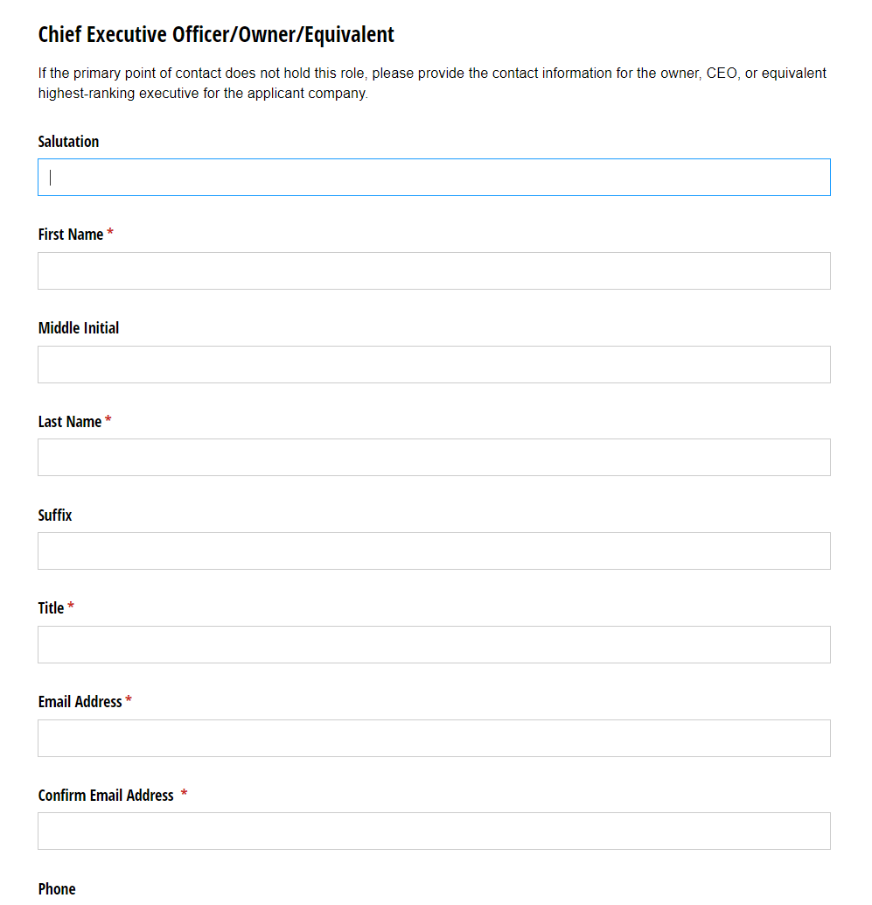
Chief Executive Officer/Owner/Equivalent*
Contact information is needed for the applicant’s Chief Executive Officer/Owner/Equivalent. If the primary point of contact is not the Chief Executive Officer/Owner/Equivalent, this page will appear so you can enter this information.
*This page will only be visible if the individual filling out the application is not the CEO.

Slide 7
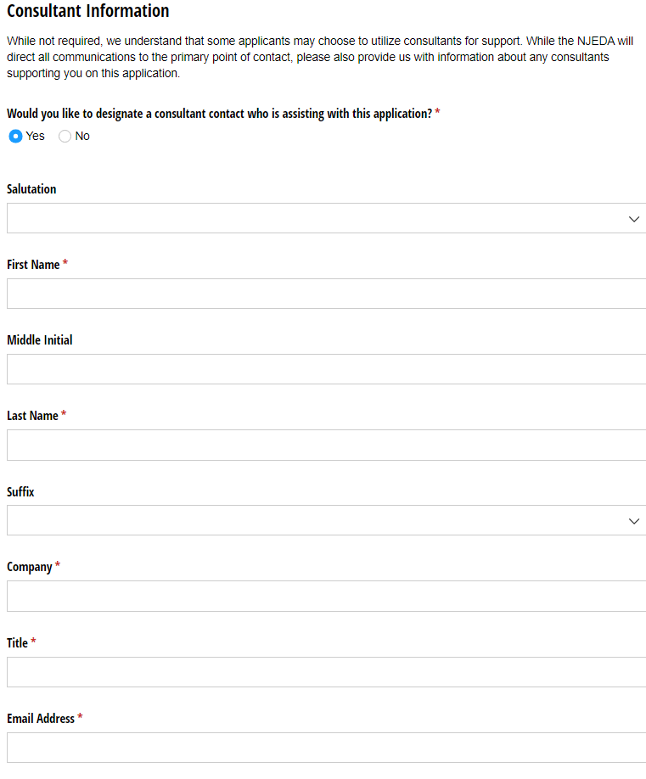
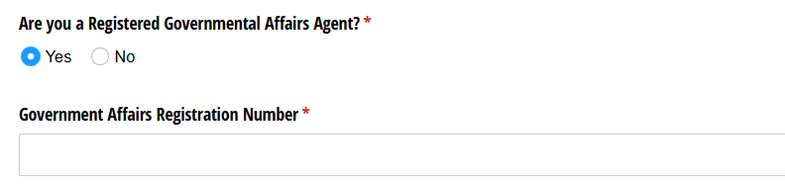
Consultant Information
While not required, some applicants may choose to utilize consultants for support on grant applications.
Are you, the applicant company, using a consultant to assist with this application?
IF YES, you will be asked to fill out the contact information for the consultant, including the question shown below, asking if the consultant is a registered governmental affairs agent.

Slide 8
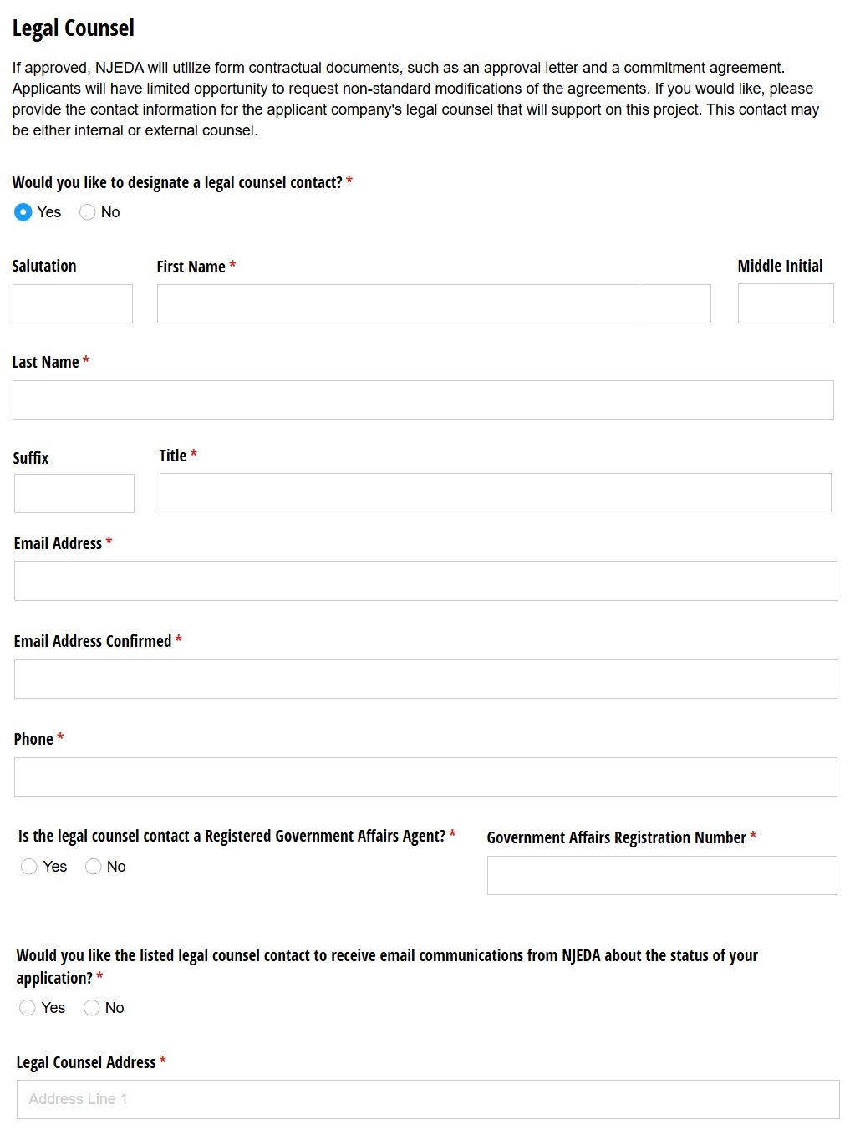
Legal Counsel
Legal Counsel designation is not mandatory, however, it is helpful for application and award purposes for NJEDA to have the basic contact information for your legal counsel, if you have one designated at the time of application.

Slide 9
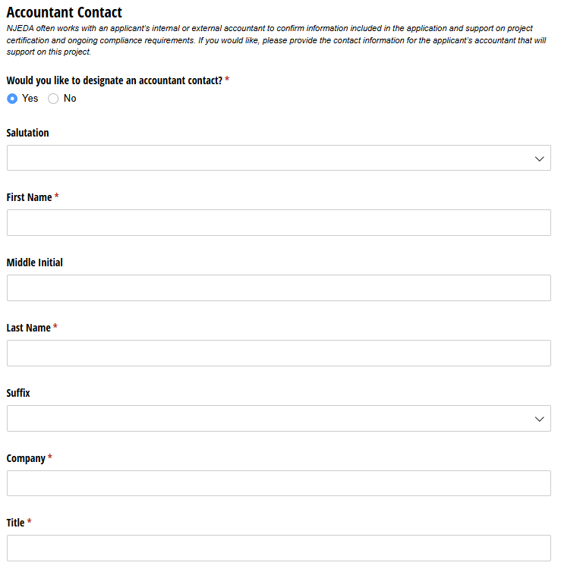
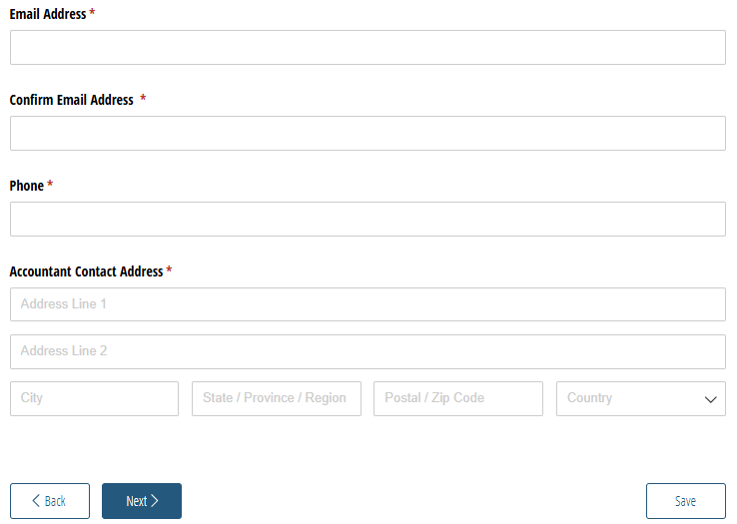
Accountant Information
Your accountant designation is not mandatory, however, it is helpful for application and award purposes for NJEDA to have the basic contact information for your accountant, if you have one designated at the time of application.

Slide 10
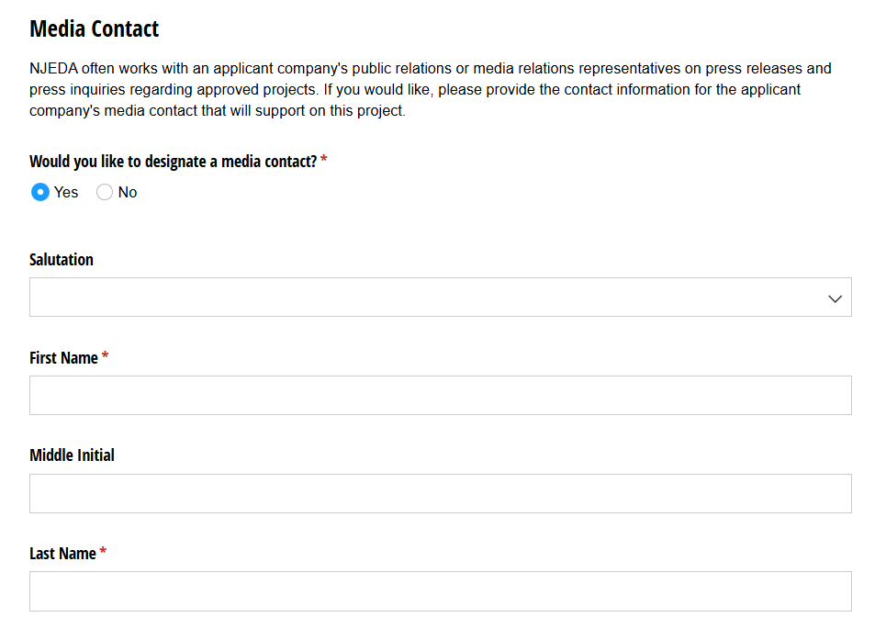
Media Contact*
If the primary point of contact is not authorized to speak to the media on behalf of the applicant, you will be asked to fill out the contact information for the authorized media contact.
*This page will only be visible if the individual filling out the application is not authorized to speak to the media on behalf of the applicant organization.

Slide 11
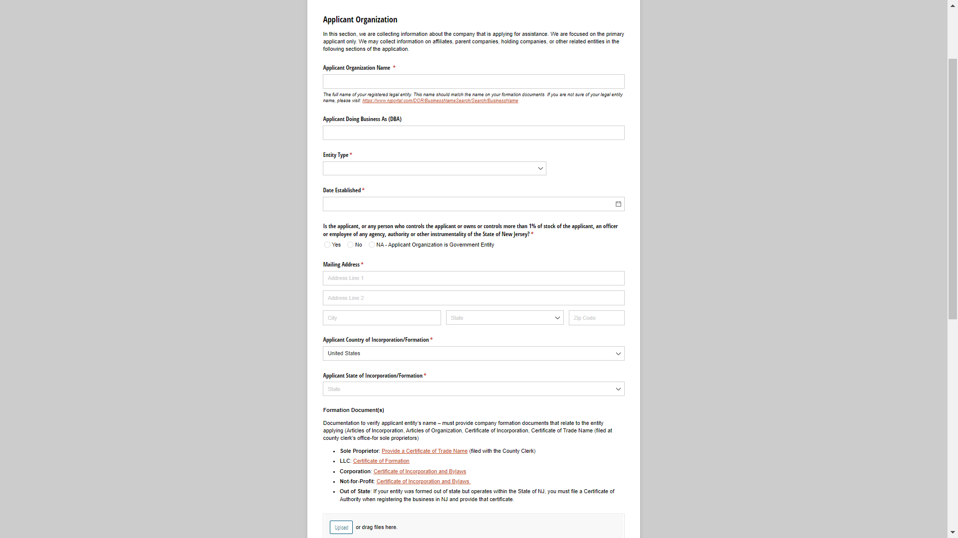
Applicant Organization
In this section, we are collecting information about the registered business that is applying for this program.
This page will request applicant organization information including, but not limited to:
Legal Business Name
Entity Type
Date Established
Entity Formation Documents
  Sole Proprietors should provide a Certificate of Trade Name
  LLCs provide a Certificate of Formation
  Corporations provide Certificate of Incorporation and Bylaws
  Nonprofits provide Certificate of Incorporation and Bylaws
Federal Tax Identification Number (FEIN)
NJ Tax Identification Number
NAICS Code
Short Organizational Description
Organization Phone Number
Organization Website
NJ Tax Clearance Certificate

Slide 12
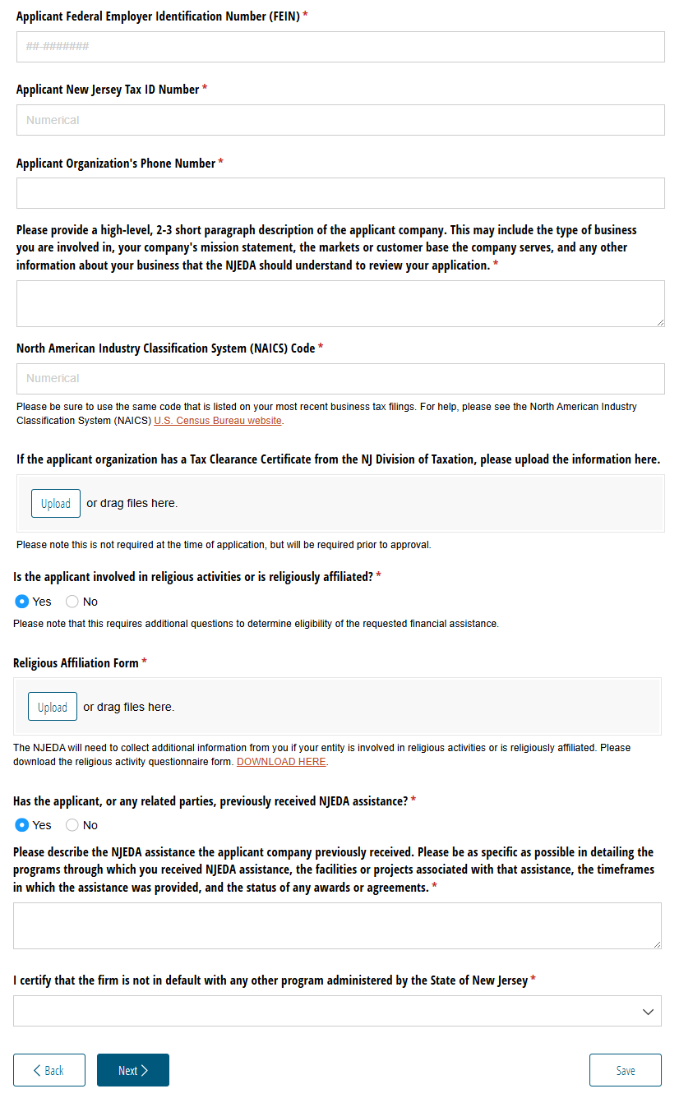
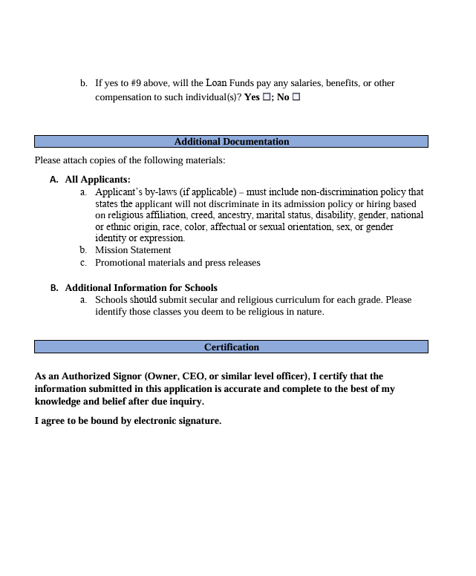
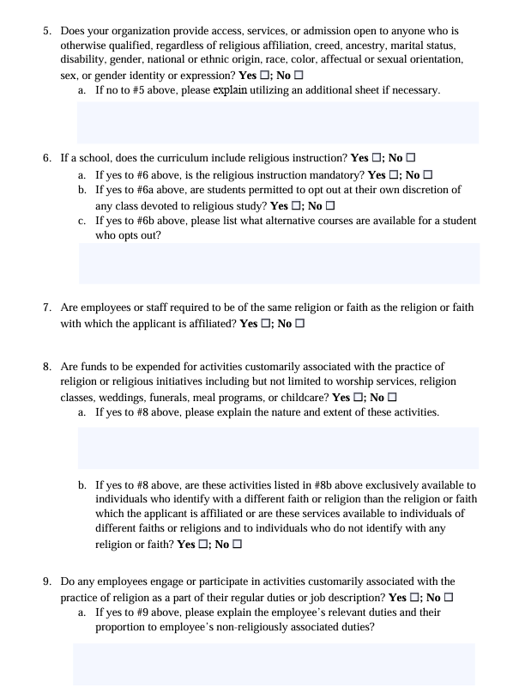
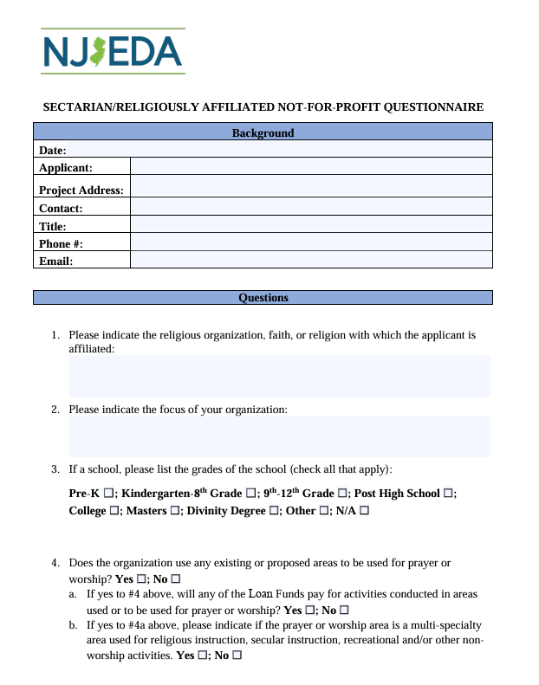
Applicant Organization
(Continued)
If the applicant is involved in religious activities or is religiously affiliated, an additional Religious Activity Questionnaire will be required.
If the applicant organization (or any related entities) has previously received NJEDA, details of that funding is required to be included as part of the application.
Certification is also required that the applicant is not in default with any other State of New Jersey programs.

Slide 13
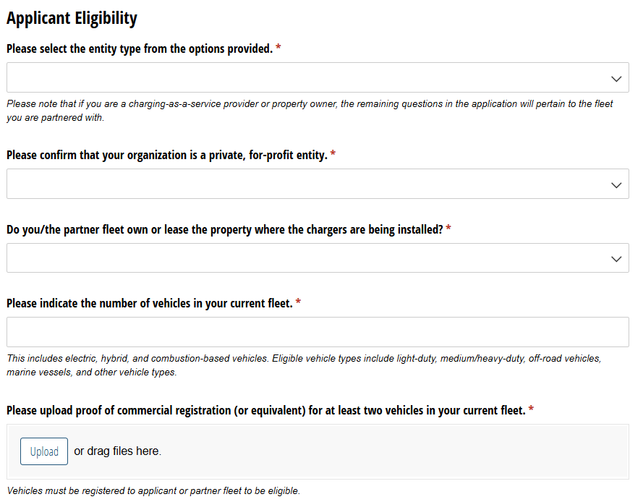
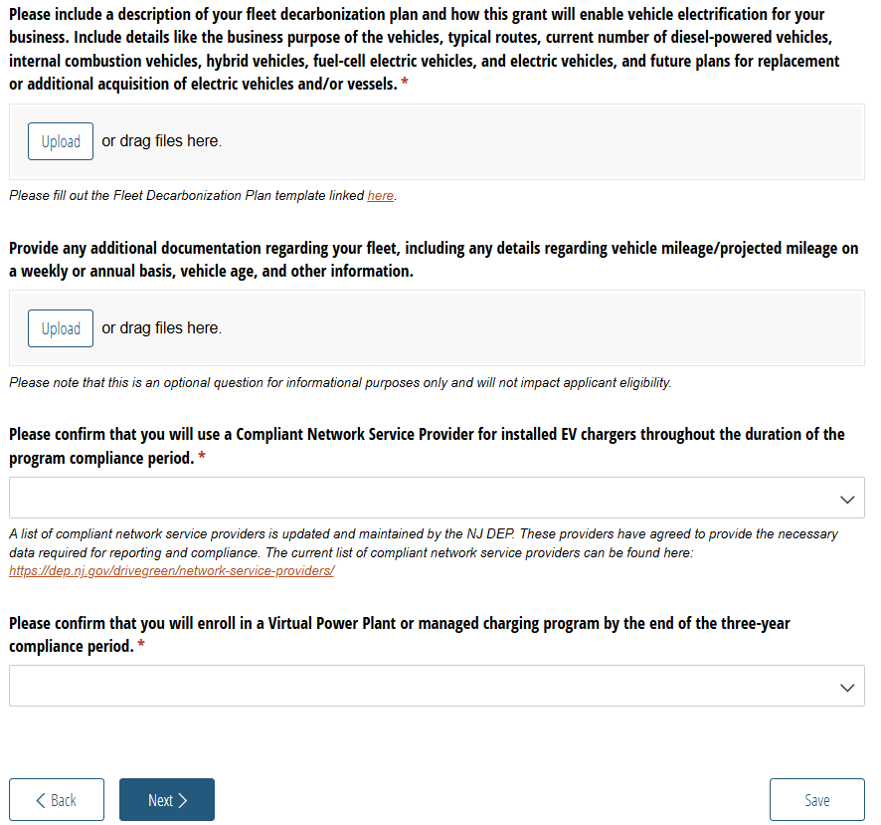
Applicant Eligibility

Slide 14
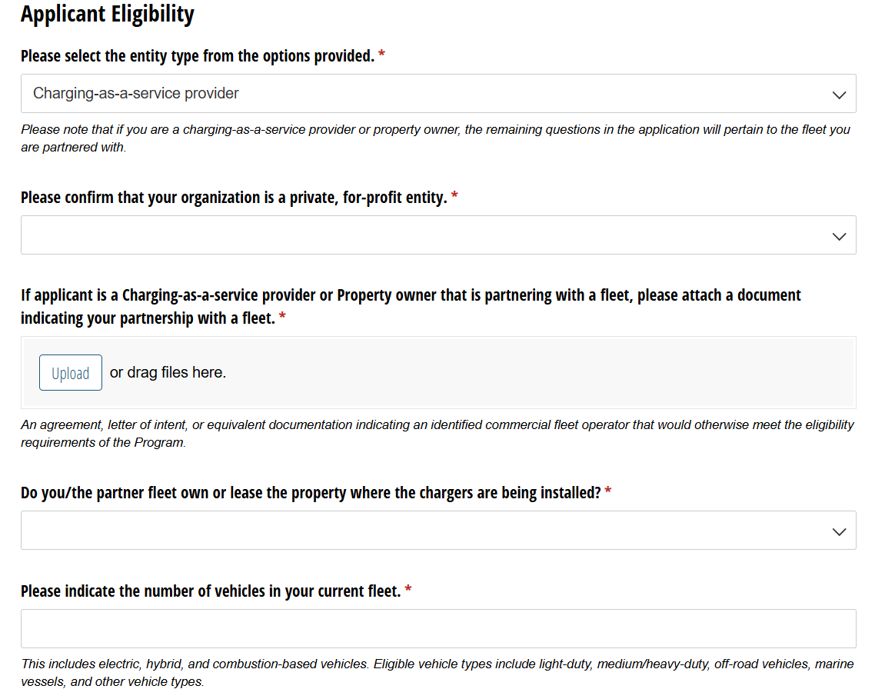
Applicant Eligibility: Non-fleet Applicants
Additional documentation needed to verify partnership.
Applicant organization must answer some of the eligibility questions on behalf of the partner fleet. Fleet decarbonization plan must also be completed by partner fleet.

Slide 15
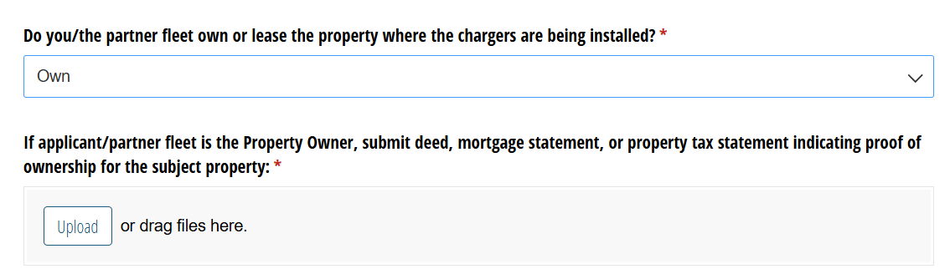
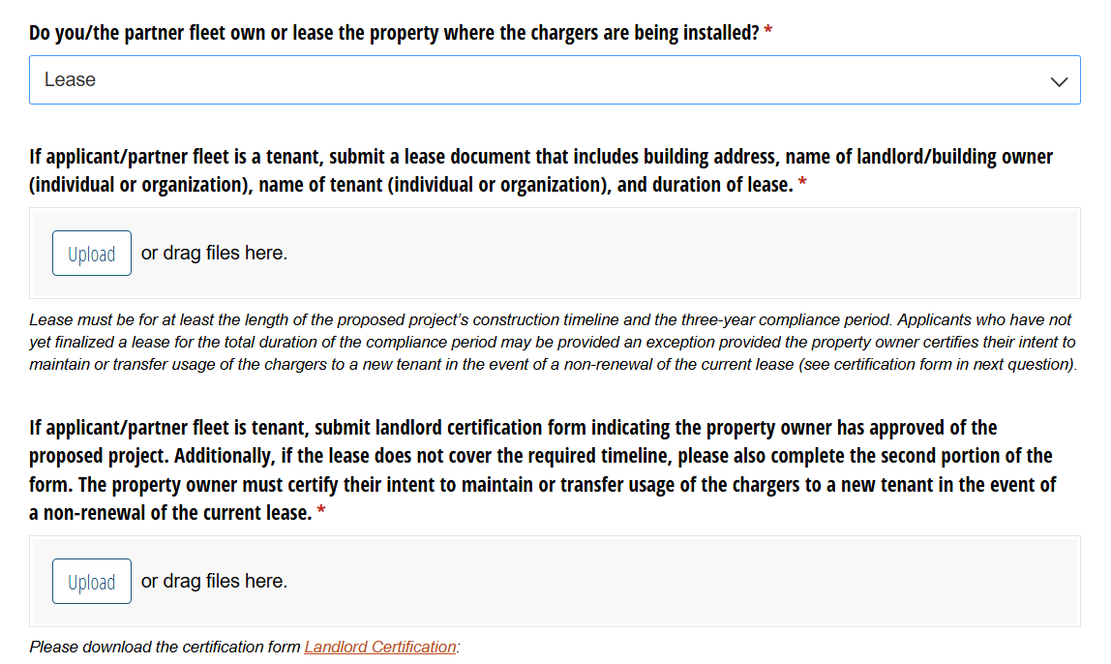
Applicant Eligibility: Project Site
Property owners and tenants will be required to submit different eligibility documents to ensure chargers will remain active through the course of the three-year compliance period.

Slide 16
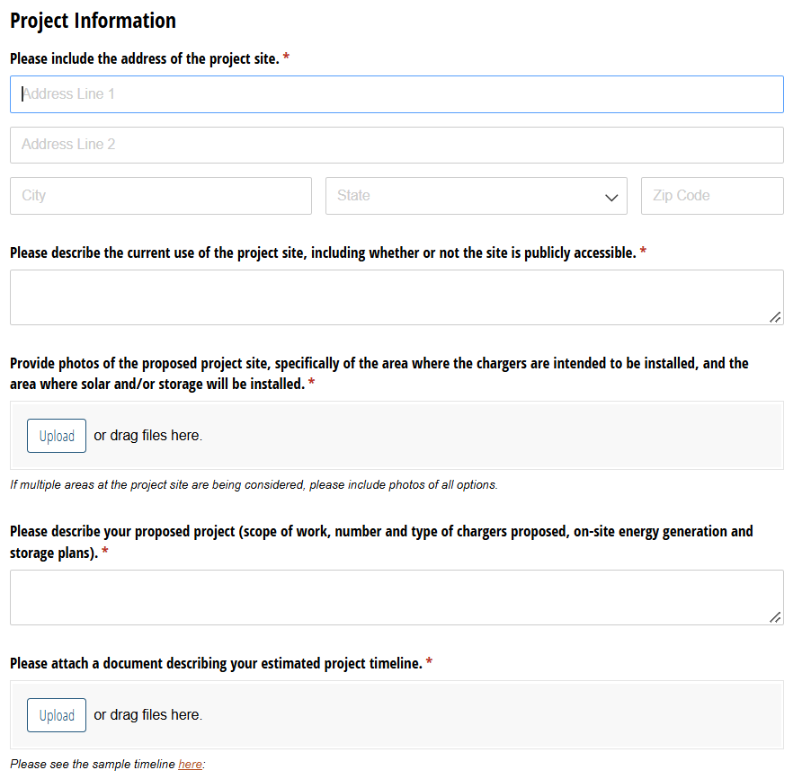
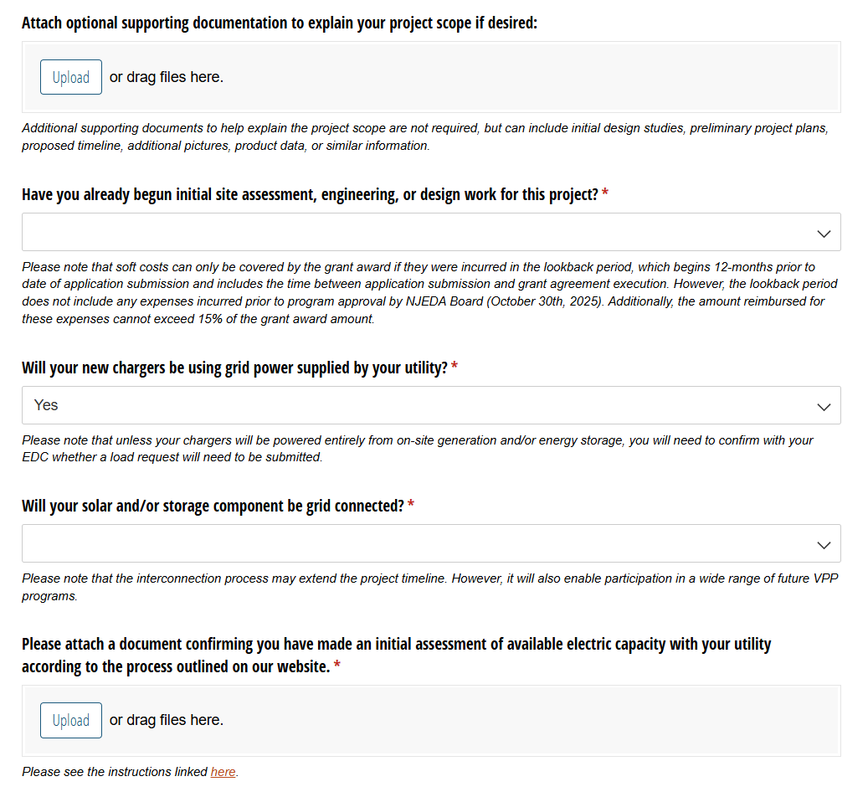
Project Information

Slide 17
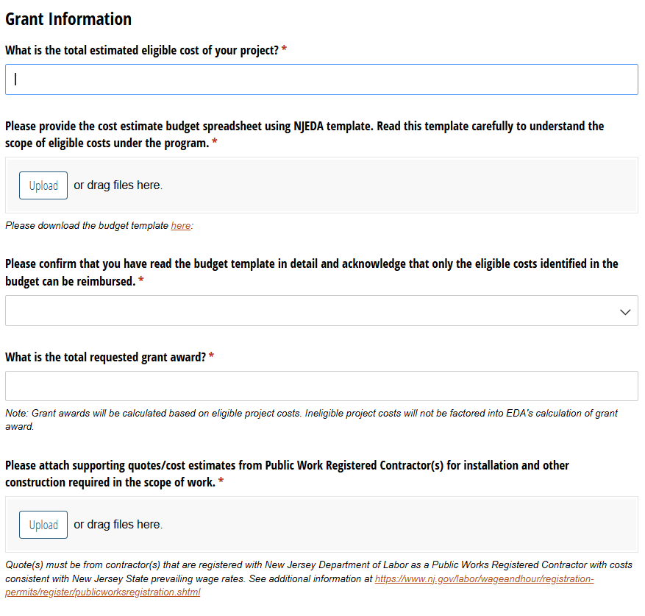
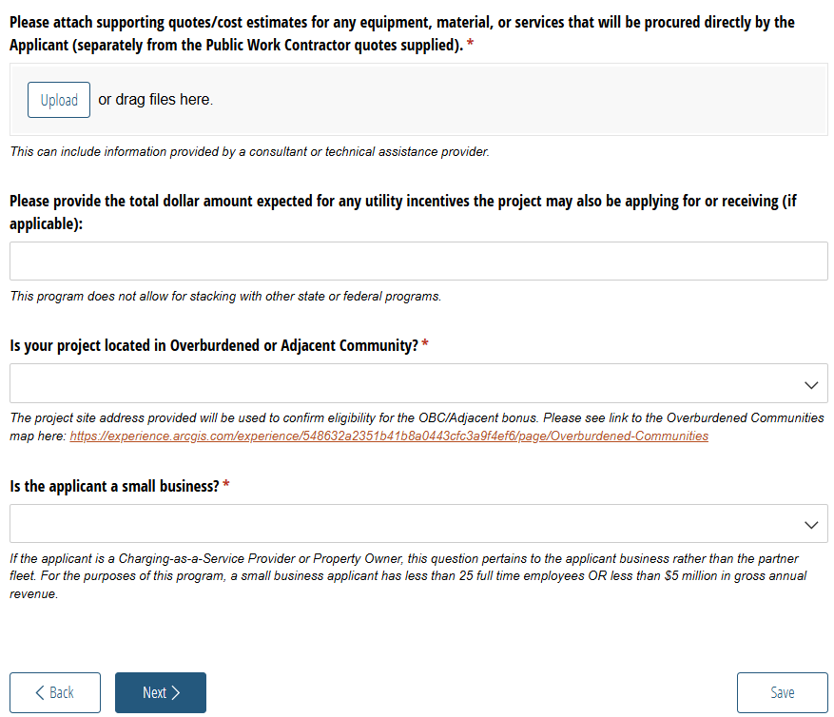
Grant Information

Slide 18
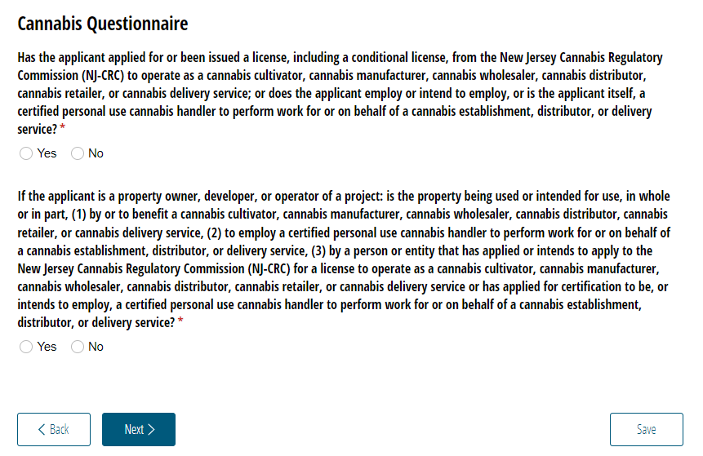
Cannabis Questionnaire
New Jersey State law prohibits certain cannabis licensees and certified personal use cannabis handlers’ employers from receiving or continuing to receive most financial incentive awards. Applicants will have to certify their status regarding cannabis licensing and handling.

Slide 19
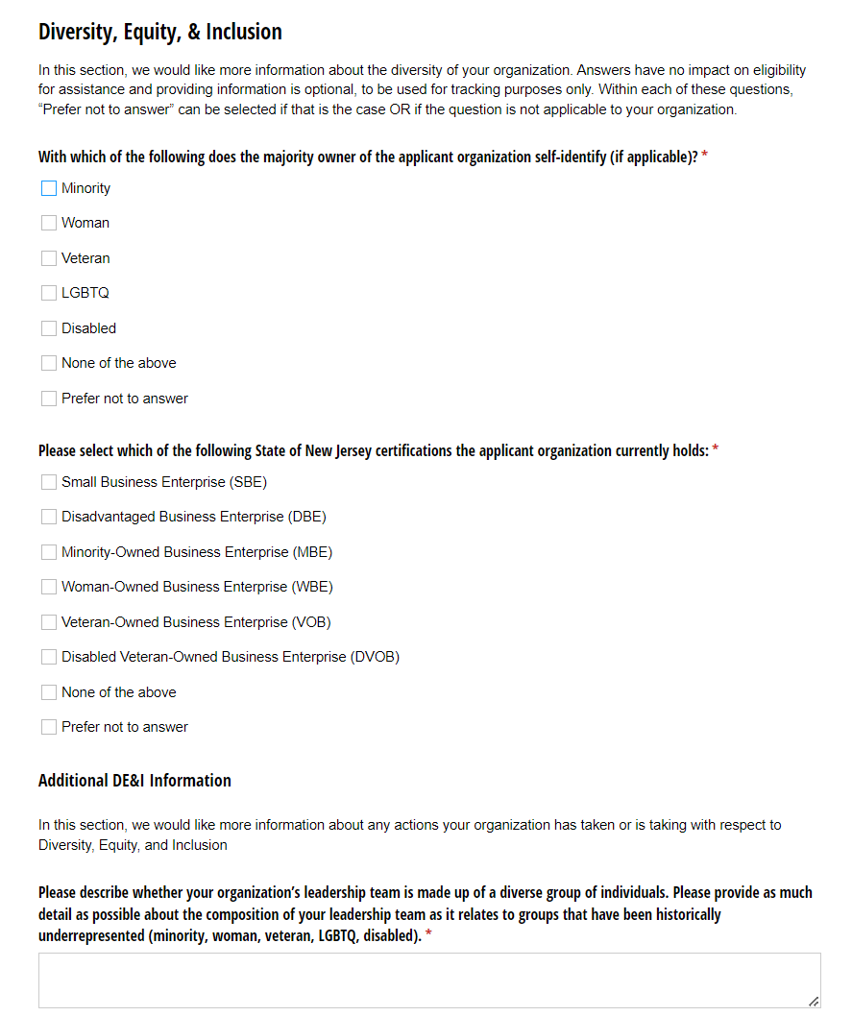
Diversity Equity and Inclusion
In this section, we would like more information about the diversity of your organization.
Answers have no impact on eligibility for assistance and providing information is optional, to be used for tracking purposes only.
Within each of these questions, “Prefer not to answer” can be selected if that is the case OR if the question is not applicable to your organization.

Slide 20
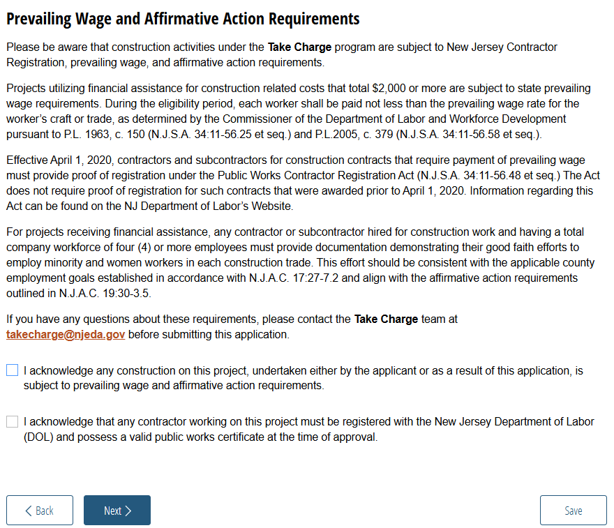
Prevailing Wage and Affirmative Action Requirements

Slide 21
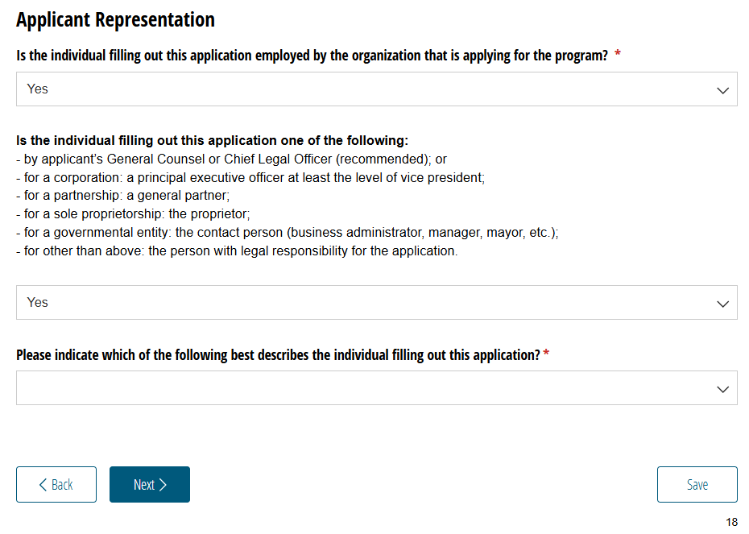
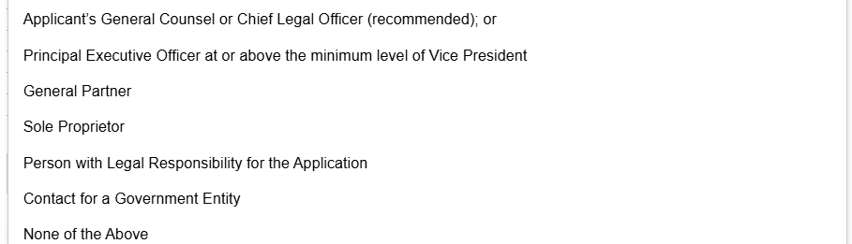
Applicant Representative for Certifications
The New Jersey Economic Development Authority requires that the Legal Questionnaire, Certification of Non-Involvement in Prohibited Activities in Russia or Belarus Pursuant to P.L. 2022, C. 3, Acknowledgments of Applicant, and Certification of Applicant, are to be completed and signed by one of the following:
by applicant's General Counsel or Chief Legal Officer (recommended); or
for a corporation: a principal executive officer at least the level of vice president;
for a partnership: a general partner;
for a sole proprietorship: the proprietor;
for a governmental entity: the contact person (business administrator, manager, mayor, etc.);
for other than above: the person with legal responsibility for the application.
If you are not an Authorized Representative you will be prompted to Upload the Certifications page, which will require you to download and then upload signed copies of the acknowledgments and certifications listed above.
If you are an Authorized Representative, you will be prompted to fill out these pages throughout the application.

Slide 22
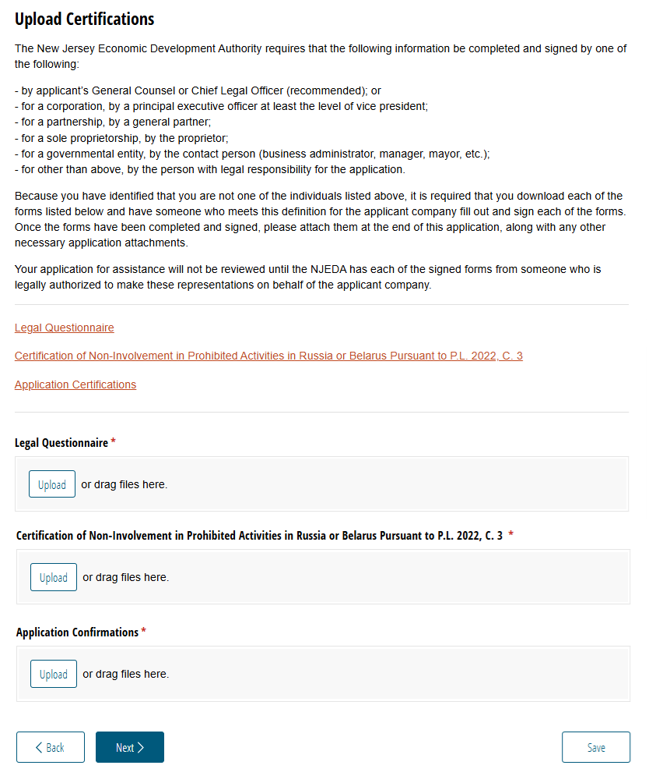
Upload Certifications
If the individual filling out the application is not an authorized representative, this page will appear so that the certifications listed below can be downloaded, completed by and authorized representative, and then uploaded as part of the application.
  Legal Questionnaire
  Certification of Non-Involvement in Prohibited Activities in Russia or Belarus Pursuant to P.L. 2022, C. 3
  Application Confirmation

Slide 23
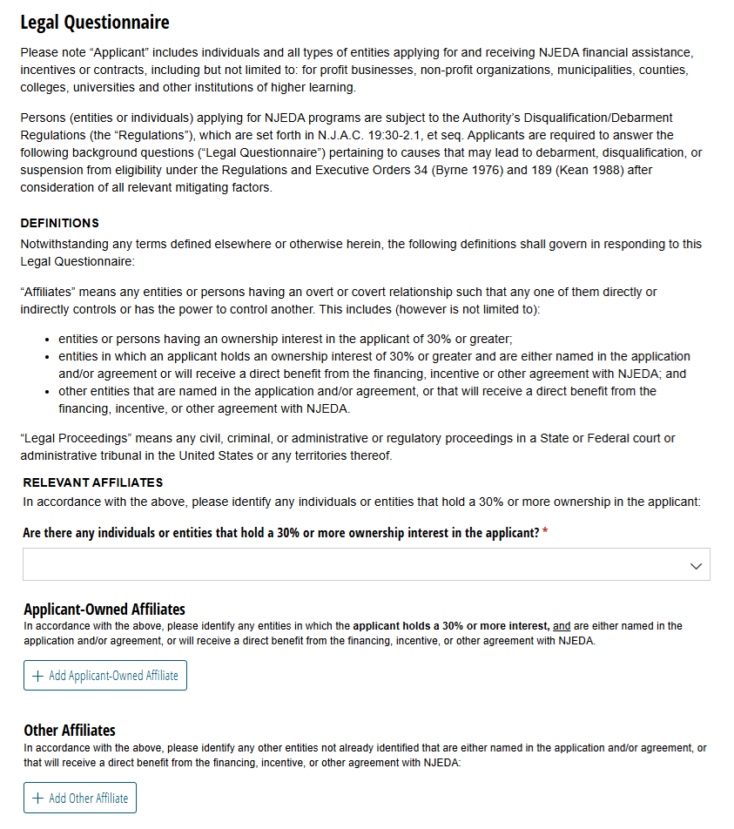
Legal Questionnaire*
In this section, applicants are required to answer background question pertaining to any causes that may lead to debarment, disqualification, or suspension from eligibility.
Additionally, applicants are required to identify any “affiliate” entities. There are two main types of Affiliates:
  First, applicants must identify any individuals or entities that hold a 30% or more ownership in the applicant.
  Second, applicants must identify any individual or entity where the applicant holds a 30% or more interest, and are either named in the application and/or agreement, or will receive a direct benefit from the financing, incentive, or other agreement with NJEDA.
Applicants should take their time and make sure to read this section carefully.
*This page will only be visible if the individual filling out the application is the authorized representative.

Slide 24
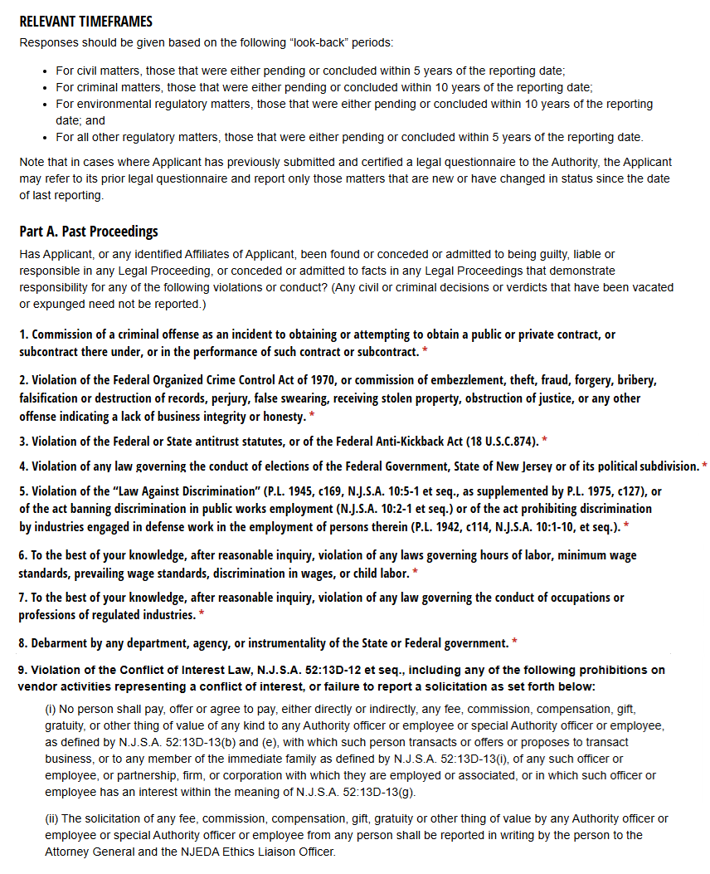
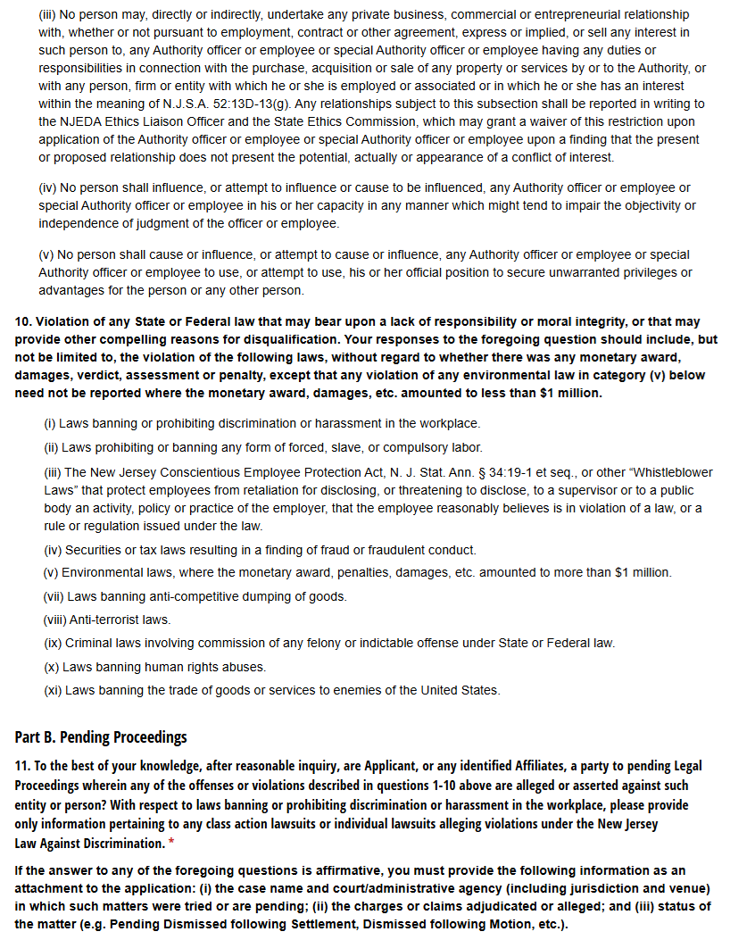
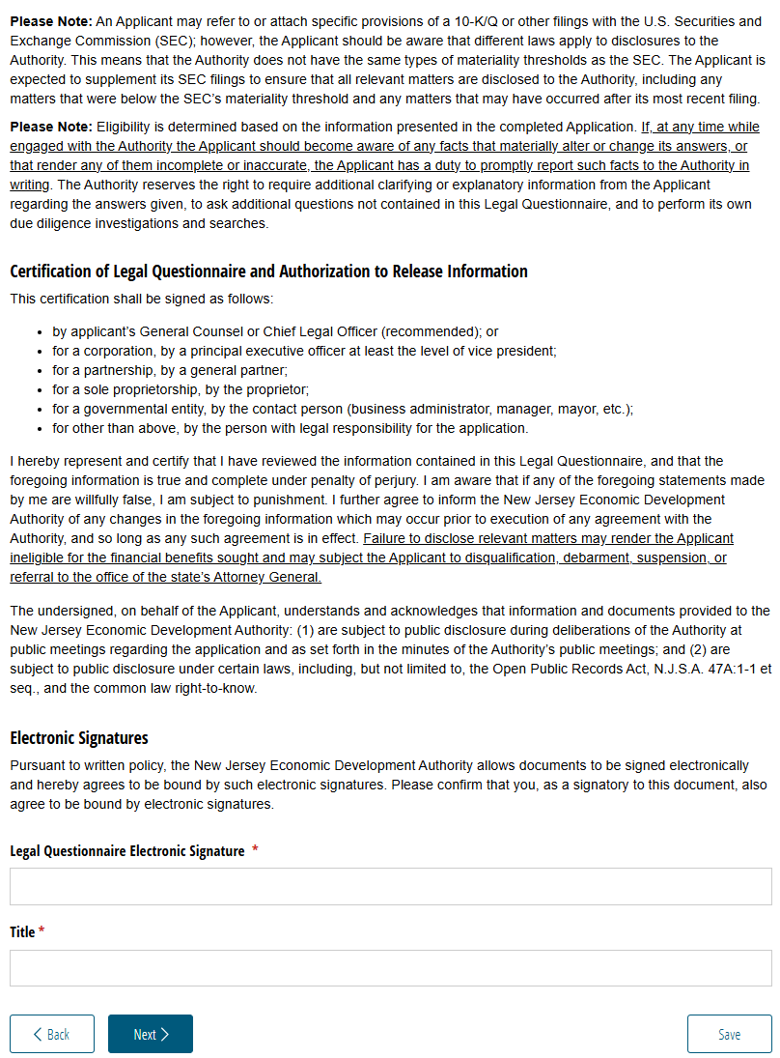
Legal Questionnaire (Continued)
There are several specific questions regarding the past proceedings of an applicant.
It is essential that applicants take their time, reading this section carefully, while keeping in mind the corresponding "look-back" periods for civil, criminal, environmental, and other legal matters.

Slide 25
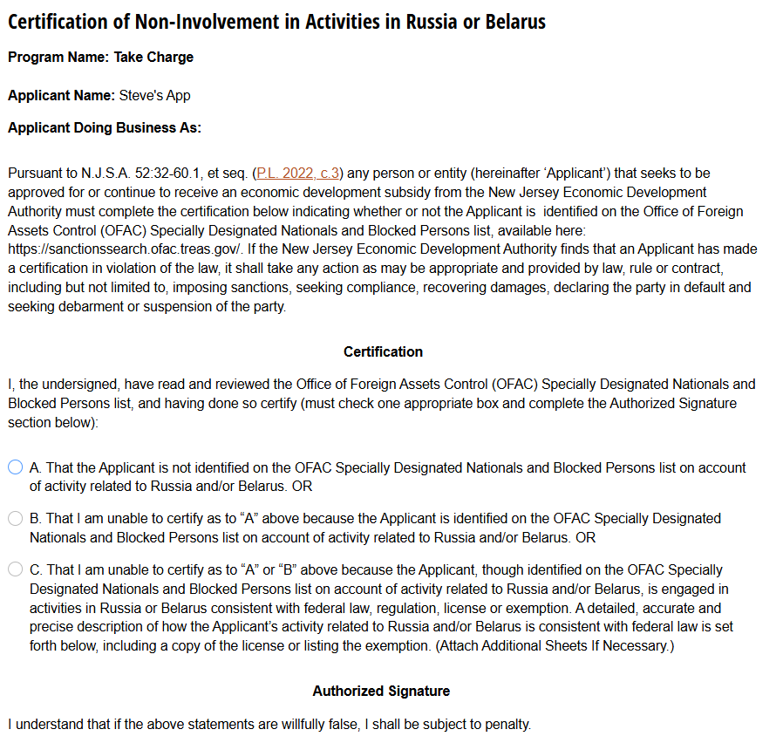
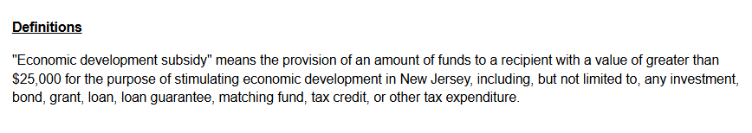
Certification of Non-Involvement in Prohibited Activities in Russia or Belarus*
As is required in N.J.S.A. 52:32-60.1, et seq. (P.L. 2022, c.3), this section we will be collecting the Certification of Non-Involvement in Prohibited Activities in Russia or Belarus and ensuring that the applicant is not listed on the Office of Foreign Assets Control (OFAC) Specially Designated Nationals and Blocked Persons List.
*This page will only be visible if the individual filling out the application is the authorized representative.

Slide 26
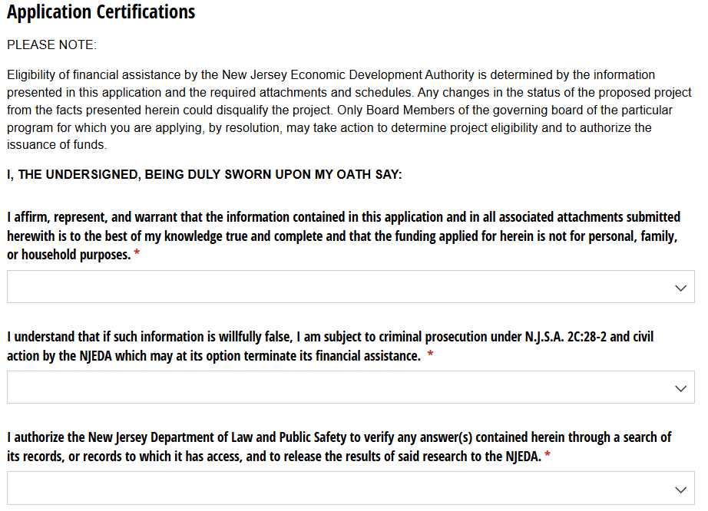
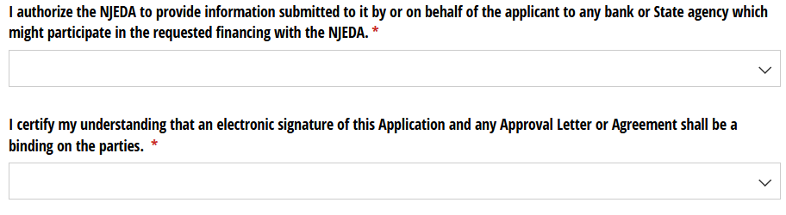
Application Certifications*
On this page, applicants will affirm the accuracy and truthfulness of the application information provided.
*This page will only be visible if the individual filling out the application is the authorized representative.

Slide 27
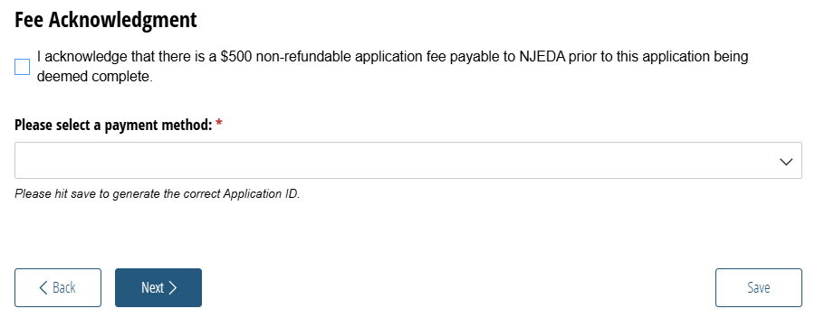
Fee Acknowledgement

Slide 28
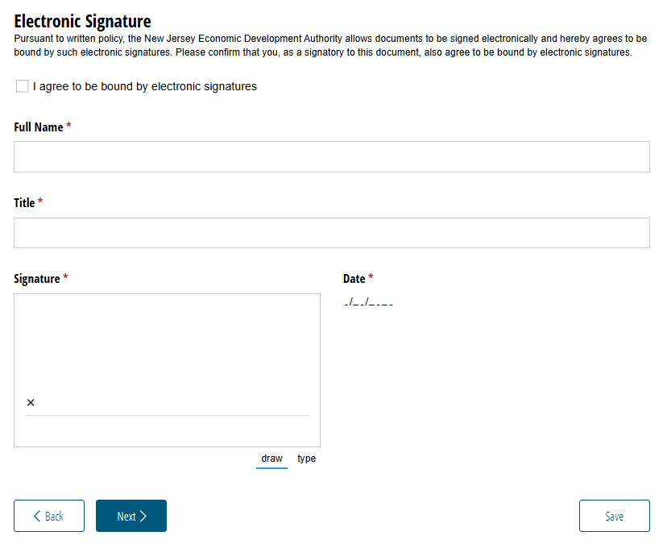
Electronic Signature
Applicants must agree to the terms and digitally sign their application.

Slide 29
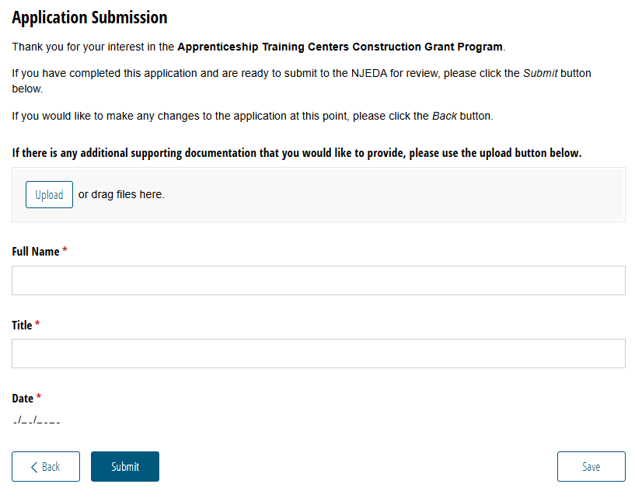
Application Submission
Applicants are provided with a field to upload any remaining relevant materials and asked for a final confirmation of their application submission.
[Program Name]

Slide 30
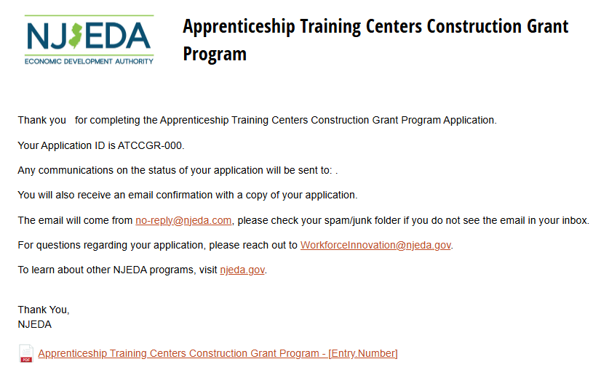
Application Submission
After successful submission, you will see the confirmation page, which will list the Applicant’s application confirmation number.
You will also receive a confirmation and copy of your application to the email address provided for the Primary Point of Contact. All future application communication will be sent to that email address.
You can download a PDF copy of your application from this page. This is the same file that will be sent by email.
[Program Name]
[Program Name]
[Program Name]
**Note: The language and instructions on this page will need to change for applications with fees.

Slide 31






Take Charge Program Website - NJEDA
@NewJerseyEDA njeda.gov 844.965.1125
31

