Slide 1


Fostering Inclusive Innovation and Entrepreneurship in New Jersey
August 2026
@NEWJERSEYEDA
WWW.NJEDA.GOV

Slide 2
Table of Contents
About NJEDA
Support for Early-Stage Innovation
NJIF Overview & Program Structure
Application Process & Eligibility
Looking Ahead: Important Program Material

Slide 3
NJEDA Mission
The New Jersey Economic Development Authority (NJEDA) grows the state’s economy and increases equitable access to opportunity by supporting high-quality job creation, catalyzing investment, and fostering vibrant, inclusive community development. The NJEDA works in partnership with a diverse range of stakeholders to implement programs and initiatives that improve quality of life, enhance economic vitality, and strengthen New Jersey’s long-term economic competitiveness.
Supports high-quality job creation, catalyze private investment and build the country’s most diverse innovation ecosystem in New Jersey. The division provides value added business engagement and products aimed at commercial businesses within the strategic sectors.
Economic Transformation (ET) Division

Slide 4
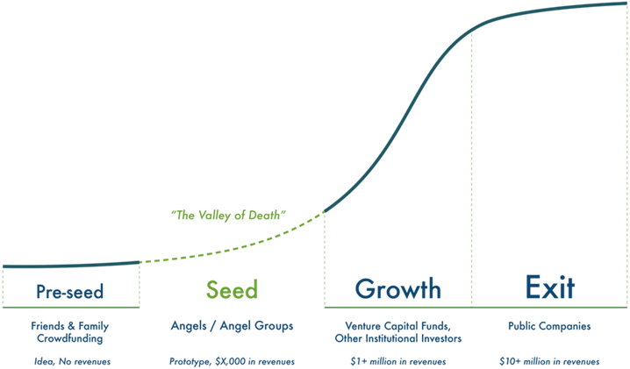
Early-Stage Support

Slide 5

NJ Innovation Fellows Program
Provides non dilutive seed funding to serve as income-replacement for entrepreneurs
Delivers mentorship and skill development opportunities
Facilitates economic growth and job creation
Invests
in diverse talent critical to
New Jersey's vibrant innovation ecosystem
Targets innovative sectors
From a $10M State appropriation, approved teams can compete to receive up to $400,000 in startup capital for innovative business ideas.

Slide 6
Award Breakdown
Base Award $200,000 | Bonus Awards up to $200,000
Each fellow receives a competitive salary to support their entrepreneurial journey and enable focus on their venture full-time.
Entrepreneurs that verify residency in a designated opportunity zone in New Jersey.
Entrepreneurs who self-certifies as a diverse entrepreneur.
Graduate of a New Jersey college or university (including 2-year and 4-year school) in the State.
Fellows gain access to income replacement capital of up to $400,000
New Jersey's Opportunity Zones

Slide 7
Competitive Review
29
Possible Points
NJIF Competitive Scoring (Max 29 Points)
Evaluates business foundation, operations, and team strength.
Business Plan Scoring:
0 – 5 points
Operations Scoring:
0 – 4 points
Management Scoring:
4 – 20 points
Note: Points are awarded only based on information provided within the application and evaluated strictly against the NJIF Scoring Rubric.

Slide 8



Mentorship
Innovation fellows will engage in a dynamic mentorship program, conducted in collaboration with the New Jersey Innovation Institute and Rowan University. This program will offer comprehensive technical training via a curated general operations curriculum. Additionally, fellows will have access to a diverse array of subject matter experts who will provide invaluable mentorship and guidance to teams, fostering innovation and growth.
Focus areas include:
Managerial finance, accounting, & financial statements preparations
Human resources development & management
Marketing & customer development
Product design, development & management
Vision mapping
Capital sourcing & raising
Buyer personas
Business model design
Contracts & business structures (legal studies)

Slide 9
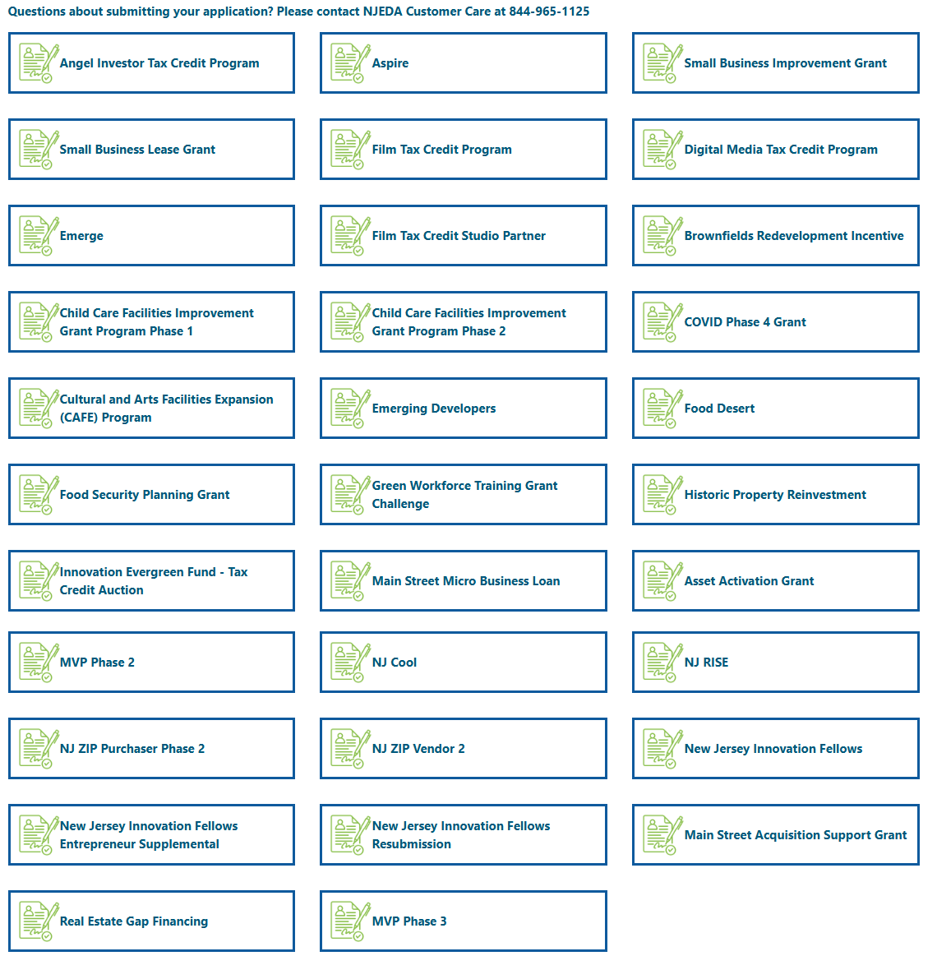
Application Process
There are four major steps this application.
The first three steps must be fully completed prior to the application deadline for consideration.
Please share these expectations with each of your entrepreneurs in order to submit your application on time.
Step 1
Step 2
Step 3
Initial Submission
Entrepreneur Supplemental Application Submission
Application Completion
To be completed by the main point of contact.
To be completed multiple times, once by each member of the Entrepreneur Team
The main point of contact will return to the initial application in order to complete the application. This can only be done after each member of the Entrepreneur Team has submitted their supplemental application section.
Entrepreneur 1 Supplemental Application
Entrepreneur 2 Supplemental Application
Entrepreneur 3 Supplemental Application
+ any additional Entrepreneur Team members
Step 3A
Step 4
To be completed by the main point of contact, after the NJIF team has reviewed and conditionally approved your application. NJIF staff will contact you directly with additional instructions.
Application Review by NJEDA
Resubmission/Providing Additional Details After Initial Approval

Slide 10

Sample Application & Eligibility Checklist
Application Requirement | Business Application | First Time Entrepreneur 1 | First Time Entrepreneur 2 | Repeat Entrepreneur 3
Business Plan | ✔
Pitch Deck | ✔
Organizational Chart (e.g., 3 Entrepreneur Minimum) | ✔
Targeted Industry & Eligible Municipality | ✔
Personal Address Documentation |  | ✔ | ✔ | ✔
Resume |  | ✔ | ✔ | ✔
NJ Gross Income Tax Payment (within 60 days of application) |  | ✔ | ✔ | ✔
Founder Equity (e.g., must hold a majority equity interest (>50%) |  | 33% | 33% | 20%
First Time Entrepreneur Status (e.g., At least half of the team) |  | ✔ | ✔
Stakeholder Bonuses (if applicable): |  | ✔ | ✔ | ✔
2 Year Mentorship Commitment |  | ✔ | ✔ | ✔
Targeted Industries | Eligible Municipalities

Slide 11
30-Day Registration Period
If approved, applicants are required to register their business with the State of New Jersey within thirty (30) days of notice of their award notification.
Formation and Business Registration Documents of Newly Formed Business
A Valid New Jersey Tax Clearance Certificate
Payroll Service Provider Contract (e.g., Bank payroll agreement & accounts, Payroll software subscription, Payroll service provider agreement)
NJIF Program Specifications

Slide 12

Award Disbursement & Ongoing Compliance Requirements
Awarded grants will be disbursed equally over the course of eight (8) quarters following NJEDA Board approval and upon submission of quarterly deliverables*:
A Certified Organizational Chart
Quarterly and Annual Financial Statements
Verification of NJ Gross Income Tax Withheld and Paid for all entrepreneur leaders
Evidence of Mentorship Engagement
Evidence the Business Remains Located in an Eligible Municipality
Individual Tax Filings

Slide 13
NJIF 2026-2027 Timeline
Application Period September 9 – December 4, 2026
Mentorship & Compliance November 2027 – November 2029
NJIF Program Webinar - August 19, 2026
Program Onboarding & Grant Closing August 2027 – November 2027
Application & Competitive Review
December 2026 – May 2027
Conditional Approval
June 2027
Q&A Period August 19 – September 9, 2026
Congratulations, you are here!
Note: All dates and milestones shown are for planning purposes only and are subject to change.

Slide 14
Important Program Material
Cohort III KEY DATES:
Q&A Period: Wednesday, August 19, 2026 - Wednesday, September 9, 2026
Application Period: Wednesday, September 9, 2026 - Friday, December 4, 2026
Available Funding: $2,500,000
Program Anticipated Start: November 2027
There is a $250 non-refundable application fee due at the time of application submission. Questions concerning the NJIF Program should be submitted to NJInnovationFellows@njeda.gov
All information related to the program can be found at njeda.com/new-jersey-innovation-fellows-program.

Slide 15
@NEWJERSEYEDA
WWW.NJEDA.GOV

