Slide 1
Building Services Act
Building Services:
N.J.S.A 34:11-56.58 et seq.
"Building services," as defined by this law, includes cleaning or building maintenance work, including but not limited to sweeping, vacuuming, floor cleaning, cleaning of rest rooms, collecting refuse or trash, window cleaning, engineering, securing, patrolling, or other work in connection with the care, securing or maintenance of an existing building.
"Building services" shall not include any skilled maintenance work, professional services, or other public work for which a contractor is required to pay the "prevailing wage" as defined in section 2 of P.L.1963, c.150 (C.34:11-56.26).

Slide 2
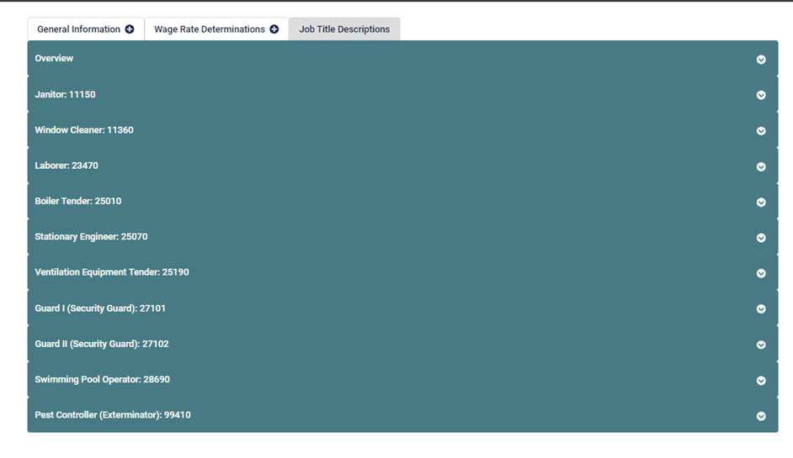
Job Title Classifications
The Building Services Act enforced by NJDOL applies to only the following work classifications (ex. maintenance and security services). The applicable wages for each can be found in the official determinations provided by the NJEDA Labor Compliance Officer, or on the Sam.gov webpage through the NJDOL’s web site:
www.nj.gov/labor/wageandhour/prevailing-rates/state-building-services/

Slide 3
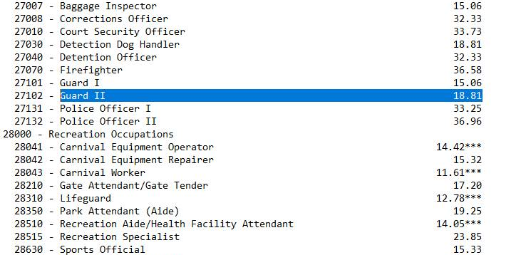
Selecting the Applicable Prevailing Wage Rate
You can find the applicable Building Service prevailing wage by searching for the classification code number listed in the determination. These rates are paid per county and updated annually.
Sample for training purposes only. Not to be used for actual payment of wages
For additional guidance, please refer to NJDOL’s BCA FAQ’s:
Wage and Hour Compliance | State Building Services FAQs (nj.gov)

