Slide 1

New Jersey Economic Development Authority
Corporate Tax Credit Auction Overview

Slide 2



WELCOME
Alexander Pachman
Manager,
Venture Products
Alexander.Pachman@njeda.gov
Riley Edwards
Senior Advisor,
Economic Security
Riley.Edwards@njeda.gov
Ty Blitstein
Project Officer,
Food Security
Ty.Blitstein@njeda.gov

Slide 3
2025 Tax Credit Auctions
NJEDA will hold two tax credit auctions simultaneously in Q3 2025. Based on their needs and preferences, companies may choose to participate in either or both auctions.
 | Food Desert Relief | NJ Innovation Evergreen Fund
Use of proceeds | Grants, loans, or technical assistance to support NJ Food Desert Communities | Investments in NJ-based innovative high-growth businesses
Tax credit types | CBT & IPT | CBT & IPT
Minimum tax credit request | $500,000 | $500,000
Minimum price | $0.85 | $0.75
Additional requirements | No ongoing compliance beyond initial purchase required | Complete Strategic Commitment + serve on Advisory Board
Tax credits sold to date | $15M in 2023; $20M in 2024 | $50M in 2022
Website for more information | https://www.njeda.gov/food-desert-relief-tax-credit-auction/ | https://www.njeda.gov/evergreen-corporate-tax-credit-auction/

Slide 4

New Jersey Innovation Evergreen Fund
Corporate Tax Credit Auction Overview

Slide 5
New Jersey Innovation Economy
5

Slide 6



Key Features of the Evergreen Program
RAISE $300M TO CAPITALIZE THE NJIEF
QUALIFY VENTURE FUNDS
STEP 3
QUALIFY INVESTMENTS
STEP 1
STEP 2
Public money, raised through annual tax credit auctions.
Minimum bid price established of no less than 75%.
Ecosystem engagement through strategic commitment and advisory board participation.
Partner with institutional venture capital firms eligible to access NJIEF capital.
Currently partnered with 24 Qualified Venture Firms managing over $5.8B in AUM.
Qualified Venture Firms can access up to $25M per year in matching funds from Evergreen to co-invest into NJ-based companies.
9 Program investments approved representing $15M of capital.
6

Slide 7
2025 NJ Innovation Evergreen Fund Tax Credit Auction Highlights
2025 Auction Amount: $50M of tax credits.
Timing: Applications open on September 2nd and close on October 3rd.
Minimum bid price: 75% of par value.
Applicable Tax Credit Types: NJ Corporation Business Tax (CBT) and Insurance Premium Tax (IPT).
Eligibility: Companies operating in NJ subject to CBT or IPT liability in the State.
Minimum amount of tax credits requested: $500,000
Carryforward: Tax credits may be carried forward for up to 7 years.
Use of Proceeds: Fund investments in NJ innovative high-growth businesses.
Additional Requirements: Strategic commitment to support the State’s innovation ecosystem and nominate representative to serve on Evergreen Fund’s Advisory Board.
Scoring: Bids scored based on financial bid price and strategic commitment score.
Oversubscription Process: Best and final bids followed by proration of awards.
NJ

Slide 8








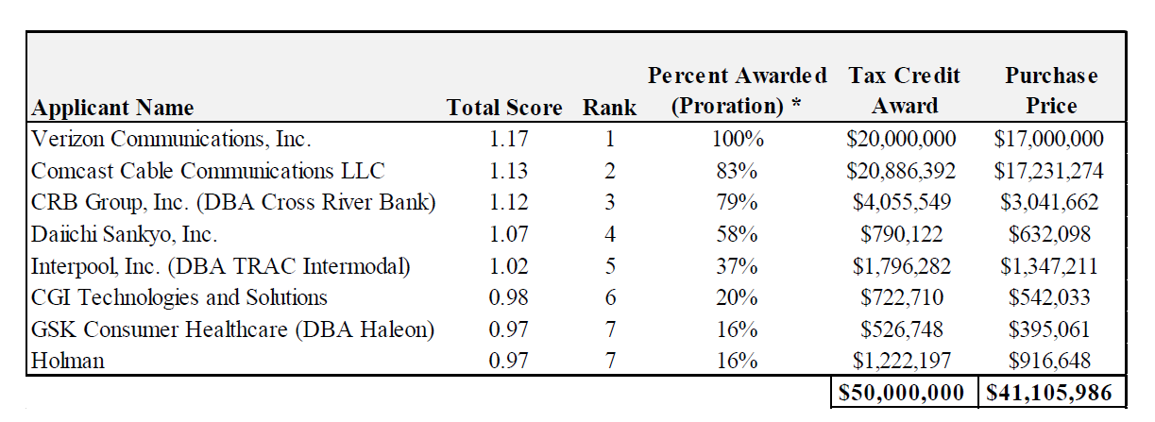
2022 Program Tax Credit Results
8

Slide 9








Strategic Commitment Support for NJ’s Innovation Ecosystem
$750,000 in direct funding to support startup incubation through the Better Future Labs, executive mentorship hours to founders, office space for events and co-working offices, and more.
A strategic commitment represents corporations’ support to New Jersey’s innovation ecosystem and accounts for a portion of bid scores. Commitments are open-ended to align with program tax credit purchasers’ goals and resources.
Communication Services
$1,000,000 in grant funding to NJ innovation ecosystem organizations.
Communication Services
Launch an executive mentorship program for low-income and underrepresented startup founders.
FinTech
P-TECH program, helping students in the New Brunswick Public School District to graduate with both a HS diploma and post-secondary STEM degree at no cost.
Information Technology
Hire four paid PhD fellows from NJ schools through fellowship program.
Pharmaceutical
MBA consulting course on innovation topic at Rutgers's Business School.
Consumer Healthcare
Host innovation ecosystem event for automotive and mobility industries in NJ.
Auto Services
$90,000 to three NJ innovation ecosystem organizations.
Transportation Solutions
9
9
*Additional Examples: www.njeda.com/evergreen-corporate-tax-credit-bidder-january-2022
Notes:
The strategic component is on top of the dollars paid for the credit.

Slide 10
Bid Scoring
Total bid scores will be calculated by adding the financial bid score and the strategic commitment score for each applicant. The relative rank of applicant scores will be used to determine priority for tax credit awards and potential proration percentages should the auction be oversubscribed.
Bid Example:
Purchase Offer: $7,500,000
Amount of Tax Credits Requested: $10,000,000
Strategic Commitment Financial Cost: $400,000
Strategic Commitment In-kind Cost: $100,000
Financial Bid Score | Strategic Commitment Score | Total Score
0.75 | 0.05 | 0.80
10
10
*Additional Examples: www.njeda.com/evergreen-corporate-tax-credit-bidder-january-2022

Slide 11
Proration Example
If the Auction is oversubscribed, bids are ranked in sequential order from the highest to the lowest total score. The allocation of credits available to each purchaser (above the minimum $500,000) decreases in equal increments based on relative score of the purchaser. Higher ranked applicants received a greater proportion of their requested amount of tax credits, while the lower ranked applicants received a smaller award as percentage of the total requested.
*Percent of requested tax credits, above the $500,000 Program minimum, awarded.
11
11
*Additional Examples: www.njeda.com/evergreen-corporate-tax-credit-bidder-january-2022

Slide 12




Example Corporate Auction Example Timeline
NJ INNOVATION EVERGREEN FUND
July 24th: 2025 Auction Formally Announced.
September 2nd: Online Application Open.
October 3rd: Online Application Closes, deposits initiated.
December 2025: NJEDA Board approves awards.
Non-binding indication of interest survey is open today:
https://www.njeda.com/evergreen-survey/
Q1: Bid contracts executed, full payments made.
Annually: Performance of strategic commitments & Advisory Board participation.
12

Slide 13
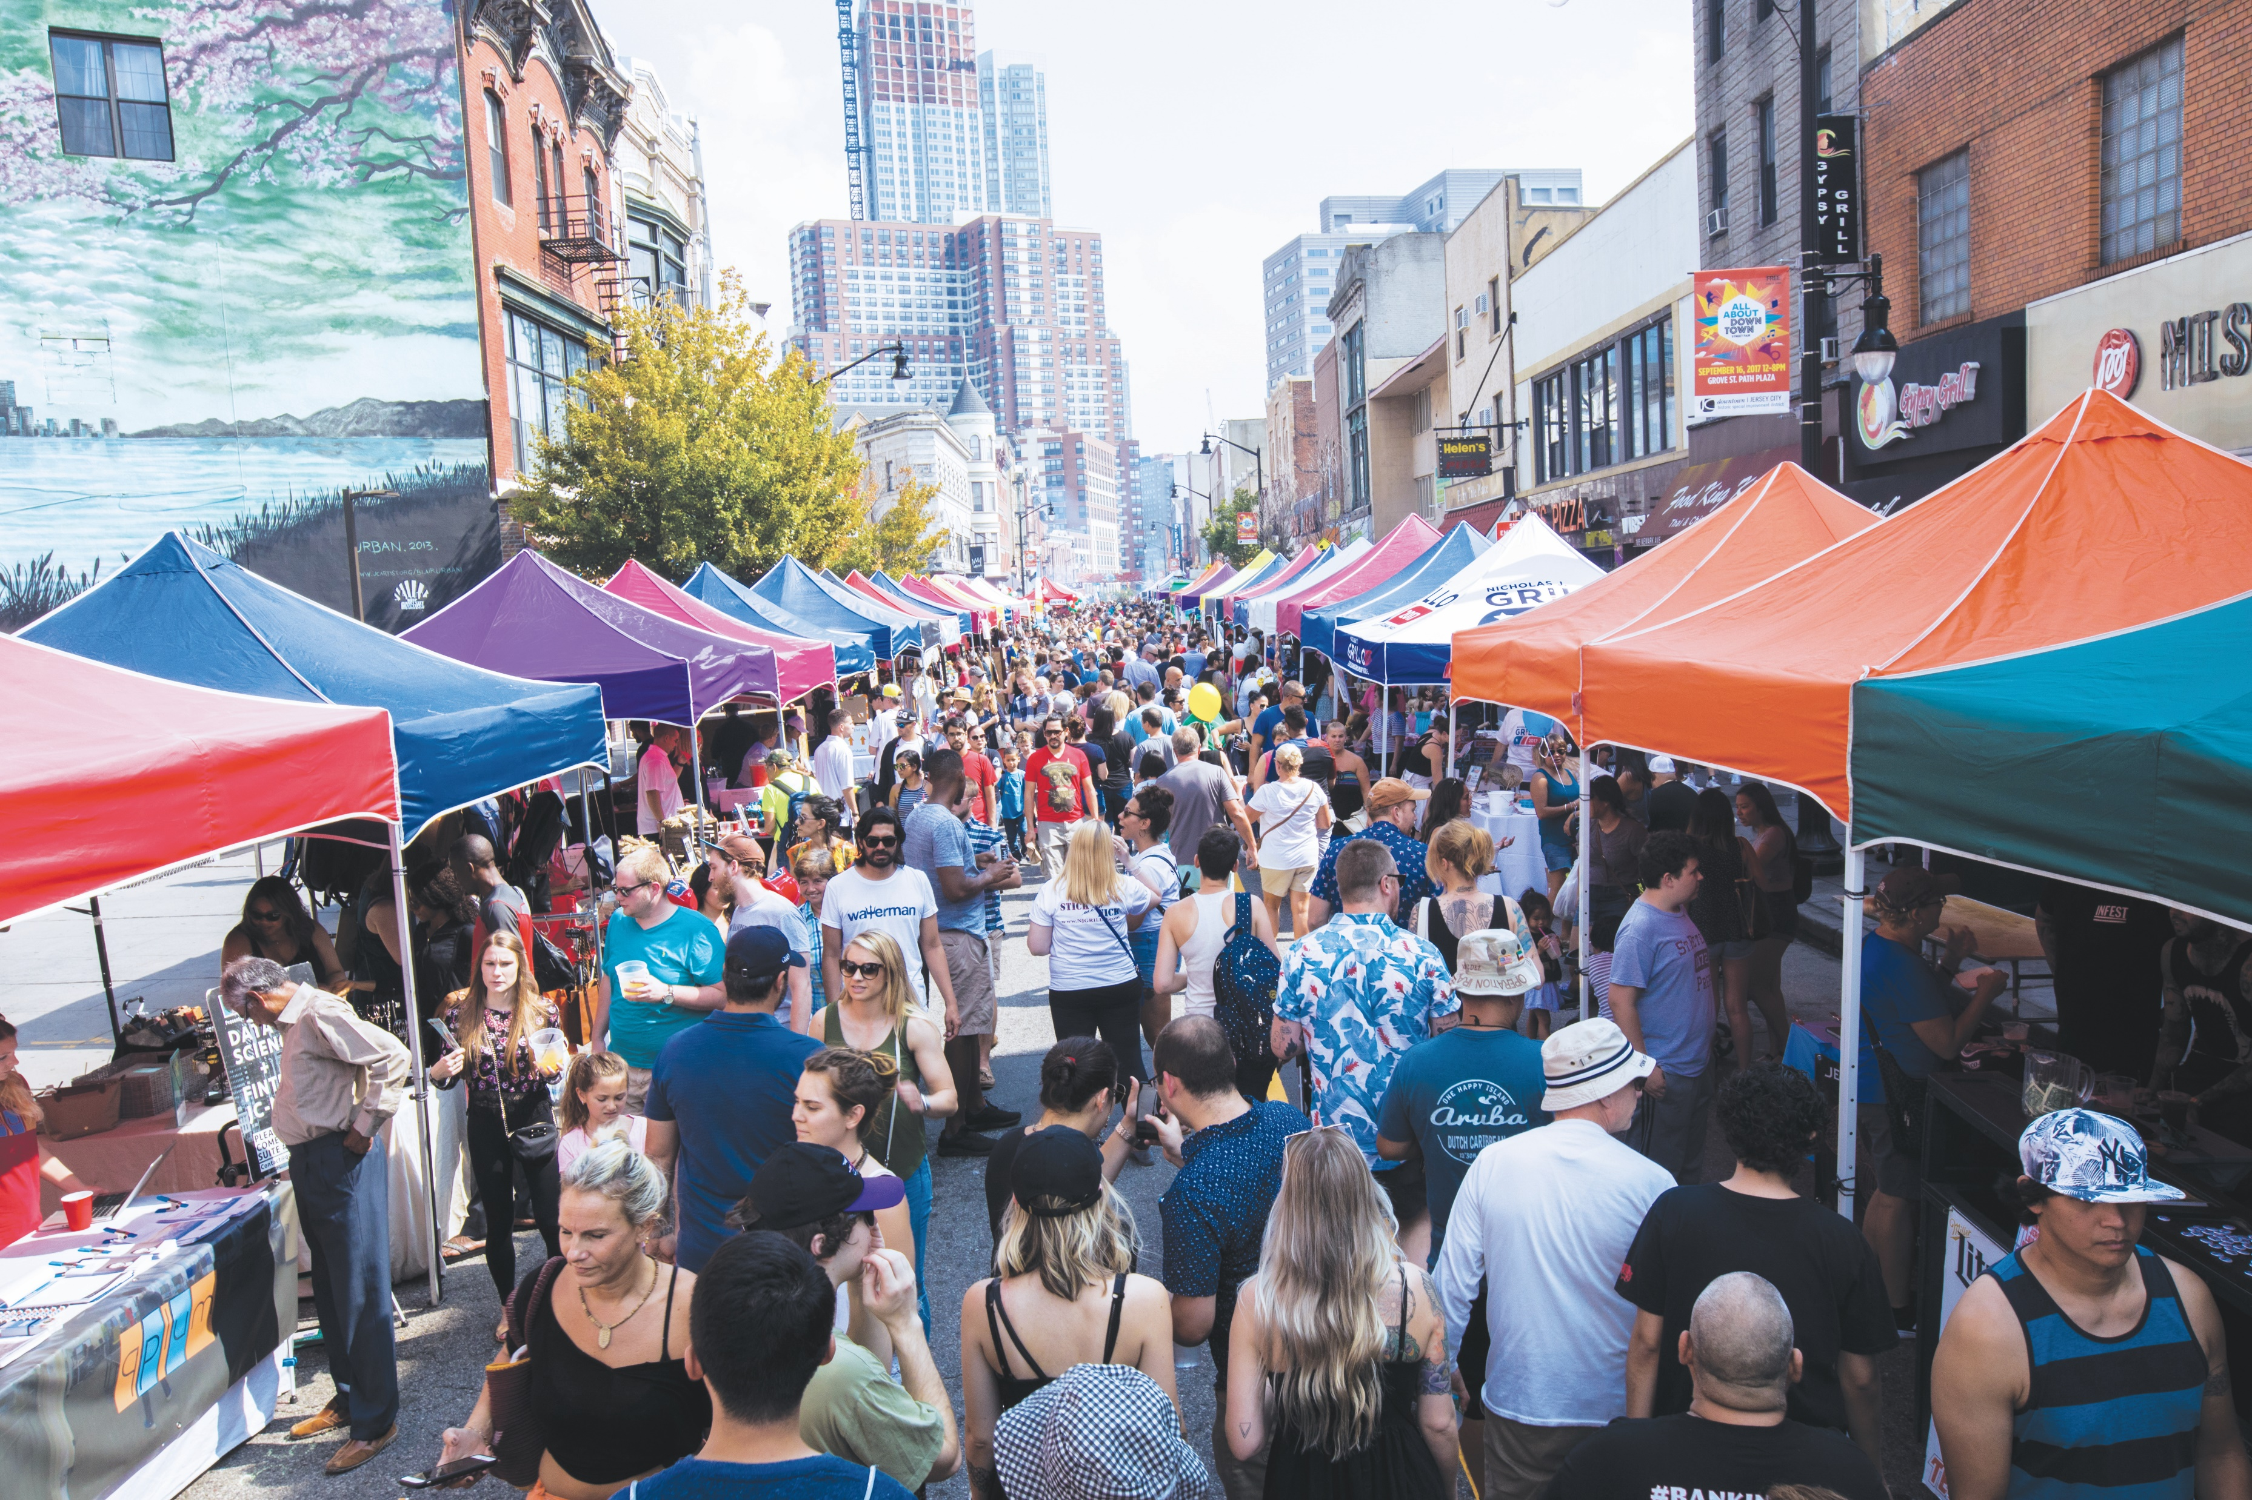







Visit www.njeda.com/evergreen for more information.
@NewJerseyEDA | njeda.com | 609.858.6767
13

Slide 14
Appendix
14
14
*Additional Examples: www.njeda.com/evergreen-corporate-tax-credit-bidder-january-2022

Slide 15
NJ Innovation Evergreen Fund – Qualified Investment Snapshot
Company | Investment Amount | Co-investor | Industry | NJ Jobs | Stage | Private Sector Ratio*
1Huddle | $1.5M | EMERGING Fund | Gamified employee training and talent identification. | 8 | Series A | 1:1
The Many Co. | $3M | Bullpen Capital | Helps retail brand customers join the circular economy. | 12 | Seed | 2:1
RICOVR Healthcare | $400K | Yaax Capital | Saliva testing medical device. | 6 | Series A | 1:1
Nascent Materials | $750K | SOSV | Cathode materials manufacturer. | 3 | Seed | 3:1
Enquyst | $3M | Eckuity Capital | Biologics drug manufacturing. | 3 | Seed | 1:1
PolyGone Systems | $1.25M | FyrFly | Microplastic Removal. | 4 | Seed | 3:1
Hill Research | $1.75M | Covenant VC | Generative AI for pharma customer clinical trials. | 1 | Seed | 4:1
JOGO Health | $3.2M | Atma Capital & Creative Ventures | EMG biofeedback for neuromuscular disorders. | 17 | Series A | 2:1
Total | $15M |  |  | 54 |  | 2:1
NJ
*Ratio of private sector catalyzed into NJ-based business by NJEDA investment.

Slide 16















Growing platform of 21 Qualified Venture Firms

Slide 17
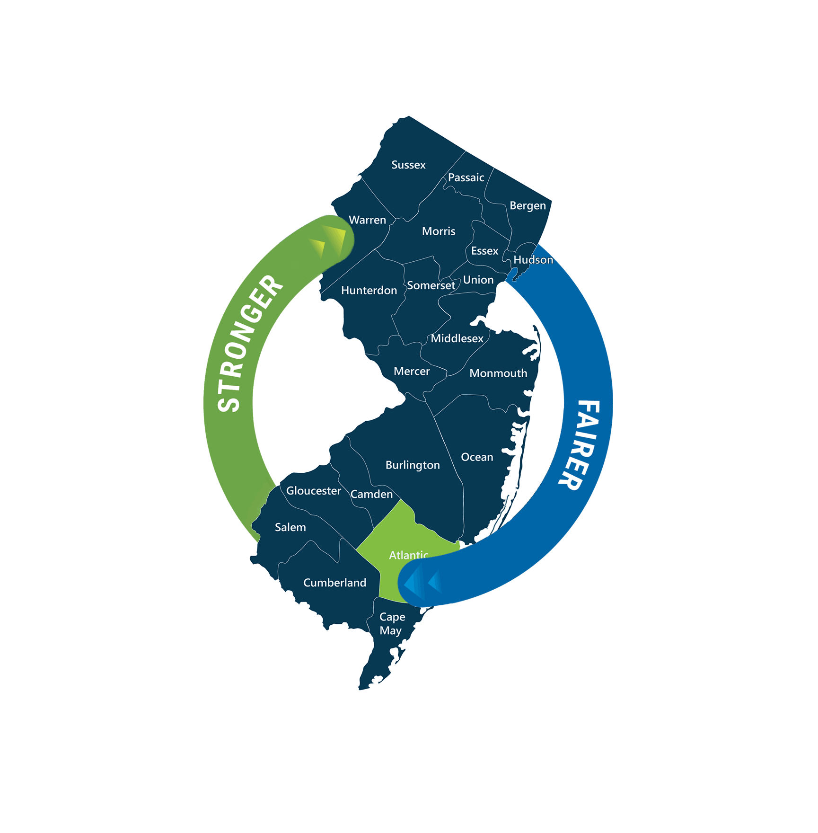
Food Desert Relief Tax Credit Auction

Slide 18
Food Desert Relief Tax Credit Auction
NJ corporations and insurance companies can bid for a tax discount of up to 15%
Can be applied to Corporation Business Tax & Insurance Premiums Tax
Tax credits can first be used for the tax year in which they are approved, with 7-year carry-forward
Minimum tax credit request of $500,000
Minimum price of $0.85 per dollar of credit
No commitment or compliance requirements after closing transaction
Proceeds from the auction will fund grant, loan, and technical assistance programs in designated Food Desert Communities, as specified by the Food Desert Relief Act

Slide 19
The Food Desert Relief Act creates new strategies for NJEDA to address food security
Tax Credits
Grants & Loans
(funded by sale of tax credits)
Technical Assistance (funded by sale of tax credits)
Project financing gap
Initial operating costs
Technology
Equipment
Food Security Initiatives
Assistance to entities eligible for tax credits, grants or loans
Food Desert Relief Act ($225M available)
Product Type
Allowable Uses
Eligible Applicants
ONLY first or second supermarket or grocery store (16K+ SF) in food desert community (FDC)
Supermarket or grocery store in FDC (new or existing)
Mid-sized food retailer (2,500-16,000 sf) in FDC
Small food retailer (less than 2,500 sf) in FDC
Other entities that support food security
Food retailers, non-retailers (e.g. farms, food pantries), non-profits, training provider
Learn more at https://www.njeda.com/food-desert-relief-program
Notes:
Three main components focused on different needs/recipients – tax credits, grants and loans, technical assistance
Focus of this presentation and this rules process is on the tax credits, but this is the big picture of the statute
To add – which taxes does this credit apply to?

Slide 20
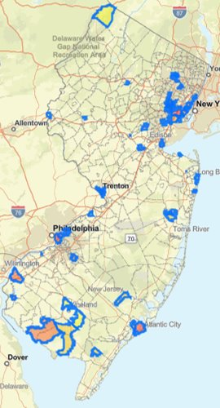
Food Desert Communities
The FDRA directed NJEDA to work with the Departments of Community Affairs and Agriculture to designate up to 50 Food Desert Communities (FDCs) across the state
Designations were informed by a combination of community input and rigorous, data-driven analysis
20+ variables considered spanning food retail environment, demographics, economic/health/community factors
More than 1.5 million NJ residents live in a FDC, which span 57 municipalities and all 21 counties
The interactive map of Food Desert Communities can be found at https://www.njeda.gov/food-security-programs/

Slide 21
FEED NJ
Food Equity and Economic Development in New Jersey (FEED NJ) is a $30 million pilot program awarding grants between $50,000 and $500,000 for innovative projects that strengthen food access and food security in New Jersey’s most acute FDCs.
FEED NJ aims to catalyze innovative, sustainable, and scalable food security and food access initiatives with high potential to maximize community-level impact. Examples include, but are not limited to:
Establishing or enhancing a mobile market, food pantry, or food co-op
Purchasing cold storage or other equipment
Technical assistance to help residents to use nutrition benefits
Increasing access to local produce (e.g. via a farmers’ market, CSA, delivery)
Expanding free food provision services for residents in need
Accelerating existing planning + implementation efforts
And many, many more!

Slide 22
Tax Credit Purchase Eligibility Criteria
Bidders do NOT need to:
Bidders need to:
Be in the food industry
Be in a Food Desert Community
Be NJ CBT or IPT filers
Be in good standing with NJ DOL, DEP, and Taxation
Request at least $500,000 in tax credits
Bid at least $0.85 per dollar of tax credits
Pay a refundable deposit of 10% of total bid, up to $500,000
Make any ongoing commitments beyond the purchase transaction
Undergo standard NJEDA legal review

Slide 23
Tax Credit Auction Timeline
Late July, 2025:
Sample application & template agreement posted, initial amount announced, Q&A begins
October 3, 2025:
Application closes, bids and 10% deposits due
Eligibility & legal review
Before December 31, 2025:
Approvals and agreements sent to successful bidders
30 business days after executing agreement:
Remaining bid funds due
FDRA grant and loan programs funded to alleviate food deserts
Best and final offers sought, if oversubscribed; Tax credit awards calculated
September 2, 2025:
Online application opens
Tax credit certificates issued by NJ Dept. of the Treasury
August 19, 2025:
Questions due to FDRTCAuction@njeda.gov
August 26, 2025:
Final FAQ update posted
Notes:
In the event the total amount of tax credits requested by purchasers exceeds the amount offered in that auction, bidders will be asked to submit a best and final offer (BAFO)

Slide 24
Determining Tax Credit Award Amounts
Eligible bids will be ranked by offer price, from highest to lowest
Available tax credits will be allocated starting with the highest bidders
Bids above the clearing price will receive their full request
Bids at the clearing price may receive a prorated amount
Bids below the clearing price will be declined, with deposit refunded
The price at which the last available tax credits are allocated becomes the clearing price
Notes:
Eligible bids will be ranked in order from highest to lowest offer price to determine the clearing price
The clearing price is the highest price above which the amount requested at or above that price equals or exceeds the amount available
Bidders above the clearing price receive their full request
Bidders offering a purchase price below the clearing price will be declined
Bidders offering a purchase price equal to the clearing price may receive a prorated amount based on the amount requested at the clearing price
For example, if there is $10M available and bidders above the clearing price request $8M, bidders at the clearing price will receive a prorated share of the remaining $2M
If requests at the clearing price total $4M, bidders at that price will receive 50% of their total request

Slide 25
Determining Tax Credit Award Amounts
Example: $10 million available
Bidder | Offer Price | Face Value | Total Purchase Offer | Tax Credits Awarded
A | $0.95 | $4,000,000 | $3,800,000 | $4,000,000
B | $0.93 | $3,000,000 | $2,790,000 | $3,000,000
C | $0.93 | $1,000,000 | $930,000 | $1,000,000
D | $0.90 | $3,000,000 | $2,700,000 | $1,500,000
E | $0.90 | $1,000,000 | $900,000 | $500,000
F | $0.85 | $3,000,000 | $2,550,000 | $0
TOTAL |  | $15,000,000 | $13,670,000 | $10,000,000
Above clearing price
At clearing price
Below clearing price
Notes:
Eligible bids will be ranked in order from highest to lowest offer price to determine the clearing price
The clearing price is the highest price above which the amount requested at or above that price equals or exceeds the amount available
Bidders above the clearing price receive their full request
Bidders offering a purchase price below the clearing price will be declined
Bidders offering a purchase price equal to the clearing price may receive a prorated amount based on the amount requested at the clearing price
For example, if there is $10M available and bidders above the clearing price request $8M, bidders at the clearing price will receive a prorated share of the remaining $2M
If requests at the clearing price total $4M, bidders at that price will receive 50% of their total request

Slide 26


To learn more about the Food Desert Relief Tax Credit Auction:
Visit https://www.njeda.gov/food-desert-relief-tax-credit-auction/ for resources:
Frequently Asked Questions
Detailed overview of the auction process
Application checklist
Sample application
Tax credit purchase agreement template
Email FDRTCAuction@njeda.gov with questions
Questions must be submitted by August 19 at 5:00 PM
FAQ will be updated on a rolling basis with answers to submitted questions
Final FAQ update will be posted by August 26 at 5:00 PM

Slide 27

@NewJerseyEDA | njeda.com | 609.858.6767

