Slide 1

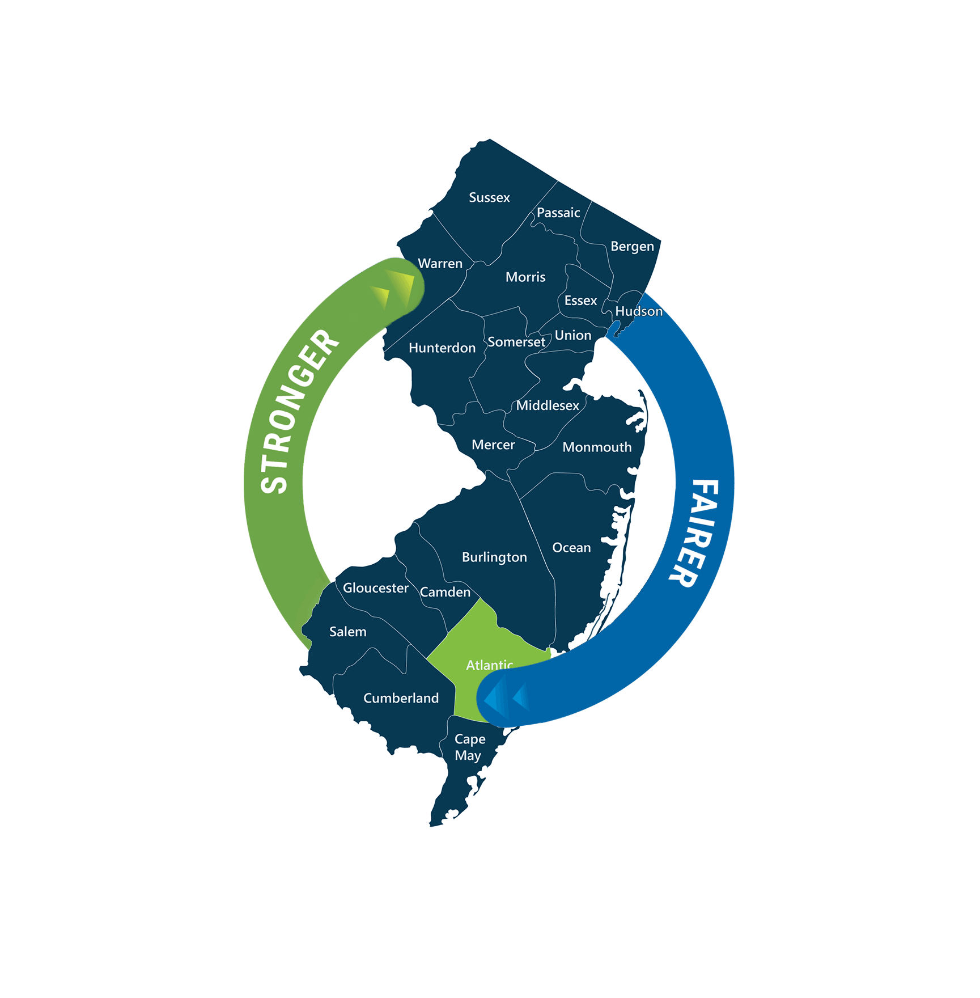
Next NJ Program-AI EO 63 Listening Session
November 22, 2024

Slide 2
Recording of Public Feedback Sessions
Members of the public can submit written feedback on the Next NJ Program-AI Rules via www.njeda.gov/public_information/#rules through December 2, 2024 at 5PM ET
This NJEDA Next NJ Program-AI public feedback session will be recorded and posted on the www.njeda.gov so that members of the public unable to participate in a virtual session have the opportunity to review.

Slide 3
Executive Order No. 63
Pursuant to Governor Murphy’s Executive Order No. 63, the NJEDA is providing opportunities for groups and stakeholders to engage with the NJEDA in crafting rules around Next NJ Program Incentive Program.
We welcome constructive input on how to ensure new programs created are structured and administered in a manner that drives opportunities for all residents and communities.
The NJEDA will begin the session with a presentation to summarize the information – opportunity for public feedback will be available following the NJEDA’s presentation. It is expected that the entirety of the session will take up to 90 minutes.
3

Slide 4
Public Feedback Policy
Feedback may be submitted verbally by using the “raise hand” function in Zoom, or in writing through the Q&A feature. Input will not be accepted verbally until the NJEDA has concluded its presentation.
Each member of the public who wishes to speak during the public feedback period should use the “raise hand” function in Zoom. The host will acknowledge each speaker in the order in which they raised their hand and will open the speaker’s microphone to make their statement.
To ensure everyone that chooses to has an opportunity to speak, each speaker will have a maximum of three (3) minutes to speak and should limit input to matters pertaining to the Next New Jersey Program-AI.
Each member of the public will have one opportunity to provide remarks. If time remains at the end of the session, we will reopen the opportunity for additional remarks.
Speakers should not expect to engage in a dialogue. NJEDA staff may respond to basic questions or clarify a speaker’s input. However, NJEDA staff are not obligated to answer impromptu questions or address remarks from members of the public.
Speakers and members of the public should at all times maintain proper decorum and shall
provide their remarks in a civil manner.
4

Slide 5
Please Note
For this presentation, please note the following:
Non-highlighted text indicates areas where the NJEDA has used the rules to add clarity to the legislation
Highlighted text is written into law which NJEDA does not have discretion to change
5

Slide 6


Notes:
On January 7, 2021, Governor Phil Murphy signed the New Jersey Economic Recovery Act of 2020, a key step toward revitalizing the state's economy. Building on this momentum, the Next NJ Program for AI was signed into law on July 25, 2021, with the goal of driving job creation, capital investment, and innovation in New Jersey’s thriving AI sector. The program is designed to position the state as a dynamic leader in the AI industry, fueling long-term growth and economic prosperity.

Slide 7


Introduction
The Next NJ Program - AI is a robust tax credit program aimed at:
Attracting significant investment.
Creating high-paying jobs.
Cementing New Jersey's position as a leader in the AI industry economy.
It offers competitive incentives for companies ready to invest in New Jersey's AI sector and commit to the state's long-term growth.
7
Notes:
The Next New Jersey Program is a tax credit initiative designed to attract substantial investment, generate high-paying jobs, and establish New Jersey as a leader in the AI industry.

Slide 8

Introduction
The Next NJ Program-AI offers substantial tax credits to businesses that support the AI industry and are looking to start or grow their operations in New Jersey. The Next NJ Program awards tax credits to eligible businesses investing in large-scale AI data centers and AI-related development projects, including visual perception, speech recognition, decision-making, translation between languages, and generative AI.
The Next NJ Program-AI incentivizes collaboration and fosters a dynamic environment where established businesses and innovative startups can work together to achieve shared goals. The program is to include related company jobs, the applicant/awardee will need to secure the job reporting data for NJEDA validation.
8
Notes:
The Next NJ Program for AI utilizes tax incentives to businesses supporting the AI industry and expanding operations in New Jersey. It provides tax credits to companies investing in large-scale AI data centers and AI development projects, including areas like visual perception, speech recognition, decision-making, language translation, and generative AI. The program promotes collaboration between established businesses and innovative startups to drive shared goals and growth.

Slide 9






Key Features
The program legislation (S3432) was signed by Governor Phil Murphy on July 25, 2024 as P.L. 2024, c.49 and codified at N.J.S.A. 34:1B-394 through -402
Tax credits are transferable under this program
Provides tax credits to incentivize AI Datacenters and /or companies involved in AI activities in New Jersey
Program accepts applications through March 1, 2029 on a rolling basis subject to available tax credits
Encourages long-term investment into the State and welcome investment in New Jersey’s AI technology sector
Bolsters smart growth investments focused on the cultivation of an AI ecosystem by helping to bring the industry to the Garden State
9
Notes:
This program offers transferable tax credits to incentivize companies involved in AI activities right here in New Jersey! With applications accepted on a rolling basis through March 1, 2029, it's designed to attract long-term investment and welcome companies eager to join New Jersey's booming AI tech sector. By supporting smart growth investments, this initiative is paving the way for a thriving AI ecosystem in the Garden State, positioning New Jersey as a leader in the industry!

Slide 10

Benefits
Long-Term Commitment: Awarded tax credits will be issued over a five-year period, providing ongoing benefits for both businesses and the state.
Collaboration: This initiative aims to support New Jersey research universities and technology start-ups to foster growth and promote the New Jersey AI ecosystem
Awardees must create and maintain jobs in New Jersey for 10 years. The credits are transferable and include a 10-year carryforward option.
Projects are NOT ELIGIBLE if they have already commenced site cleanup, unless they could not have known the extent of contamination.
Notes:
This exciting initiative offers long-term benefits, with tax credits issued over five years, providing ongoing benefits for both businesses and the state! Awardees must commit to creating and maintaining jobs in New Jersey for 10-years, with transferable tax credits and a 10-year carryforward option. Designed to fuel collaboration, this program supports New Jersey’s research universities and technology start-ups, driving growth and strengthening the state's AI ecosystem.

Slide 11
Eligibility
  Minimum Job Creation: 100 full-time employees
      Each employee must be paid at least 120% of the county median salary
      Each employee must be assigned to the qualified business facility and in the state at least 80% of their work time.
  Minimum Capital Investment: $100 million at qualified business facility.​
  Collaboration: the business will enter a collaborative relationship, evidenced by the provision of price concessions, artificial intelligence support services, or other measures determined appropriate by the Authority, with a New Jersey-based public or private research university or technology startup company, or both.
11
Notes:
There are three key eligibility requirements to unlock the benefits of this program— First, you’ll need to create at least 100 jobs and make a minimum capital investment of $100 million. Plus, more than 50% of your workforce or company must be engaged in AI-related activities. And don’t forget, there’s an exciting collaboration component that we'll dive into in the next slides!

Slide 12
Eligibility (Cont.)
Companies Must: maintain a record of good standing with the New Jersey Department of Treasury, Department of Labor and Workforce Development, and Department of Environmental Protection.​
  Prevailing Wages: construction contracts and building services contracts must adhere to New Jersey’s prevailing wage and labor compliance requirements.
  Minimum Environmental and Sustainability Standards: means standards established by the Authority in accordance with the green building manual prepared by the Commissioner of the Department of Community Affairs.
12
Notes:
Companies must maintain a record of good standing with the New Jersey Department of Treasury, Department of Labor and Workforce Development, and Department of Environmental Protection. Additionally, construction and building services contracts must comply with New Jersey’s prevailing wage and labor requirements. To ensure sustainability, companies must also meet the minimum environmental and sustainability standards set by the Authority, in alignment with the green building manual prepared by the Commissioner of the Department of Community Affairs.

Slide 13
Eligibility (Cont.)
  AI Activities: The applicant business or division of the business must have more than 50% of employees involved in AI related activities or more than 50% of revenue from AI related activities; or both.​
  AI-related activities include, but are not limited to: Developing new AI algorithms and techniques, such as machine learning, natural language processing, and computer vision; creating AI-powered software and hardware products for various applications; medical AI modelling or programing; development of AI chatbots for customer service; AI development for vehicles, and collecting, storing, and managing the vast amount of data needed to train and use AI models.
13
Notes:
A major component of this program focuses on AI and AI-related activities. But what exactly does that encompass? AI-related activities include, but are not limited to: developing AI algorithms (e.g., machine learning, Natural Language Processing( Virtual assistants, Siri, Alexa, Cortana, Etc), computer vision), creating AI-powered software and hardware, medical AI modeling, building AI chatbots, developing AI for vehicles, and managing the data needed to train AI models.

Slide 14

Collaborative Relationship
  Requirements:
A Collaborative Relationship involves a partnership between
an eligible business and one or more New Jersey-based entities,
such as public or private research universities or technology
startups. This partnership must span the commitment period
and may be renewed annually.​
Key requirements include:​
Evidence of Collaboration: The relationship must be
demonstrated through activities such as price concessions, AI
support services, or other AI-related initiatives, as determined
appropriate by the Authority’s Board.​
Minimum Contribution: The net value of the collaboration must equal at least 10% of the award.​
This requirement is designed to foster synergy, driving greater outcomes through combined efforts and strengthening New Jersey’s AI ecosystem.
14
Notes:
This collaboration requirement is designed to create powerful synergies that amplify results and strengthen New Jersey’s growing AI ecosystem. A Collaborative Relationship refers to the partnership between an eligible business and a New Jersey-based public or private research university, technology startup, or both, throughout the commitment period. Renewed annually, this partnership can involve a range of activities, such as offering price concessions, providing AI support services, or launching other AI-related initiatives, all guided by the Authority’s Board. The total value of this collaboration must equal at least 10% of the award, driving innovation and fostering impactful growth in the state.

Slide 15
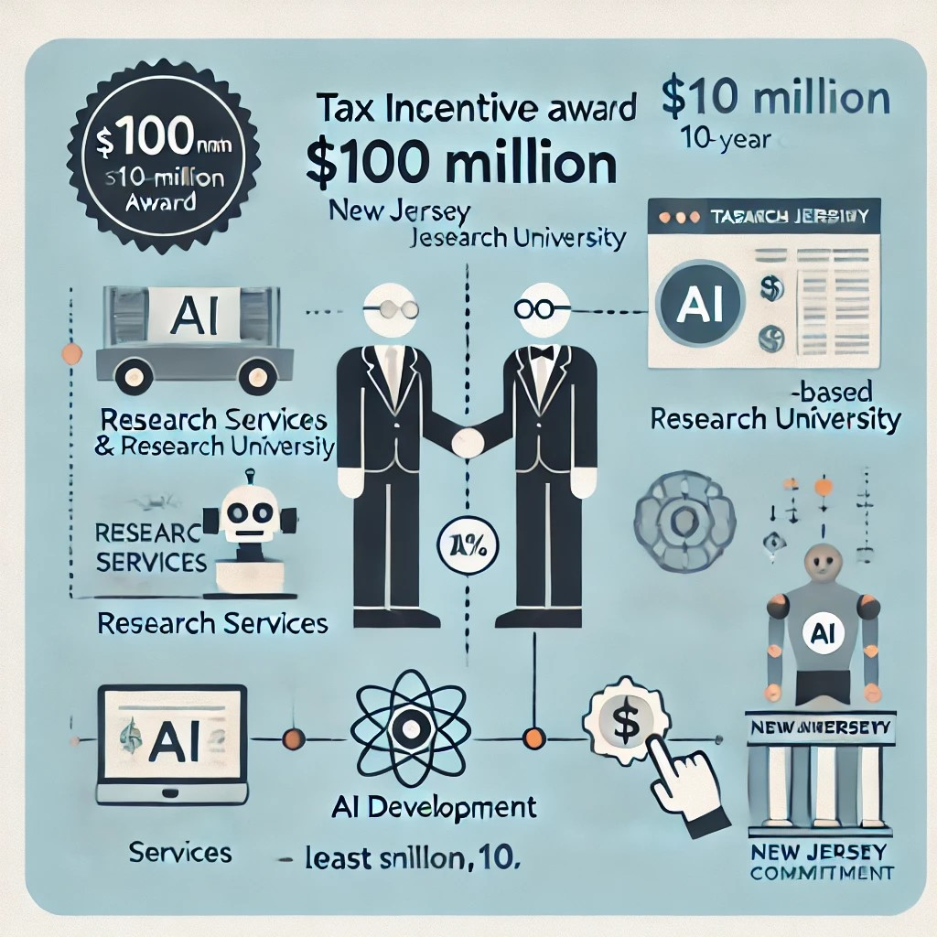
Collaborative Relationship
  EXAMPLE:
10-Year AI Collaboration: The business partners with a New Jersey-based research University for a 10-Year AI collaboration.
Support Services: The partnership includes benefits such as price discounts on research services, AI development assistance, and access to specialized AI resources.
Minimum Value Requirement: The total value of the collaboration must equal at least 10% of the business’s tax incentive award.
Example Commitment: A $100 million tax incentive, the university collaboration must provide at least $10 million in value over the 10 years.
Year 10
($1M)
Year 1
($1M)
Year 2
Year 3
($1M)
Year 4
Year 5
($1M)
Year 6
Year 7
($1M)
Year 8
Year 9
($1M)
($1M)
($1M)
($1M)
($1M)
Total $10 million collaboration
15
Notes:
Let's take for instance an eligible AI business partnering with a New Jersey-based research university for a 10-year collaboration. Throughout this partnership, the business can receive a variety of valuable support, such as price discounts on research services, AI development assistance, or access to cutting-edge AI resources. The total value of this collaboration—including price concessions and AI support services—must equal at least 10% of the business’s tax incentive award.
For example, if the company qualifies for a $100 million award, the collaboration with the New Jersey-based research university must provide at least $10 million in value over the 10-year commitment.

Slide 16

Program Timeline
  10-year Commitment to New Jersey
  Awarded tax credits are issued during the first 5 years of a 10-year commitment to the state.
Certification Period
Up to 4 years
Award Period
Years 1-5
Compliance Period
Years 6-10
Total 10-year commitment to NJ
16
Notes:
The 10-year commitment to New Jersey involves a structured process for receiving and maintaining tax credits. During the first five years, known as the award period, the eligible business receives tax credits. The business has up to four years to certify its compliance, with years 1-5 dedicated to the award period. Following this, years 6-10 represent the compliance period, where the business must continue to meet the requirements to maintain its eligibility and ensure long-term commitment to the state.

Slide 17
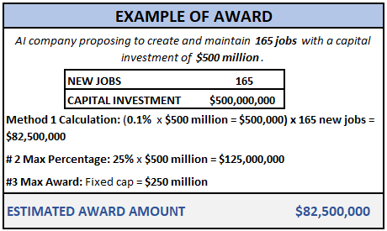
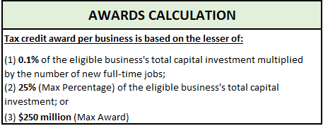
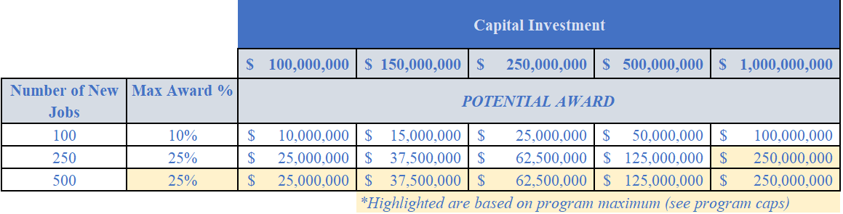
Tax Credit Award (Cont.)
Awarded tax credits are disbursed over five years. The example of 500 New Jobs is illustrative, based on the maximum cap of $250,000,000.
Notes:
The tax credit is determined by one calculation with two options for maximums.
0.1% of the eligible business's total capital investment, multiplied by the number of new full-time jobs created.
25% of the businesses total capital investment or
a maximum award of $250 million.
If an AI company proposes to create 165 new jobs and invest $500 million, the potential tax incentive is calculated using method one, with the final award determined by the lowest of the three: Let's do the math!
Method 1: Multiply 0.1% by the capital investment of $500 million, then multiply that result by 165 jobs. This gives us an award of $82,500,000.
Option 2 (Max Percentage) : Simply take 25% of the $500 million capital investment, which equals $125,000,000.
Option 3 (Max Award): The program has a fixed cap of $250 million.
In this case, the company would receive the lesser of the three amounts, so they would be eligible for up to $82,500,000 in tax incentives.

Slide 18
Additional Program Details (Cont.)
  FOREFEITURE, REDUCTION, AND/OR RECAPTURE OF THE TAX CREDIT
Construction
No tax credits are issued
Year 1-5
Award Recalculation
Year 6-10
80% Threshold
Awards based on Jobs and Capital Investment
80% Threshold
Forfeiture
Recapture and Terminate
Grace period
18
Notes:
In years 1-5, companies must maintain at least 80% of the required job creation and other criteria to remain in compliance. Falling below this threshold will result in a reduction of the awarded tax credits. In years 6-10, companies are given a grace period to recover any shortfall; however, continued non-compliance after this period will lead to a recapture of tax credits.
In short, tax credits will be forfeited or recaptured based on the company’s ability to meet job creation and other requirements during both the eligibility and compliance periods. Any recapture will be proportional to the level of non-compliance, and companies will be provided time to recover before full recapture is enforced.

Slide 19
Additional Program Details (Cont.)
  FORFEITURE, REDUCTION, AND/OR RECAPTURE (yrs 1-5) OF TAX CREDIT
Statutory Requirement: 80% OF JOB COUNT AND INCENTED SALARY (a) If, in any tax period, an eligible business reduces the total number of full-time employees in its Statewide workforce by more than 20% from the number of full-time employees in its Statewide workforce in the last tax period prior to the tax credit approval under the program, then the eligible business shall forfeit its credit for that tax period and each subsequent tax period, until the first tax period for which documentation demonstrating the restoration of the eligible business's Statewide workforce to the threshold levels required has been reviewed and approved by the Authority, for which tax period and each subsequent tax period the full amount of the credit shall be allowed.
Statutory Requirement: The credit shall be forfeited in the case of material misrepresentation.
Proposed Rules:
Failure to timely submit the annual report or progress report, absent extenuating circumstances and the written approval of the Authority, may result in forfeiture of some or all of the tax credit award.
New jobs will be considered as backfilling open positions when establishing the statewide jobs baseline. Only after this baseline is established can they be counted as new full-time positions.
In any year in which the applicant is not in substantial good standing with the Department of Labor and Workforce Development, the Department of Environmental Protection, or the Department of the Treasury, the applicant may forfeit all tax credits awarded in that year subject to the determination, in the sole discretion of the Authority, to extend, in individual cases, the deadline for any annual reporting requirement.
19
Notes:
Years 1-5 (Eligibility Period): During this period, if the company falls below 80% of the required jobs, they would face a forfeiture in their award and a possible recapture. This means if they were expected to create, say, 200 jobs, they need to maintain at least 160 jobs (80% of the required amount). If they dip below this threshold, the tax credit award is reduced accordingly.

Slide 20
Additional Program Details (cont.)
  FORFEITURE, REDUCTION, AND/OR RECAPTURE OF THE TAX CREDIT (yrs 6-10)
  Statutory Requirement: Failure of the eligible business to meet any program criteria shall constitute a default and shall result in the recapture of all or part of the tax credit awarded.
  Proposed Rules:
If all or part of a tax credit sold or assigned is subject to recapture, the Authority shall pursue recapture from the eligible business and not from the purchaser or assignee of the tax credit transfer certificate.
The Authority may recapture all or part of a tax credit awarded if an eligible business does not remain in compliance with any other requirements of the program and/or the project agreement for the duration of the commitment period. Failure of the eligible business to meet any program criteria shall constitute a default and shall result in the recapture of all or part of the tax credit awarded
20
Notes:
Years 6-10 (Compliance Period): In the compliance period, there's a 1-year grace period. This means that if the company falls below the required number of jobs, they have a full year to recover the required jobs without facing consequences. If they don't recover within the grace year, then recapture is enforced.

Slide 21
Additional Program Details (cont.)
  Affiliates
  Statutory Requirement: An affiliate of an eligible business may contribute towards the capital investment and eligible position requirements and may satisfy the requirement for site control during construction and the eligibility period, but in no event shall the tax credit certificate be issued to an affiliate.
  Affiliates means an entity that directly or indirectly controls, is under common control with, or is controlled by an eligible business. Control exists in all cases in which the entity is a member of a controlled group of corporations as defined pursuant to section 1563 of the federal Internal Revenue Code (26 U.S.C. s.1563) or the entity is an organization in a group of organizations under common control that is subject to the regulations applicable to organizations pursuant to subsection (b) or (c) of section 414 of the federal Internal Revenue Code (26 U.S.C. s.414).
  Proposed Rules:
Evidence of affiliation requires an opinion of counsel or a CPA letter.
21

Slide 22
Capital Investment
  Included in Eligible Capital Investment
  Statutory Requirement:
  Capital investment means expenses that a business or an affiliate of the business incurs, or is incurred on behalf of the business or affiliate by its landlord, following its submission of an application to the authority pursuant to N.J.S.A. 34:1B-398, but prior to the project completion date, as shall be defined in the project agreement, for: site preparation and construction, repair, renovation, improvement, equipping, or furnishing on real property or of a building, structure, facility, or improvement to real property; obtaining and installing furnishings and machinery, apparatus, or equipment, including, but not limited to, computer systems, hardware, software, and equipment and material goods subject to bonus depreciation under sections 168 and 179 of the federal Internal Revenue Code (26 U.S.C. ss.168 and 179), for the operation of a business on real property or in a building, structure, facility, or improvement to real property; or any combination of the foregoing.
22
Notes:
Capital investment refers to expenses incurred by a business or its affiliate, or on its behalf by a landlord, between the submission of the application and the project's completion. These expenses include costs for site preparation, construction, repairs, renovations, improvements, equipment installation, and furnishings for real property or buildings. It also covers the acquisition and installation of machinery, computer systems, hardware, software, and equipment eligible for bonus depreciation under federal tax code sections 168 and 179, all aimed at supporting business operations on the property.

Slide 23
Capital Investment cont.
  Included in Eligible Capital Investment
  Proposed Rules:
  Site preparation and construction, repair, renovation, improvement, equipping, or furnishing on real property or of a building, structure, facility, or improvement to real property, including security systems such as surveillance camera, access control systems, and secure entry points to protect the physical infrastructure, site-related utility, including, but not limited to, water, electric, sewer, and stormwater; and transportation infrastructure improvements, plantings, solar panels and components, energy storage components, installation costs of solar energy systems, or other environmental components required to attain the minimum environmental and sustainability standards established by the Authority in accordance with the green building manual prepared by the Commissioner of Community Affairs.
  Site-related connectivity and telecommunications installation costs, including, but not limited to, fiber optic cables; energy power generation, including energy storage components, distributed storage systems, redundant power supplies, backup generators and uninterruptible power supplies (UPS); and advanced cooling technologies, such as liquid cooling or HVAC systems, to manage the heat generated by high-performance computing equipment;
  Obtaining and installing computer systems, hardware, and equipment, and for the initial, but not ongoing, operation of a business on real property or in a building, structure, facility, or improvement to real property. Capital investment shall include the value of a capital lease, as defined by generally accepted accounting practices (GAAP), of furnishings and machinery, apparatus, or equipment, based on the shorter of the useful life of the leased property or the commitment period;
23
Notes:
For the Next NJ Program-AI, Capital investment includes expenses for site preparation, construction, repairs, renovations, and improvements to real property or buildings, such as security systems, utilities (water, electric, sewer), transportation infrastructure, and environmental components like solar panels and energy storage to meet sustainability standards. It also covers the installation of telecommunications systems, energy power generation (including backup power and cooling technologies), and the procurement of computer systems and equipment necessary for business operations. Additionally, capital investment accounts for capital leases of furnishings and equipment based on their useful life or the commitment period, in accordance with generally accepted accounting principles (GAAP).

Slide 24
Capital Investment
  Soft Costs (including software)
  Statutory Requirement:
  Capital investment means expenses that a business or an affiliate of the business incurs, or is incurred on behalf of the business or affiliate by its landlord, following its submission of an application to the authority pursuant to N.J.S.A. 34:1B-398, but prior to the project completion date, as shall be defined in the project agreement, for: site preparation and construction, repair, renovation, improvement, equipping, or furnishing on real property or of a building, structure, facility, or improvement to real property; obtaining and installing furnishings and machinery, apparatus, or equipment, including, but not limited to, computer systems, hardware, software, and equipment and material goods subject to bonus depreciation under sections 168 and 179 of the federal Internal Revenue Code (26 U.S.C. ss.168 and 179), for the operation of a business on real property or in a building, structure, facility, or improvement to real property; or any combination of the foregoing.
  Proposed Rules:
  Associated soft costs and software, which combined shall not exceed 20 percent of capital investment.
24
Notes:
Regarding software: we propose capping the soft cost portion of the capital investment, as defined by generally accepted accounting principles (GAAP), at 20%. This would limit the amount of non-tangible costs—such as legal fees, administrative expenses, and other indirect costs—that can be counted toward the total capital investment. However, there will be a carve-out for licensed software, recognizing its critical role in the operation of modern businesses, especially in sectors like AI technology. Unlike hardware and equipment, which are physical assets, licensed software is intangible but essential for business functionality. This distinction ensures that businesses investing in essential technology tools can still receive the full benefit of their investment in software, data, etc., while maintaining a reasonable limit on non-physical, indirect costs.

Slide 25
New Jersey Qualified Business Facility
  Qualified Business Facility (QBF)
  Statutory Requirement: The business entity must maintain the project in New Jersey for duration of 10-year commitment.
  Proposed Rules:
  Projects will be allowed to lease up to 5% of the qualified business facility.
  Sale of the qualified business facility is not allowed.
Maintenance of the project in New Jersey:
Notwithstanding the foregoing, a business may lease or sublease a portion of its qualified business facility to a new tenant that is a quality childcare facility and up to 5% for any other new tenant without forfeiting any of the business's credits, provided that the new tenant's full-time employees and capital investment shall not be included in the business's eligible full-time employees or capital investment.
25
Notes:
A business participating in the program will be allowed to lease up to 5% of its Qualified Business Facility (QBF) to another business. However, this leasing arrangement is capped at 5% of the total space to ensure that the primary purpose of the facility remains focused on the business's operations and the intended use of the QBF.
Additionally, businesses will have the unique opportunity to lease space to a child-care facility without any restrictions on the amount of space leased. This carve-out acknowledges the importance of supporting employee work-life balance and access to essential services, like child care. By providing unlimited leasing space to child-care facilities, the program aims to encourage businesses to offer family-friendly environments, which can improve employee retention, attract talent, and contribute to a positive workplace culture. This policy helps create a more supportive ecosystem, balancing business needs with social responsibility.

Slide 26
Green Building Standards
  Minimum Environmental and Sustainability Standards
The proposed appendix to the NJEDA Green Building Manual would outline acceptable green construction standards widely recognized in the industry. To comply with minimum environmental and sustainability standards, a qualified business would, within two years of service, be required to certify compliance under one or more of the following green building standards:
      BREEAM for New Construction or In-Use
      ENERGY STAR
      Envision
      ISO 50001 – Energy Management
      LEED for Building Design and Construction or Operations and Maintenance
      Green Globes for New Construction or Existing Buildings
      ASHRAE Energy Standards for Data Centers
"Minimum environmental and sustainability standards” means standards established by the Authority in accordance with the green building manual prepared by the Commissioner of the Department of Community Affairs, regarding the use of renewable energy, energy-efficient technology, and non-renewable resources to reduce environmental degradation and encourage long-term cost reduction. The Authority shall publish these standards on its website. The highlighted programs are the ones currently featured in the Green Building manual. Based on research gathered, I believe we should continue to focus on these programs while excluding others. However, we may give consideration to the inclusion of Envision for campus-type projects that involve infrastructure and multiple buildings.
26
Notes:
The proposed appendix to the NJEDA Green Building Manual would outline acceptable green construction standards widely recognized in the industry. To comply with minimum environmental and sustainability standards, a qualified business would, within two years of service, be required to certify compliance under one or more of the following green building standards:
The highlighted programs are currently featured in the Green Building manual. Based on the research gathered, I recommend that we continue to focus on these programs and exclude others. However, we may consider including Envision for campus-style projects that involve infrastructure and multiple buildings.
Should we split this slide???

Slide 27
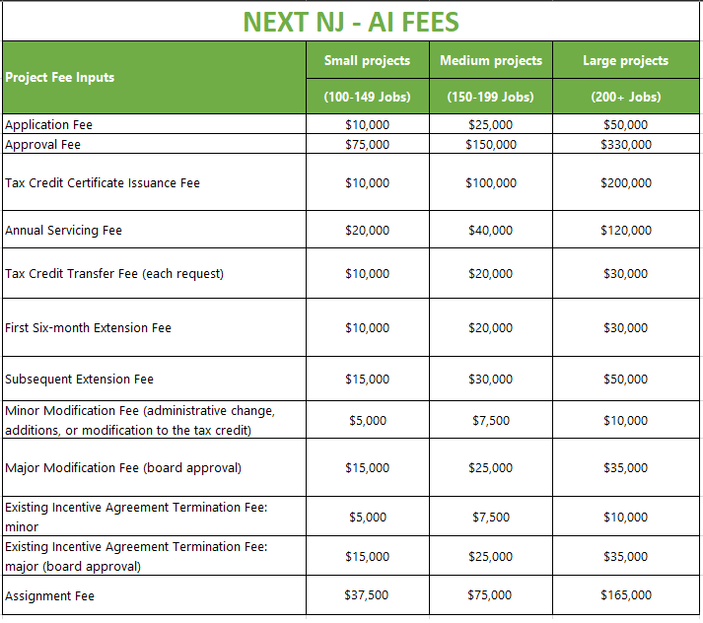
Next NJ Program-AI Fees
  Fee Chart
27
Notes:
The Next NJ Program for AI fees is structured to be scalable, with the fees tied directly to the size of the project, which is determined by the number of employees and the jobs created.

Slide 28


Conclusion
Benefits to the State
The Next NJ Program-AI presents an exciting opportunity for businesses looking to grow or establish themselves in a state dedicated to innovation and economic expansion.
It's a mutually beneficial arrangement, drawing substantial investments to New Jersey and promoting sustained job growth.
The Next NJ Program-AI will reinforce New Jersey's status as a frontrunner in the innovation economy.
Projects are NOT ELIGIBLE if they have already commenced site cleanup, unless they could not have known the extent of contamination.
Notes:
The Next NJ Program for AI is an exciting tax credit initiative designed to drive major investment, create high-paying jobs, and position New Jersey as a leader in the booming AI industry! With a minimum investment of $100 million and the creation of at least 100 full-time jobs, this program offers powerful incentives for companies to bring their capital and innovation to New Jersey. It supports businesses investing in large-scale AI data centers and cutting-edge projects like visual perception, speech recognition, decision-making, language translation, and generative AI. Eligible companies can earn tax credits based on their investment and job creation, fueling growth and innovation across the state!

Slide 29




Visit the www.njeda.gov/nextnjai
@NewJerseyEDA | njeda.gov | 609.858.6767
29
Notes:
For more information, please visit our website at www.njeda.gov/nextnjai, and be sure to follow us on our social media channels.

Slide 30
Public Feedback Policy
Feedback may be submitted verbally by using the “raise hand” function in Zoom, or in writing through the Q&A feature. Input will not be accepted verbally until the NJEDA has concluded its presentation.
Each member of the public who wishes to speak during the public feedback period should use the “raise hand” function in Zoom. The host will acknowledge each speaker in the order in which they raised their hand and will open the speaker’s microphone to make their statement.
To ensure everyone that chooses to has an opportunity to speak, each speaker will have a maximum of three (3) minutes to speak and should limit input to matters pertaining to the Next New Jersey Program-AI.
Each member of the public will have one opportunity to provide remarks. If time remains at the end of the session, we will reopen the opportunity for additional remarks.
Speakers should not expect to engage in a dialogue. NJEDA staff may respond to basic questions or clarify a speaker’s input. However, NJEDA staff are not obligated to answer impromptu questions or address remarks from members of the public.
Speakers and members of the public should at all times maintain proper decorum and shall
provide their remarks in a civil manner.
30
Notes:
Thank you for attending the Next NJ Program for AI presentation. I would now like to hand it over to Virginia, who will facilitate the next portion of the session.

