Slide 1

Emerging Developers
Sample Application

Slide 2

Program
Short intro
ELIGIBILITY
It is recommended that prior to beginning the application all applicants review the applicant checklist available at:
www.njeda.gov/
Notes:
All employees must work in New Jersey as evidenced by WR-30 filings. There is no minimum employee number and sole proprietors are eligible.

Slide 3
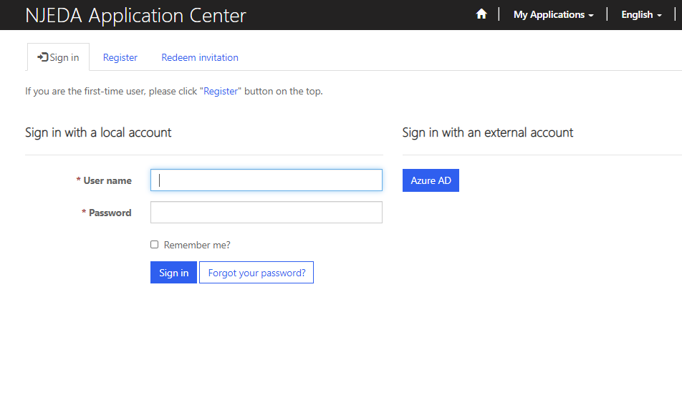
NJEDA Application Center Sign In Page
https://programs.njeda.com/en-US/
If this is the first time you are using this portal to apply for an NJEDA product, please click “Register” button on the top
If you have forgotten your password, simply click on the “Forgot your password?” button and follow the instructions. An email will be sent enabling you to reset. Please note that your Username will be included in
the email you receive. Be sure to confirm that you are using the correct username when you sign in.

Slide 4
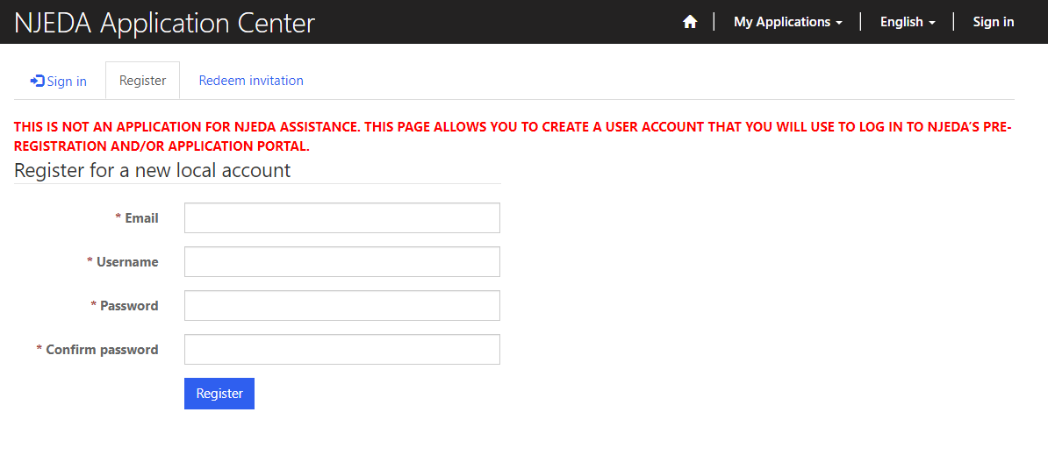

How to Register Your Email Address
Enter your email, username (can be the same as your email) and password.
  Passwords must contain characters from at least three of the following four classes: uppercase, lowercase, digit, and non-alphanumeric (special).
Once information is filled in click “Register”
PLEASE MAKE SURE TO WRITE-DOWN/ SAVE YOUR USERNAME AND PASSWORD

Slide 5
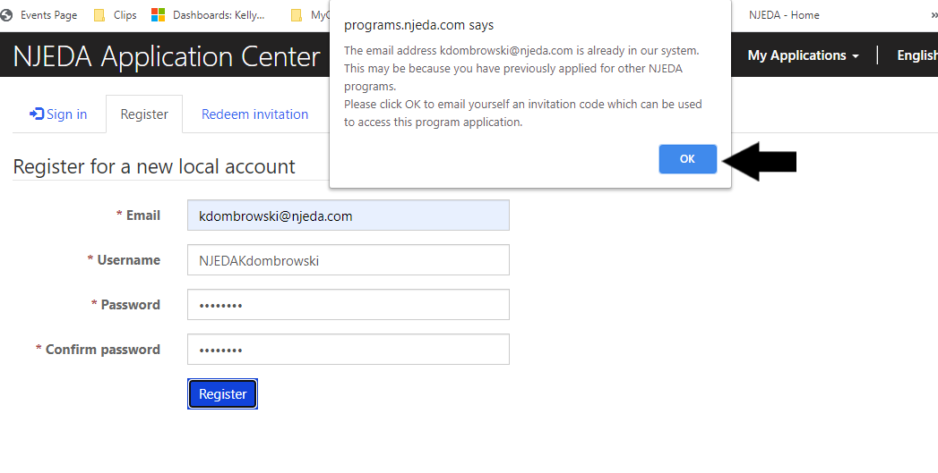
If Your Email is Recognized By the Application Portal
If after clicking on “Register” you receive the following pop-up, that indicates that your email address is already recognized in our system, and you need to request an Invitation Code. Begin by clicking on the blue “OK” button.

Slide 6
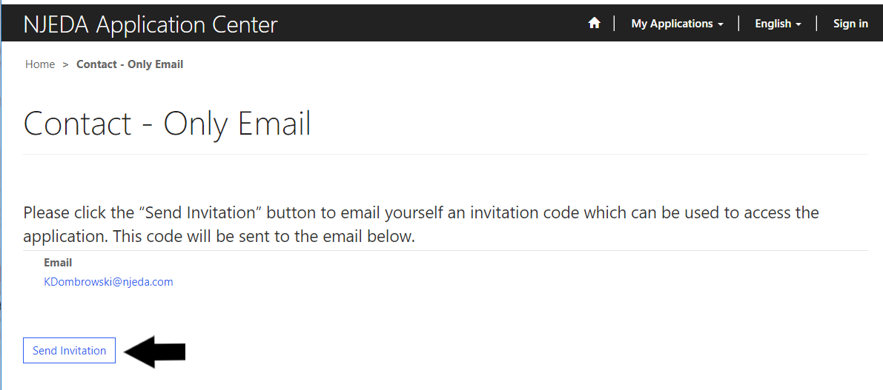
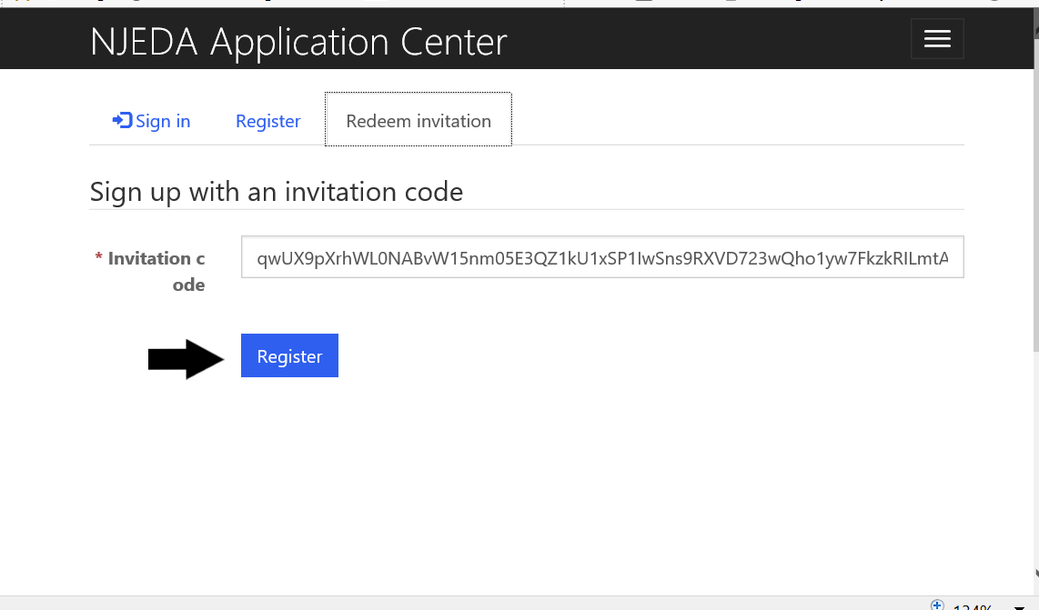
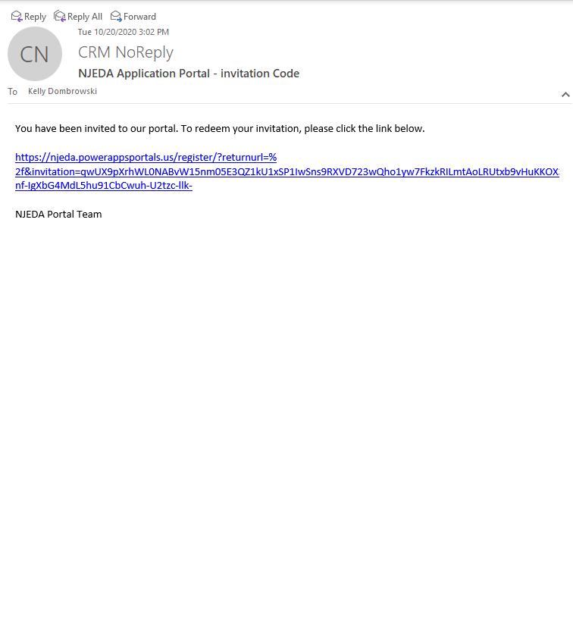
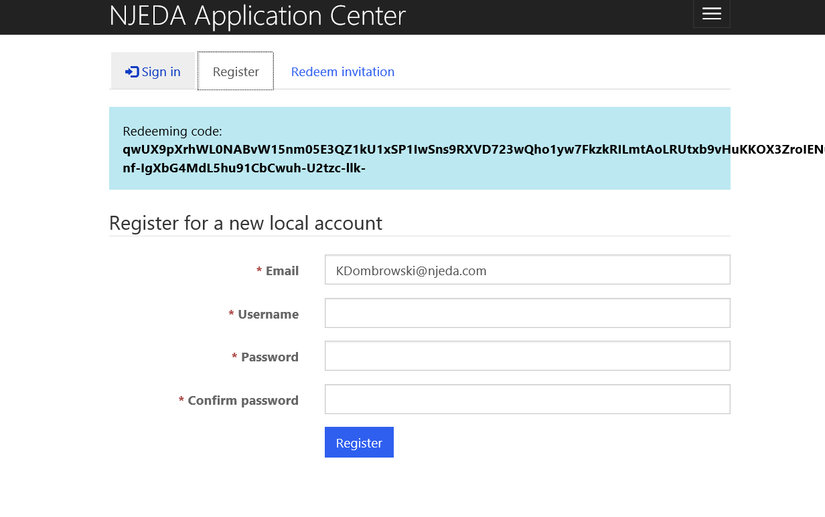
Redeeming An Invitation Code
1. Click SEND INVITATION to email yourself an invitation code.
3. The link from email should send you to this page on the portal. Make sure you are on the Redeem Information tab and Click REGISTER
2. Check your email (including junk/spam) for an email from CRMNoReply. Click the link in that email.
4. Fill in the information requested and click REGISTER to complete the process. Remember this username and password – you will need it each time you access the application portal

Slide 7
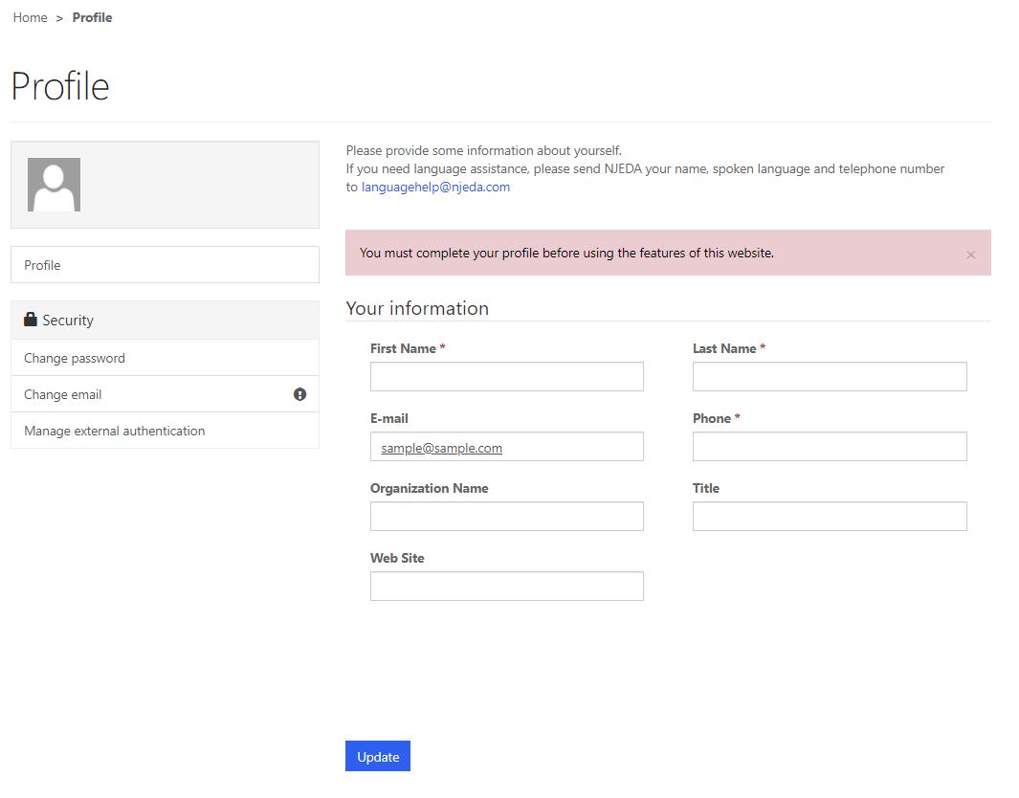
Setting Up Applicant Profile
(If Your Email is New and Not Recognized by the Portal)
Setting up your Profile
Once you click Register, you must enter “Your Information”
First Name, Last Name and Phone Number is Required
Confirm your email address is correct (this will be the primary way the NJEDA contacts your business)
Once complete, click “Update”

Slide 8
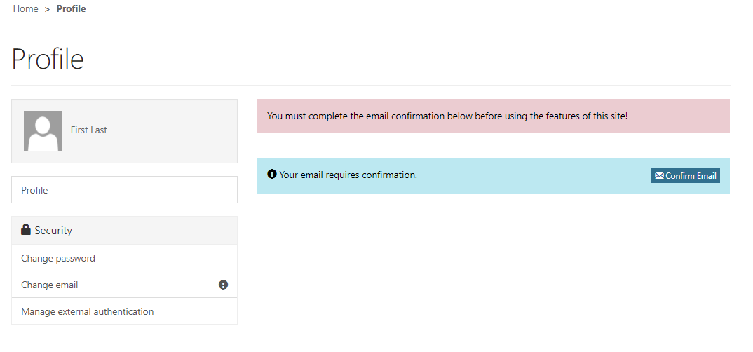
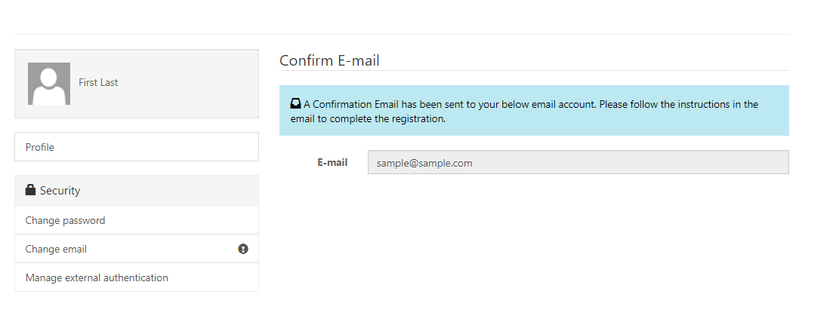

Confirming Email
Confirming Your Email
Once “Your Information” is complete, you will need to confirm your email.
Within the blue box, click on “Confirm Email”.
An email will be sent to the email address listed.
Go to your email and follow the instructions within the email.
You MUST confirm your email address.
Once your email is confirmed please return to the portal to begin your application.

Slide 9

Trouble Logging Into the Portal?
If you are having any issues creating a username or password, redeeming an invitation code, or generally logging into the portal, please call our Customer Care line (844) 965-1125 and a representative will assist you.

Slide 10
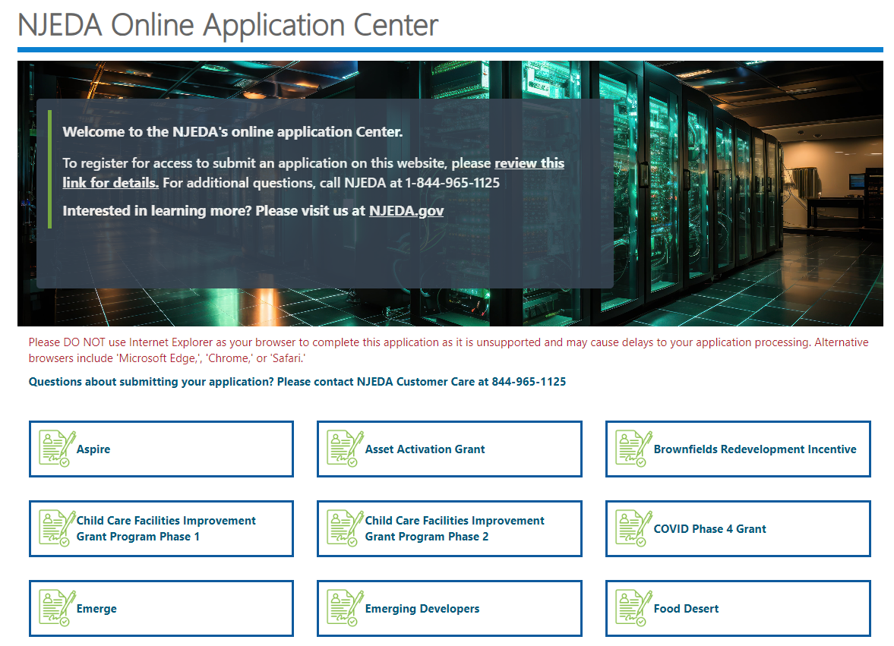
NJEDA Application Center Sign In Page
https://programs.njeda.com/en-US/
Click here to begin application

Slide 11
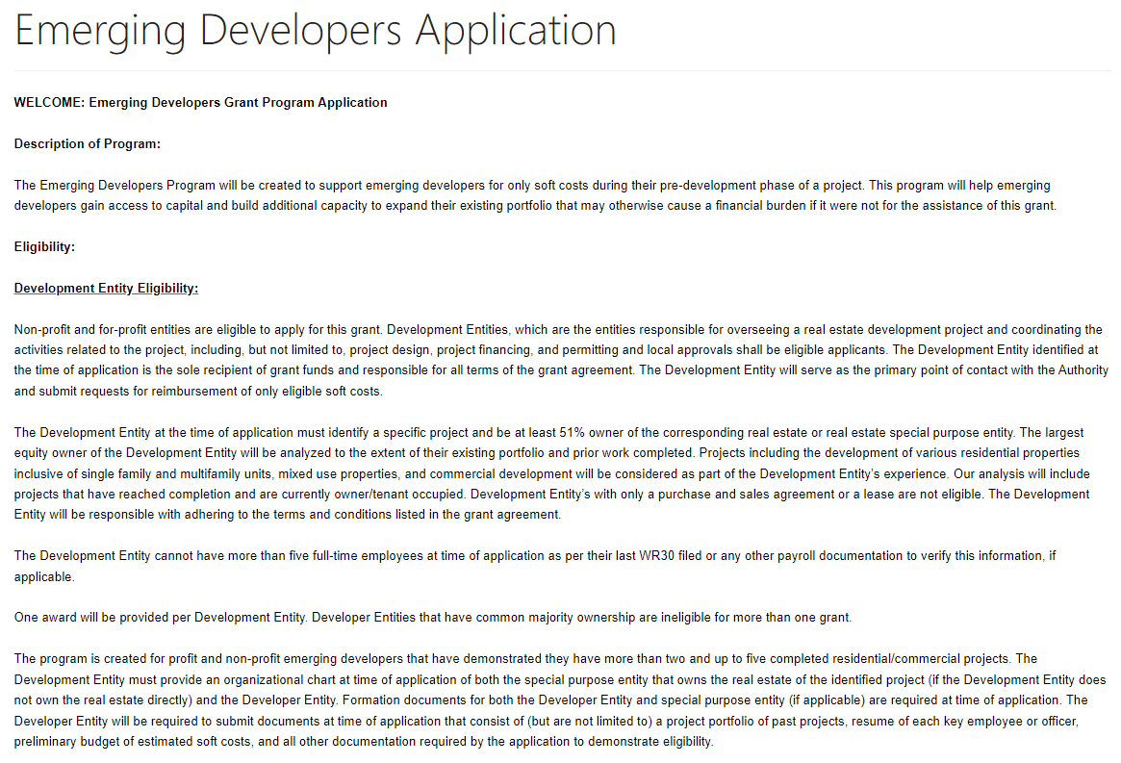
Start Application
[Insert New Screenshot of Application Welcome Page]
Read this information before starting your application.
Click CREATE button to start application.

Slide 12
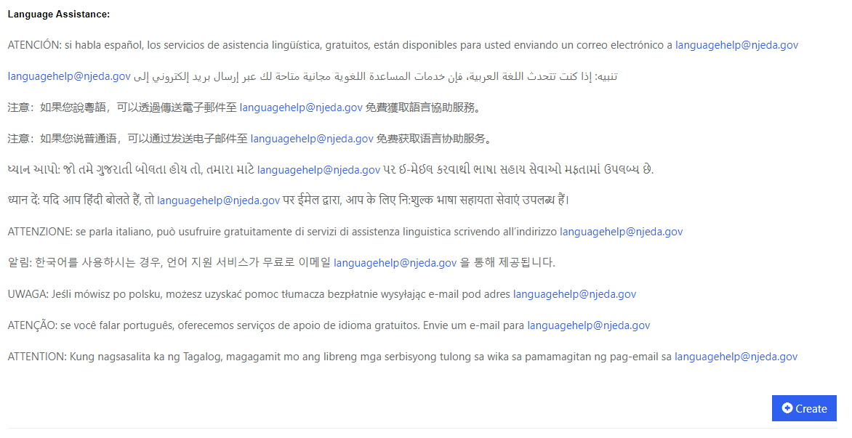
Start Application Continued
[Insert New Screenshot of Application Welcome Page]
Click CREATE button to start application.

Slide 13
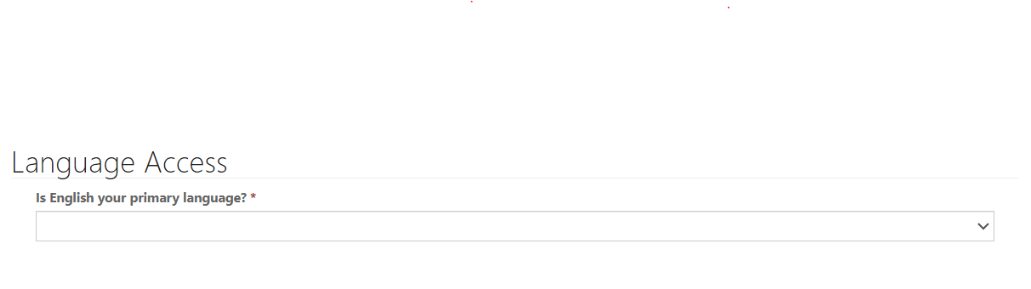
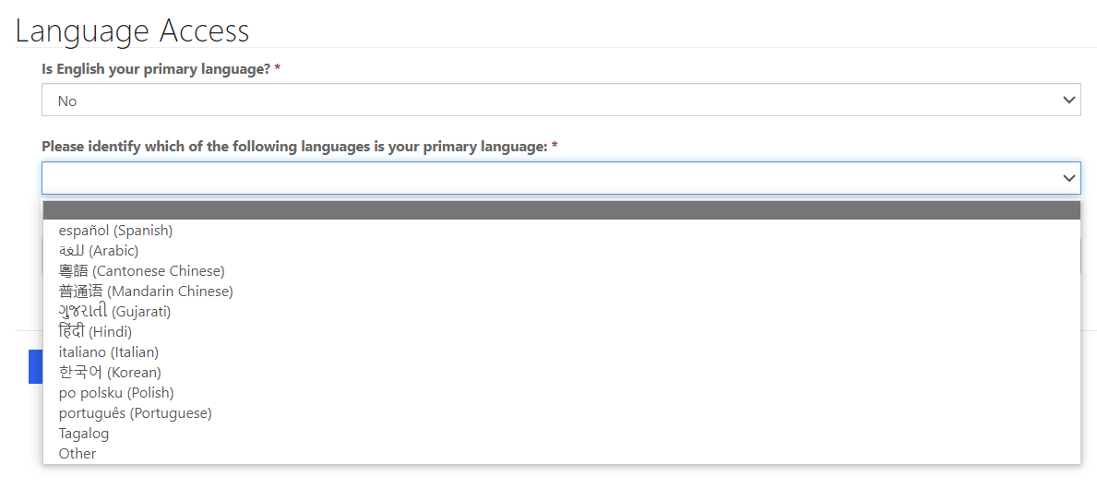
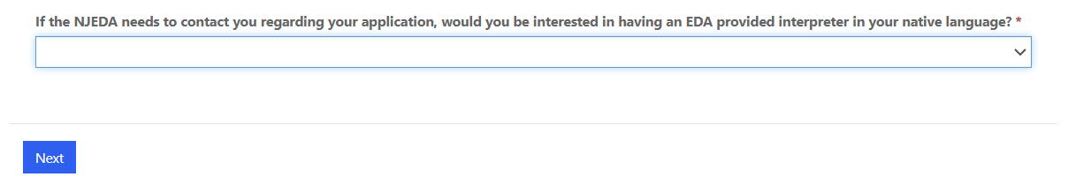
Language Access
Provide a “Yes/No” response to indicate whether English is your primary language or select “Prefer Not to Answer”.
Free language assistance services are available to you by sending an email to languagehelp@njeda.gov.
If the NJEDA needs to contact you regarding your application and you would be interested in having an interpreter in your native language, please answer “No” to “Is English your primary language?” and “Yes” to the question that appears.

Slide 14
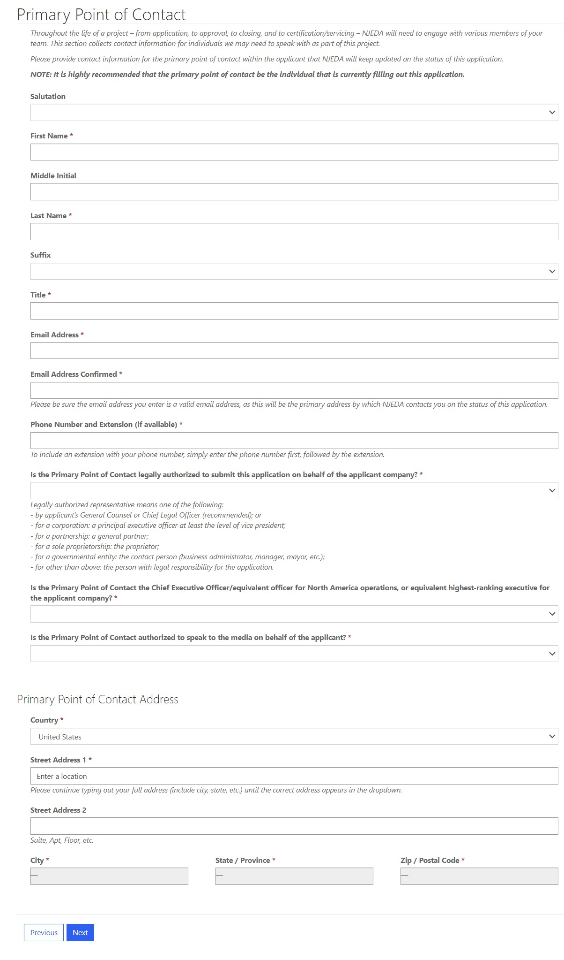
Primary Point of Contact
Provide contact information for the Primary Point of Contact for this application
Is the Primary Point of Contact legally authorized to submit the application on behalf of the applicant company?*
Is the Primary Point of Contact the CEO?*
Is the Primary Point of Contact authorized to speak to the media on behalf of the company?*
If the answer is “No” to any of the above questions, the applicant will have an opportunity to enter this information later in the application.

Slide 15
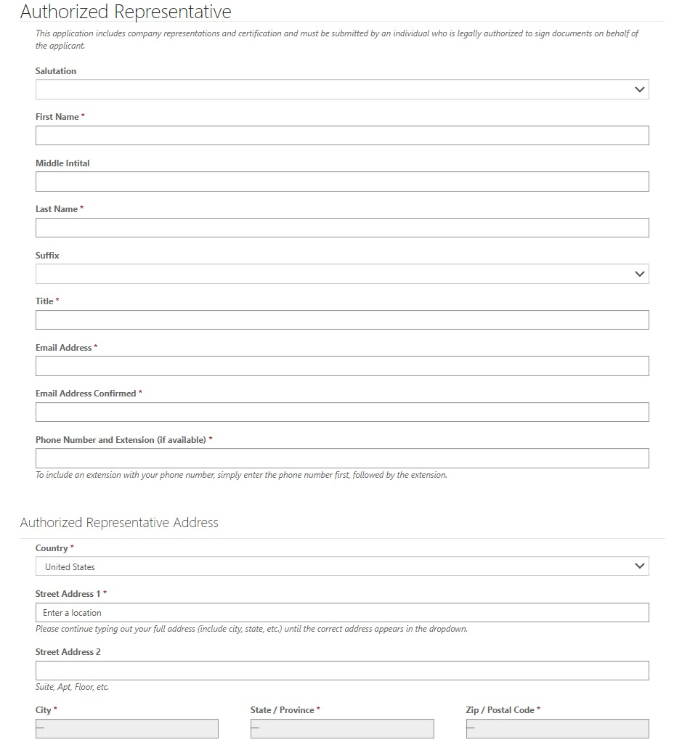
Authorized Representative
If the Primary Point of Contact is NOT the Authorized Representative, the applicant will be prompted to fill out the contact information for the Authorized Representative.
The application must be submitted by an individual who is legally authorized to sign documents on behalf of the applicant company.
NOTE: If the Primary Point of Contact is the Authorized Representative you will not see this page.
Please type your full address into the “Street Address 1” box (include city, state, etc.) until the correct full address appears in the dropdown menu underneath, then click on the correct address.

Slide 16
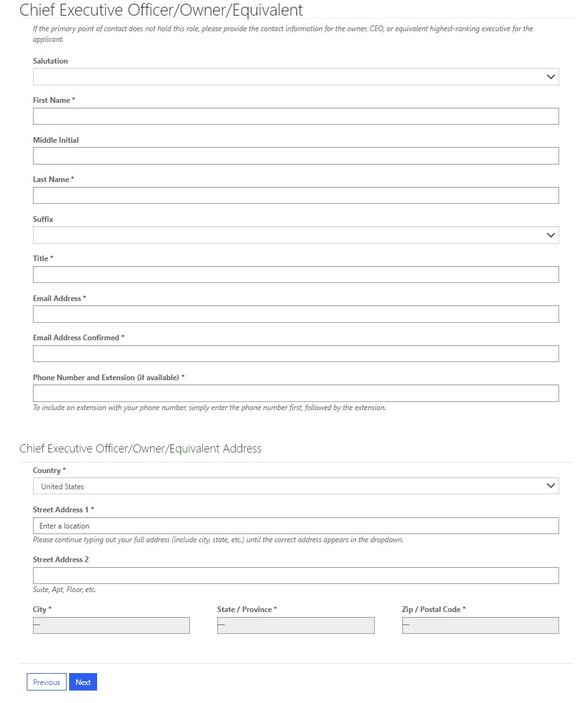
Chief Executive Officer/Owner/Equivalent
If the Primary Point of Contact does not hold this role, please provide the contact information for the CEO, owner, or equivalent highest-ranking executive for the applicant company.
NOTE: If the Primary Point of Contact is the CEO, owner, or equivalent highest-ranking executive you will not see this page.

Slide 17
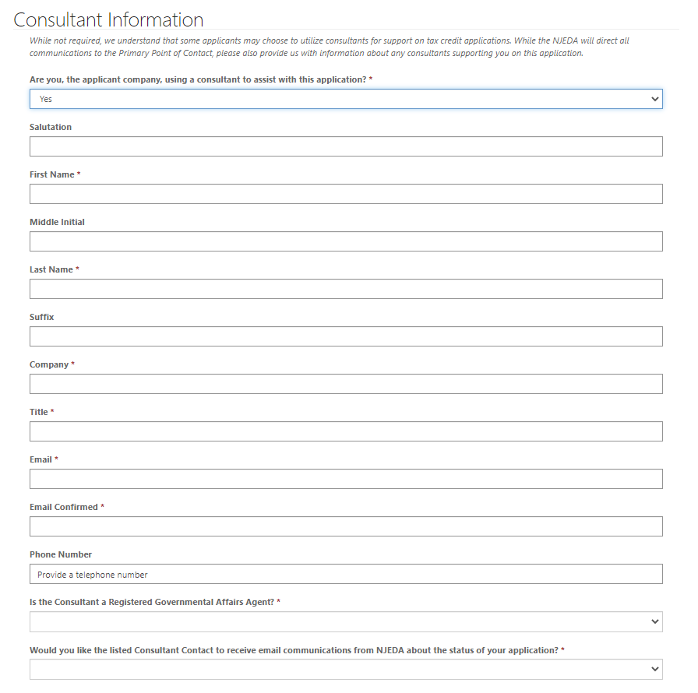
Consultant Information
While not required, we understand that some applicants may choose to utilize consultants for support on tax credit applications.
Are you, the applicant company, using a consultant to assist with this application?
If YES, you will be prompted to fill out additional contact information for the Consultant.

Slide 18
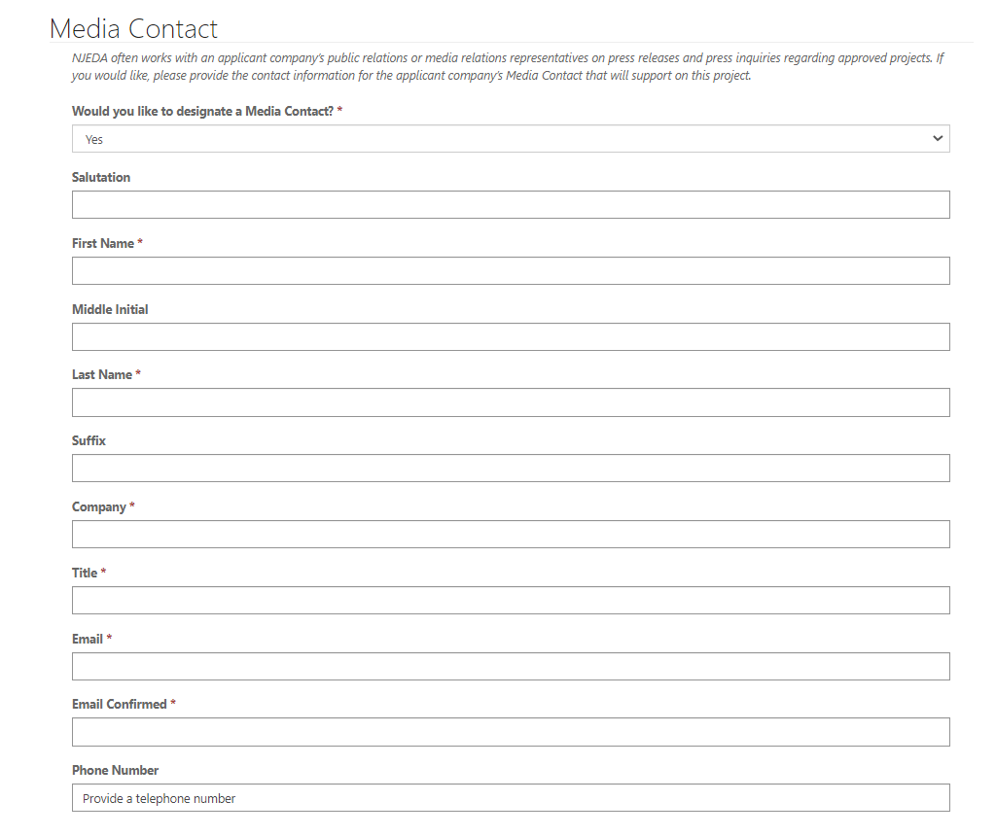
Media Contact
Please indicate if the applicant organization would like designate a Media contact to communicate with a NJEDA representative.
If YES, you will be prompted to fill out additional contact information for the Media Contact.

Slide 19
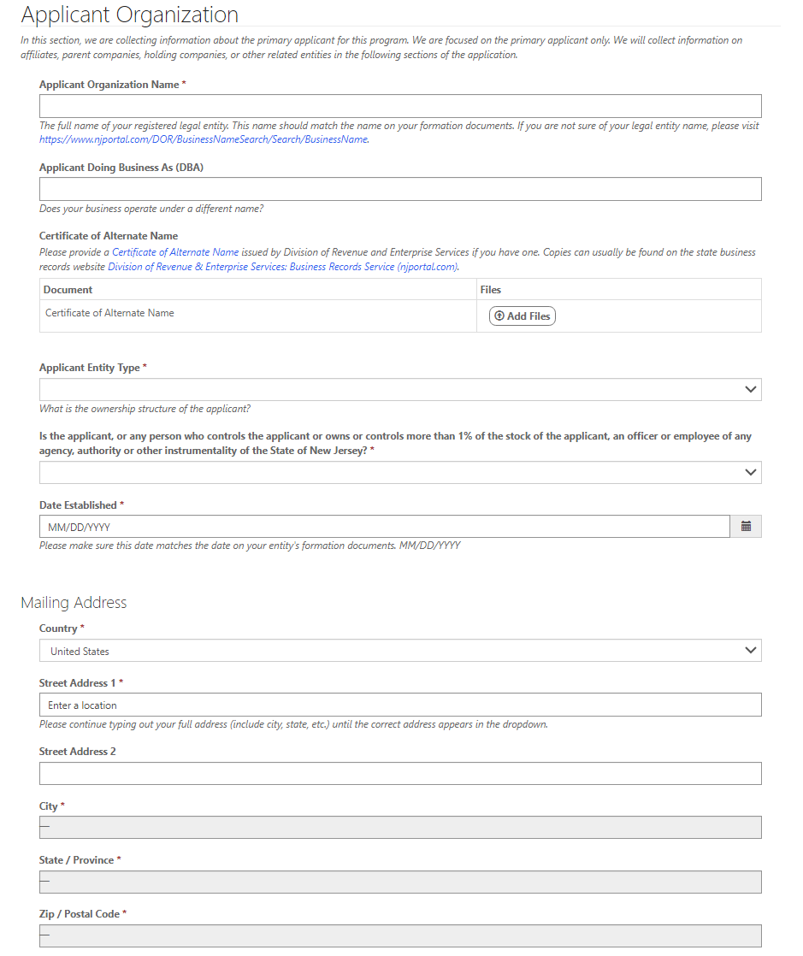
Applicant Organization (1/3)
Please provide information about the company that is applying for assistance.

Slide 20
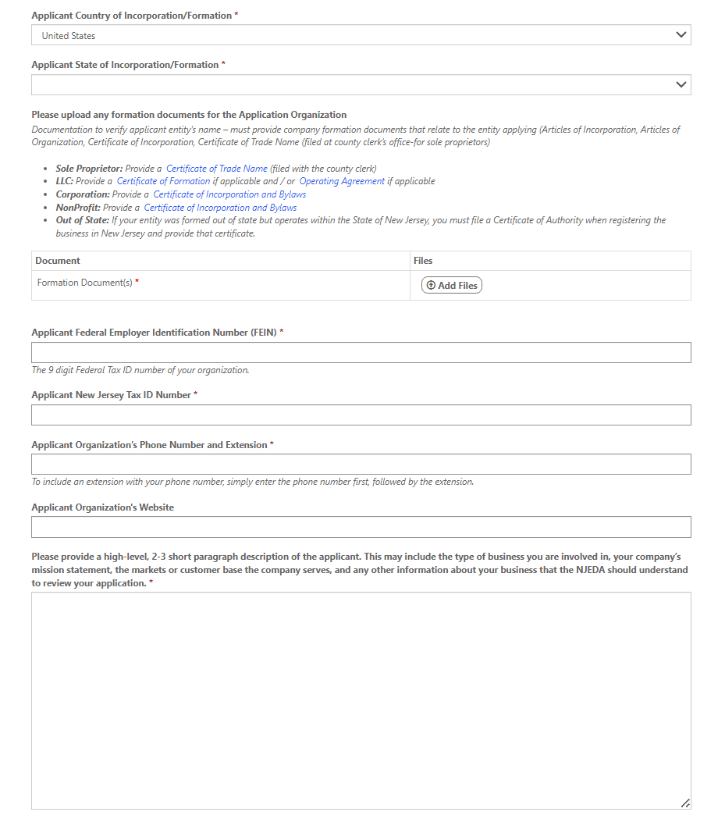
Applicant Organization (2/3)
Upload applicant formation documents.*
Formation documents can include Articles of Incorporation, Articles of Organization, Certificate of Incorporation, or Certificate of Trade Name.
Provide a high-level description of the applicant company.
* Required documentation

Slide 21

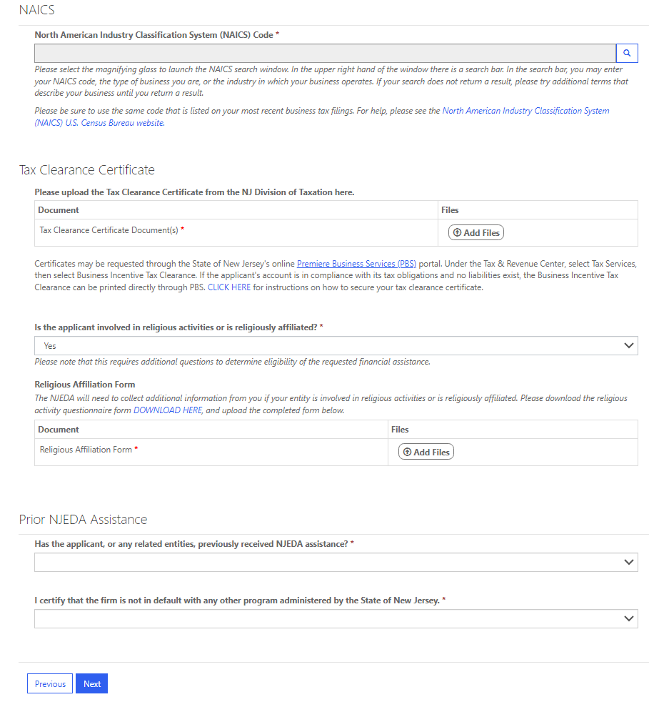
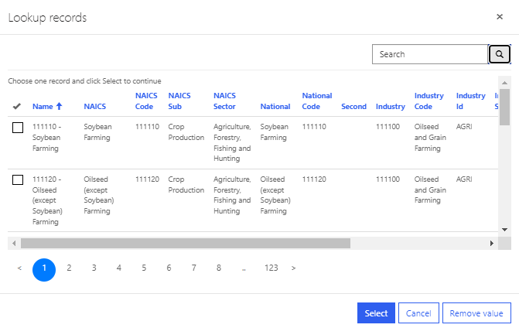
Applicant Organization (3/3)
Click the magnifying glass to launch the NAICS search window.
Please be sure the NAICS code identified is the same code that is listed on your most recent business tax filings.
Upload NJ Tax Clearance Certificate.*
Certificates may be requested through the State of New Jersey's online Premier Business Services (PBS) portal. Under the Tax & Revenue Center, select Tax Services, then select Business Incentive Tax Clearance. If the applicant's account is in compliance with its tax obligations and no liabilities exist, the Business Incentive Tax Clearance can be printed directly through PBS.
Is the applicant involved in religious activities or religiously affiliated?
IF YES The NJEDA will need to collect additional information from you if your entity is involved in religious activities or is religiously affiliated.
For a copy of the Religious Activity Questionnaire form CLICK HERE.*
* Required documentation

Slide 22
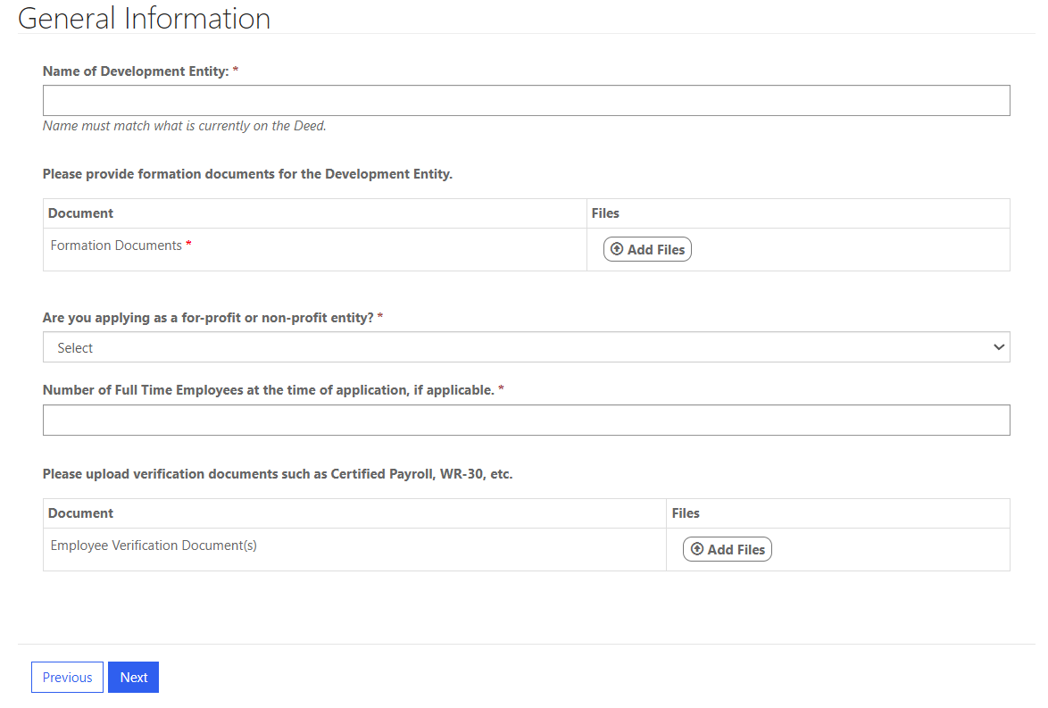
General Information

Slide 23
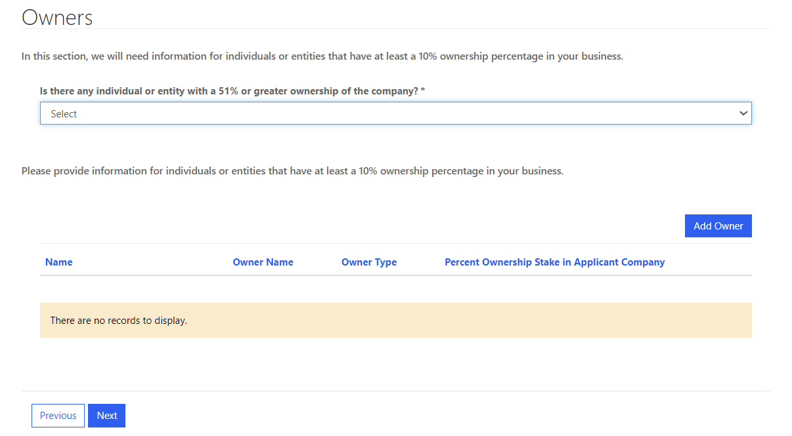
Owners
Warning Appears if “No” is selected: There must be an individual, firm, or trust that owns at least 51% of the applicant entity to be eligible for this program.
Click “Add Owner”-Please see next slide

Slide 24
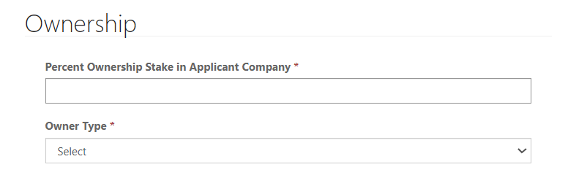
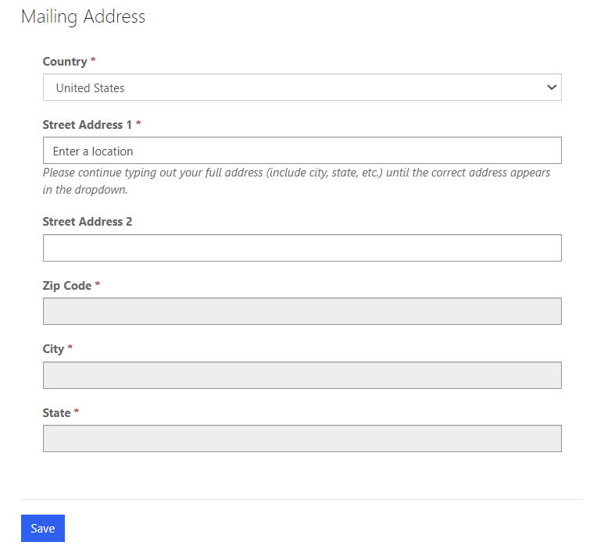
Owners Continued

Slide 25
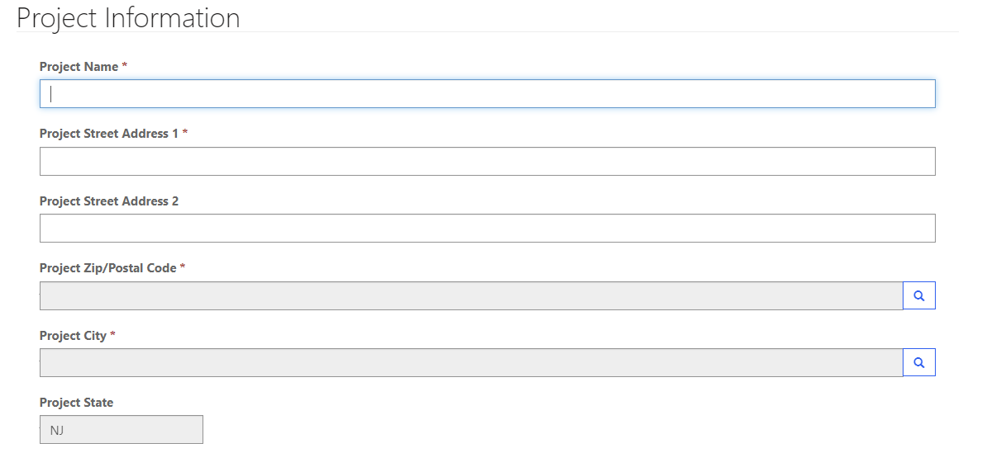
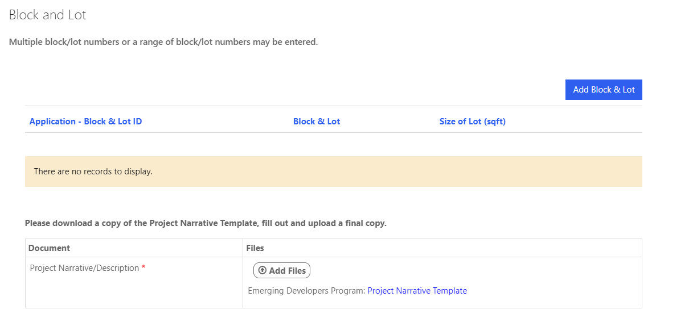
Project Information
Click “Add Block & Lot”-Please see next slide

Slide 26
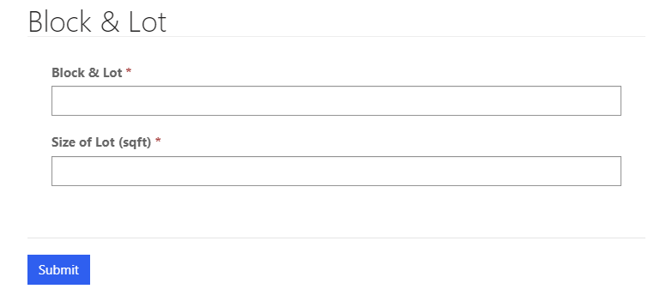
Project Information Block and Lot

Slide 27
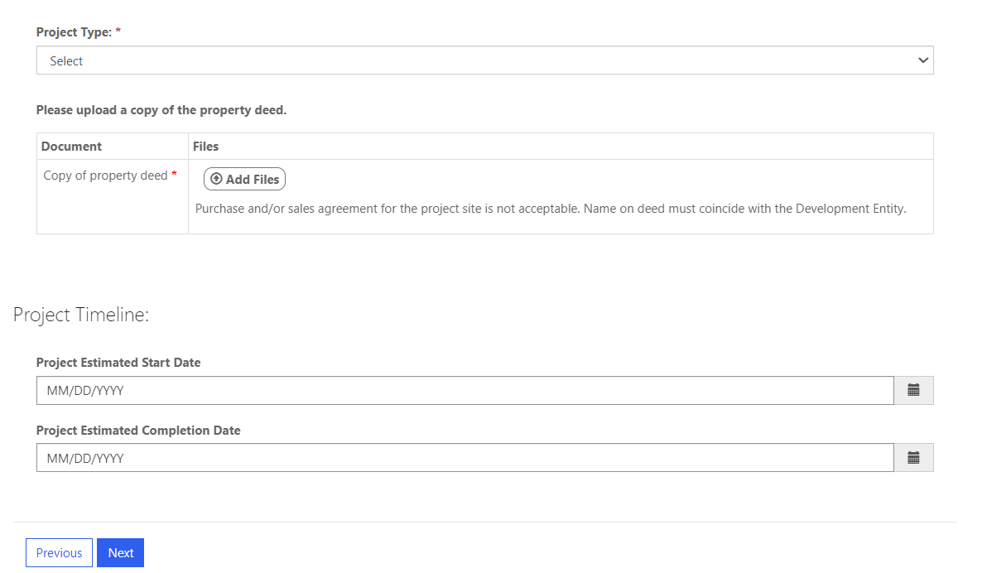
Project Information Continued

Slide 28
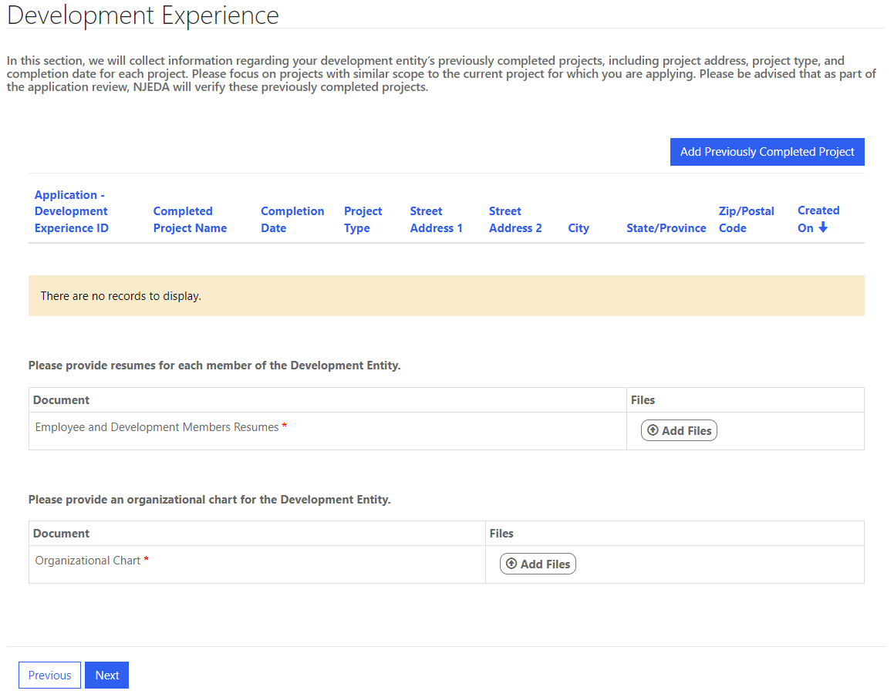
Development Experience
Click “Add Previously Completed Project”-Please see next slide

Slide 29
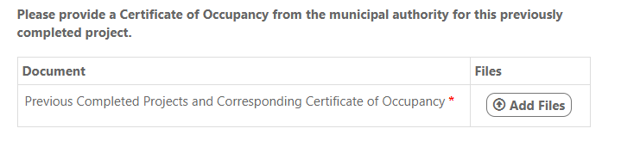
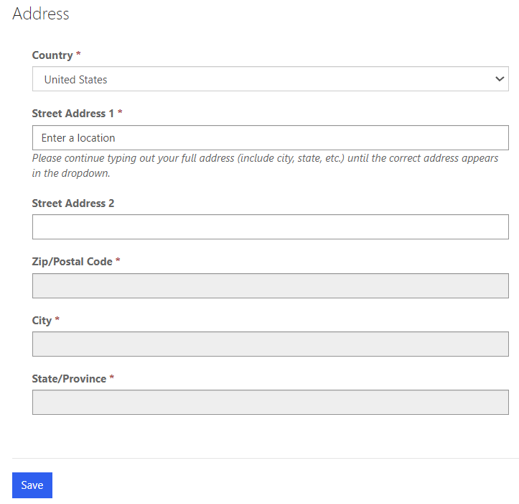
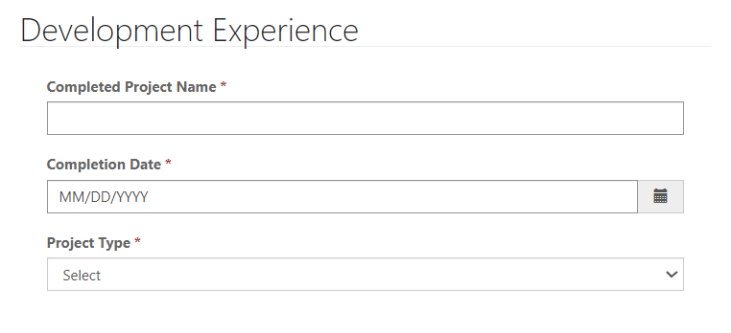
Development Experience Continued

Slide 30
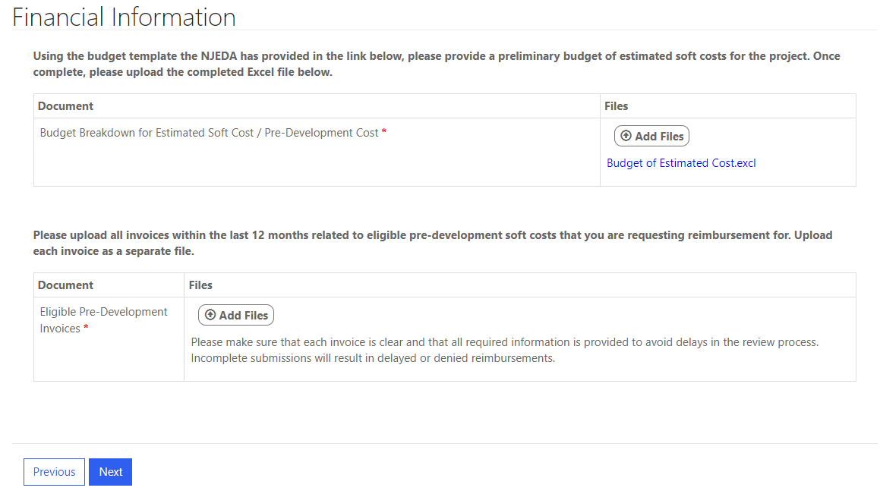
Financial Information

Slide 31
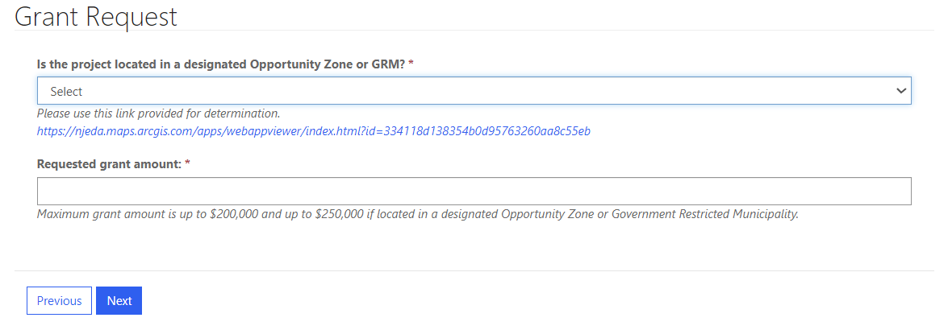
Grant Request

Slide 32
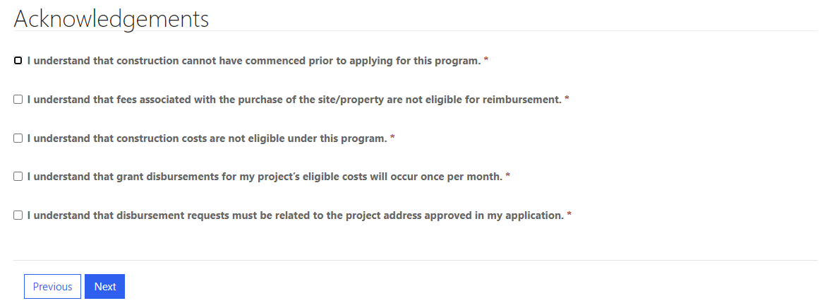
Acknowledgements

Slide 33
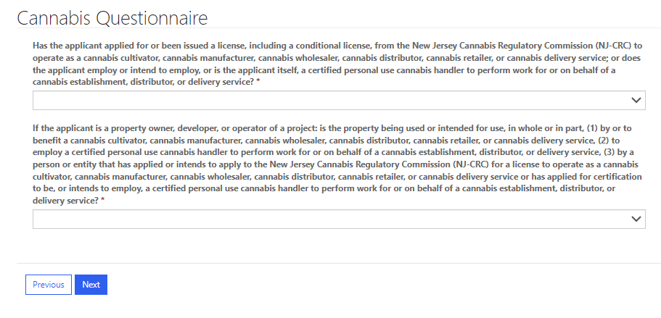
Cannabis Questionnaire
New Jersey State law prohibits certain cannabis licensees and certified personal use cannabis handlers’ employers from receiving or continuing to receive most financial incentive awards.

Slide 34
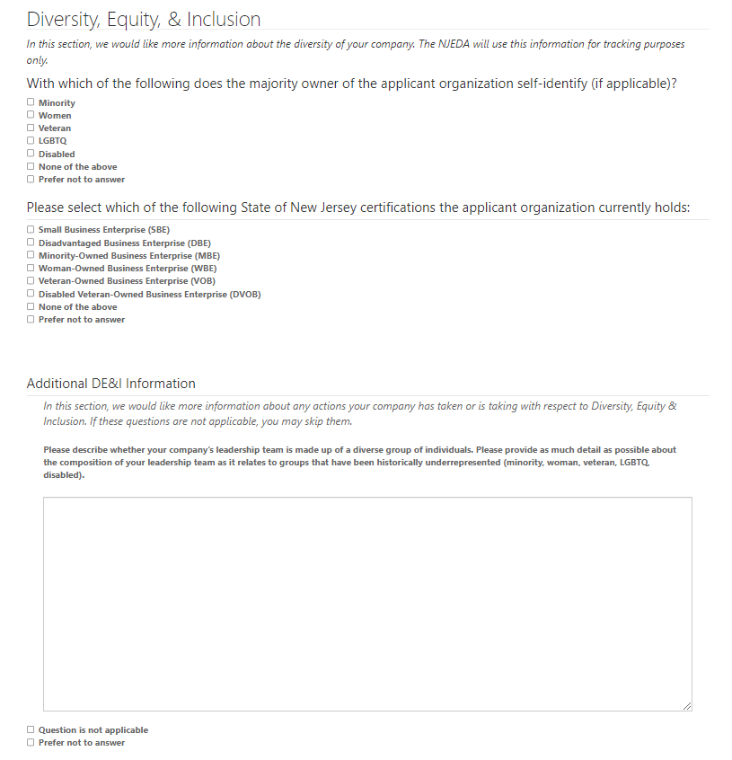
Diversity, Equity, and Inclusion
In this section, we would like more information about the diversity of your company. The NJEDA will use this information for tracking purposes only.

Slide 35
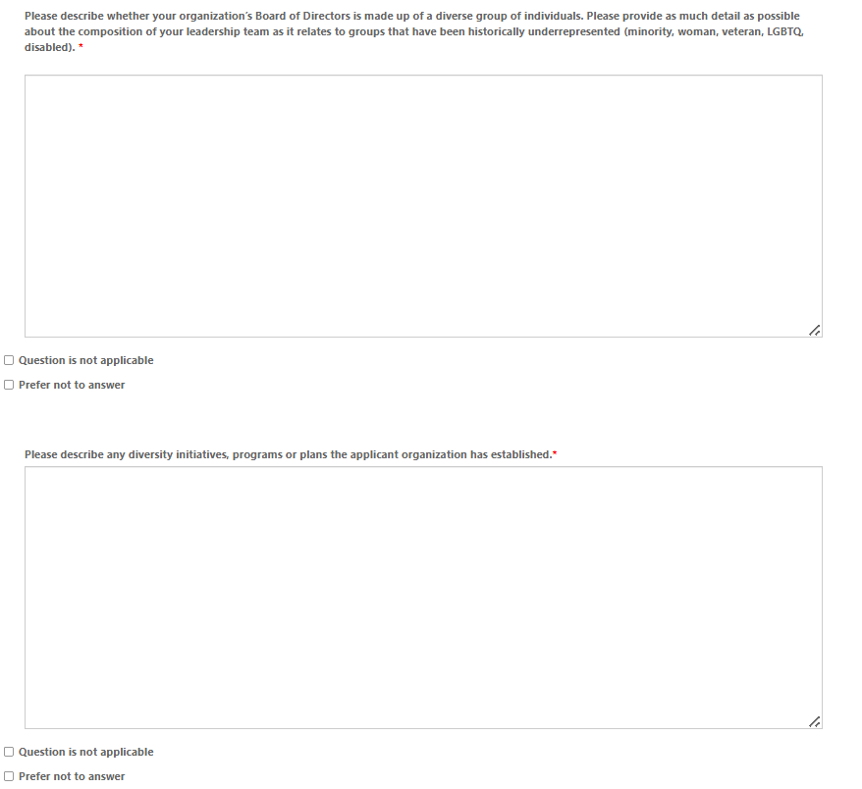
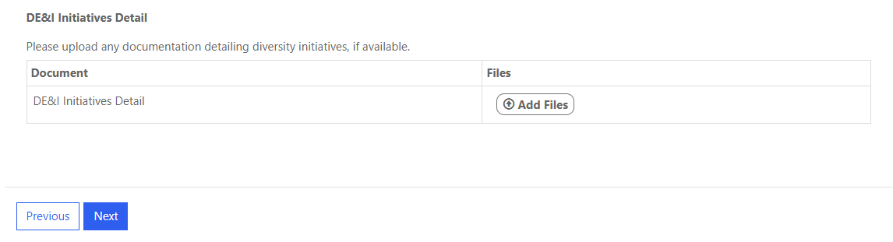
Diversity, Equity, and Inclusion Continued

Slide 36
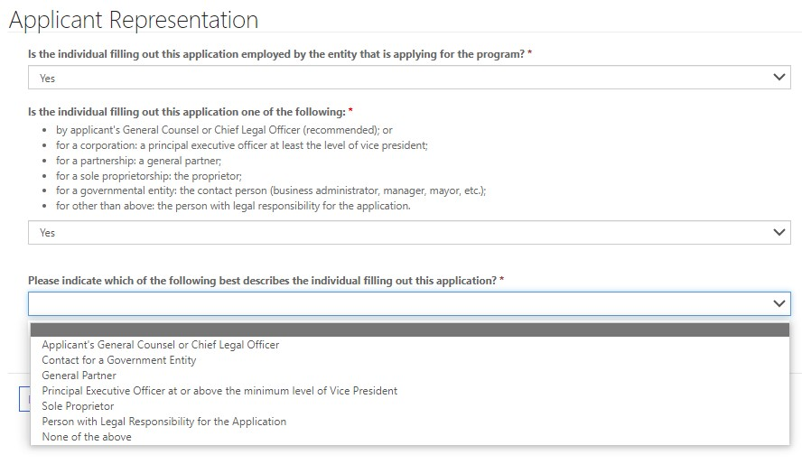
Applicant Representation
The New Jersey Economic Development Authority requires that the Legal Questionnaire, Certification of Non-Involvement in Prohibited Activities in Russia or Belarus Pursuant to P.L. 2022, C. 3, Acknowledgments of Applicant , and Certification of Applicant, are to be completed and signed by one of the following:
by applicant's General Counsel or Chief Legal Officer (recommended); or
for a corporation: a principal executive officer at least the level of vice president;
for a partnership: a general partner;
for a sole proprietorship: the proprietor;
for a governmental entity: the contact person (business administrator, manager, mayor, etc.);
for other than above: the person with legal responsibility for the application.
If you are not an Authorized Representative you will be prompted to Upload the Certifications page, which will require you to download and then upload signed copies of the acknowledgments and certifications listed above (Slide 48).
If you are an Authorized Representative you will be prompted to fill out these pages throughout the application.

Slide 37
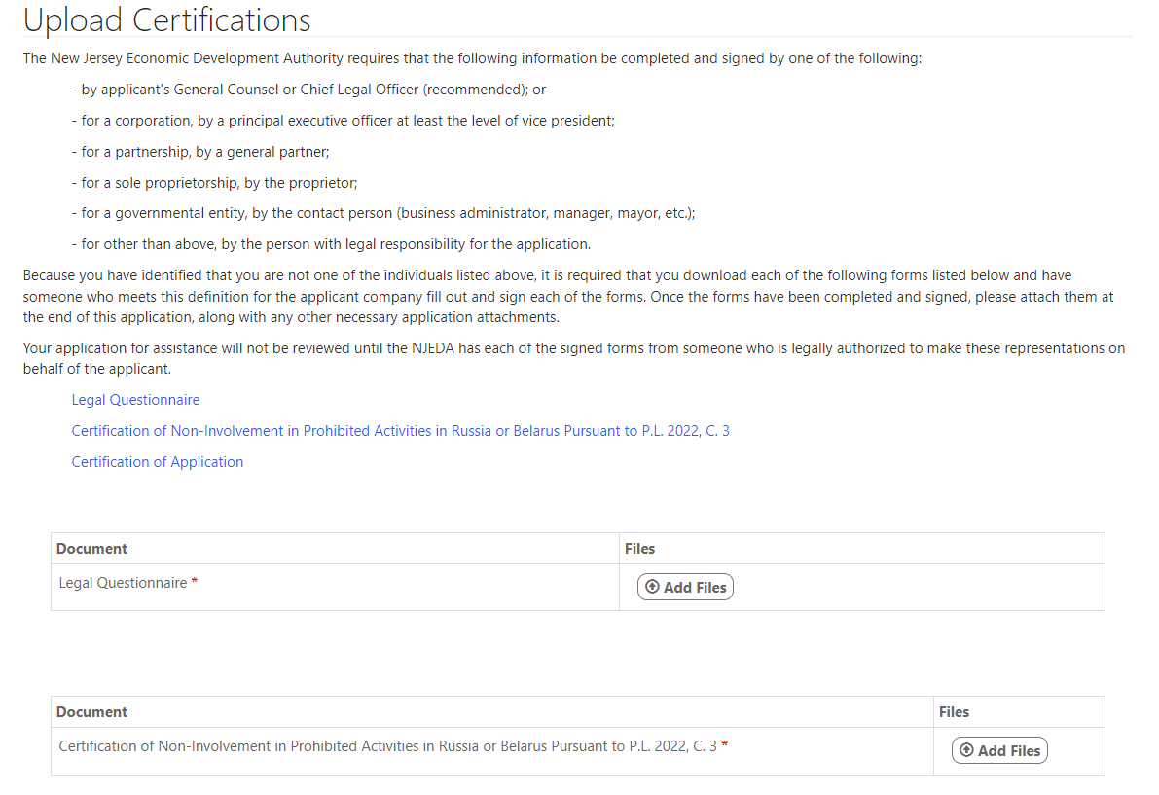
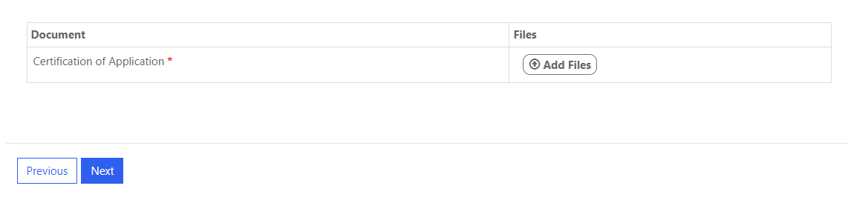
Upload Certifications

Slide 38
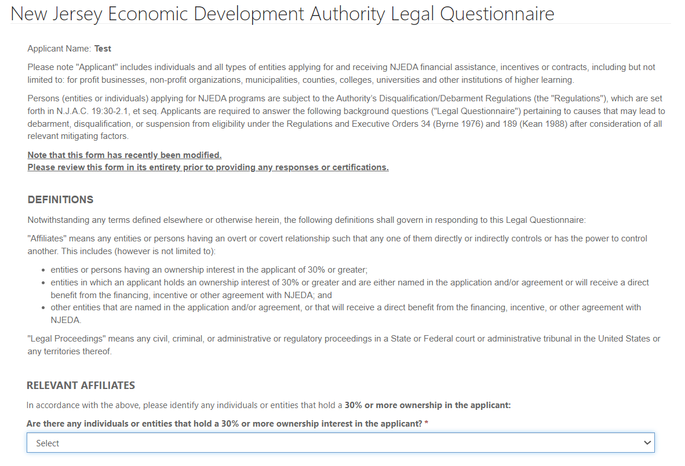
Legal Questionnaire
If the individual filling out the application is an Authorized Representative then they will proceed through the application’s:
Legal Questionnaire
Certification of Non-Involvement in Prohibited Activities in Russia or Belarus Pursuant to P.L. 2022, C. 3
Acknowledgments of Applicant
Certification of Applicant
Click here to download a full copy of the legal questionnaire.

Slide 39
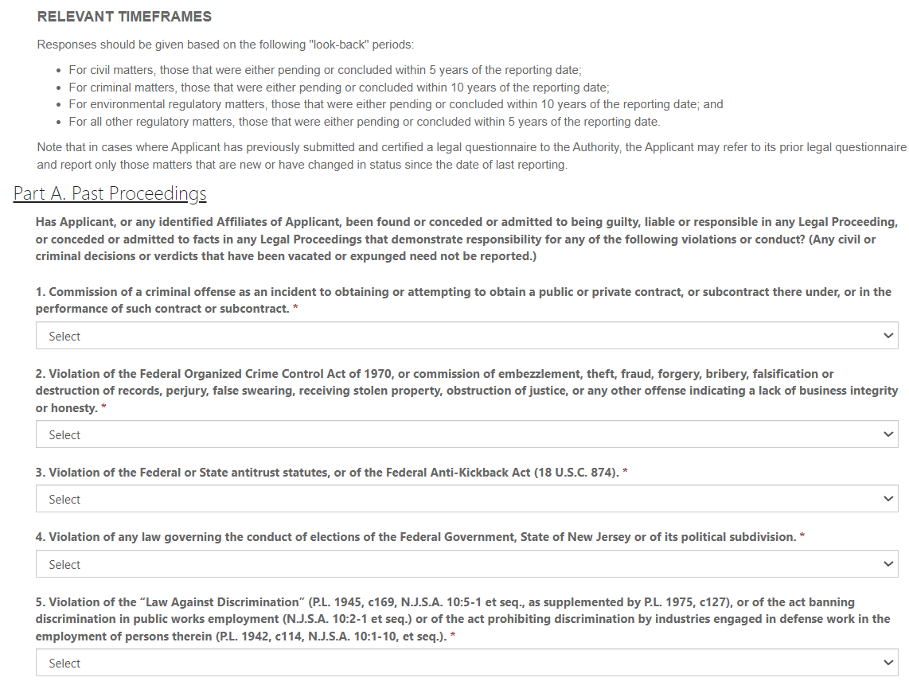
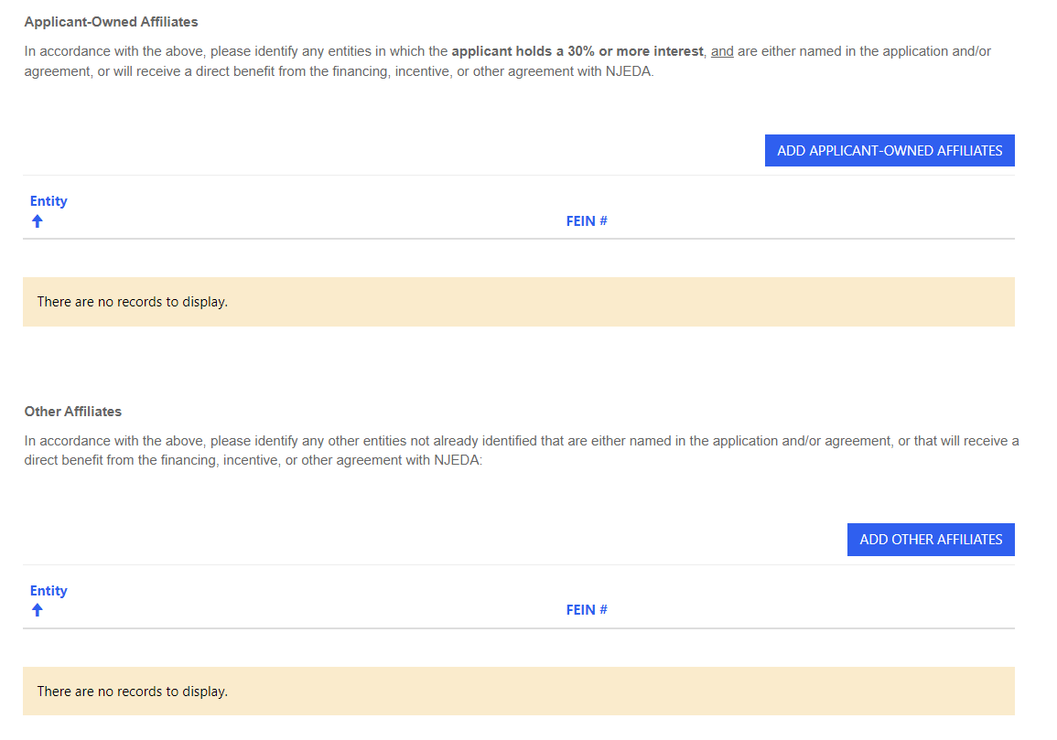
Legal Questionnaire Continued

Slide 40

Legal Questionnaire Continued

Slide 41


Legal Questionnaire Continued

Slide 42

Legal Questionnaire Continued

Slide 43


Certification of Non-Involvement in
Activities in Russia or Belarus

Slide 44

Applicant Certifications

Slide 45

Payment Method

Slide 46


Payment Details

Slide 47

Payment Details Continued

Slide 48

Electronic Signature
Your application will be submitted upon hitting the “Submit” Button.
*The NJEDA will not begin review of your application until the application fee has been received.

Slide 49


Confirmation

Slide 50









https://www.njeda.gov/
@NewJerseyEDA | njeda.gov | 609.858.6767
50

