Slide 1


Project Overview for
Heavy Civil Engineering & Design
Request For Qualifications (RFQ)

Slide 2
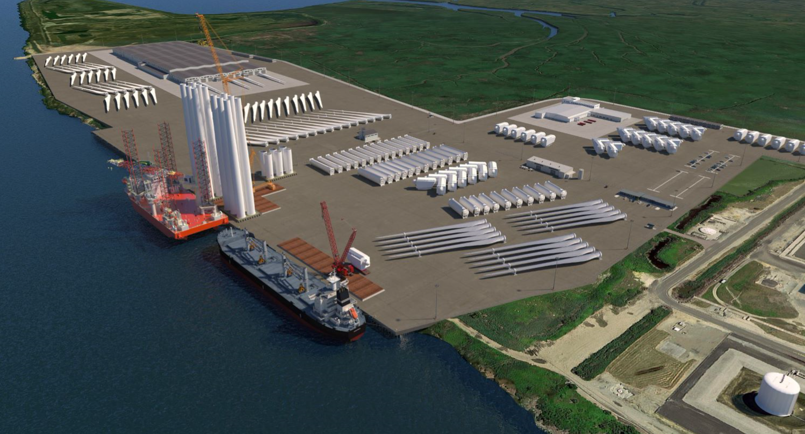

NJ IS DEVELOPING THE NATION’S 1st PURPOSE-BUILT OFFSHORE WIND “HUB”
Located in Salem County (Southern NJ)
Purpose-built for OSW
>220-acres at full scale – enabling “co-location” of marshalling and manufacturing
Publicly funded/financed ($478.2M secured to-date)
Will create >1,500 ongoing jobs + hundreds of construction jobs
$500M increase to NJ’s GDP
Visual illustration
Further information is available at the NJ Wind Port website: https://www.nj.gov/windport/

Slide 3
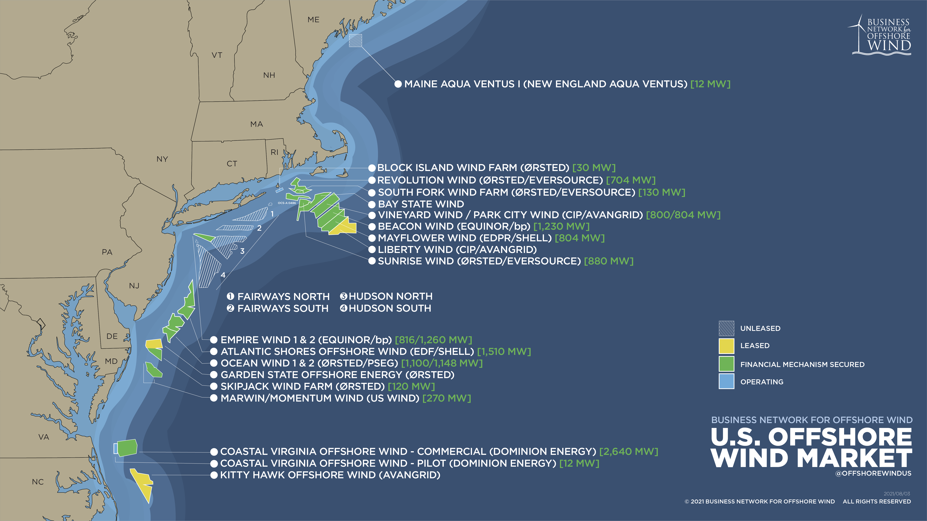
CENTRALLY LOCATED ALONG THE WIND BELT, THE NJWP WILL SERVE AS A REGIONAL ASSET
NJ WIND PORT

Slide 4

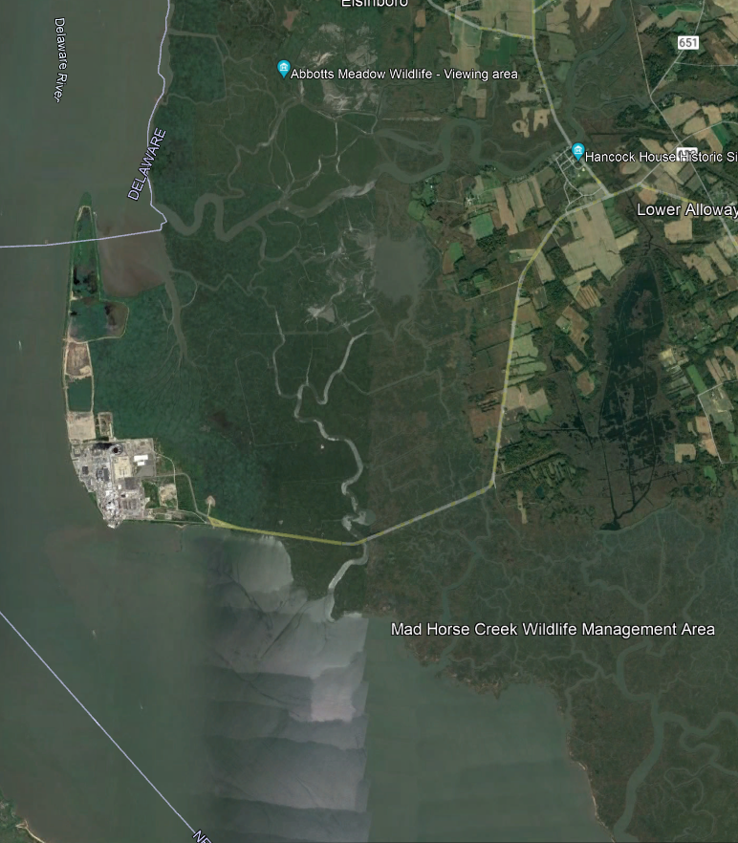
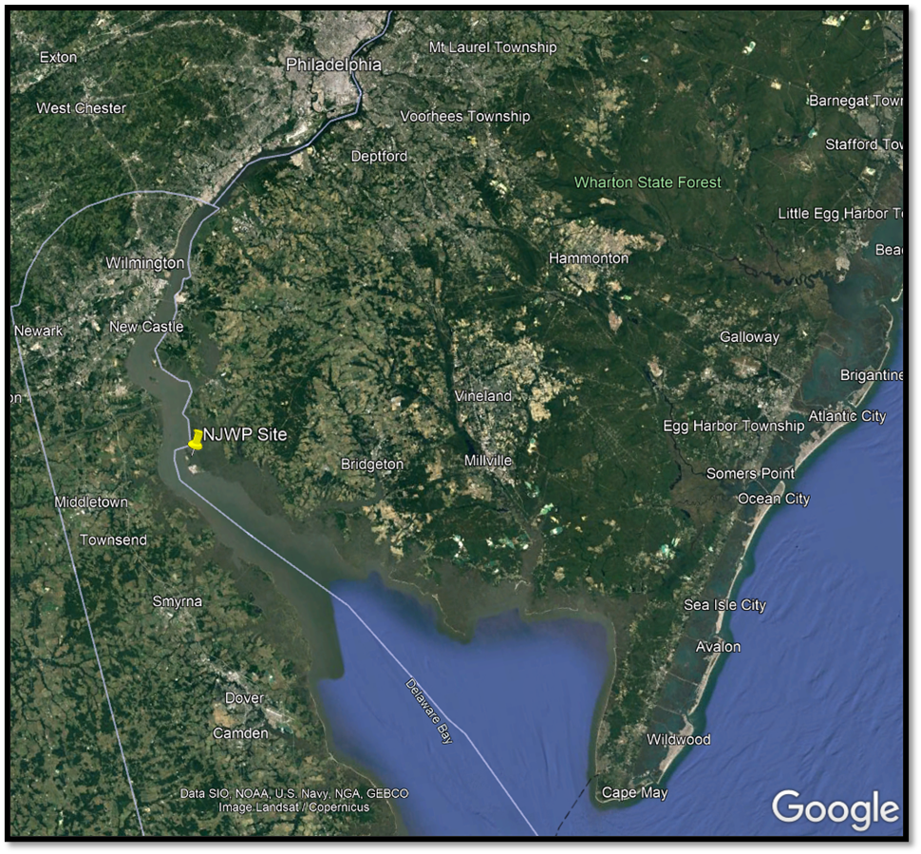
Site Location

Slide 5
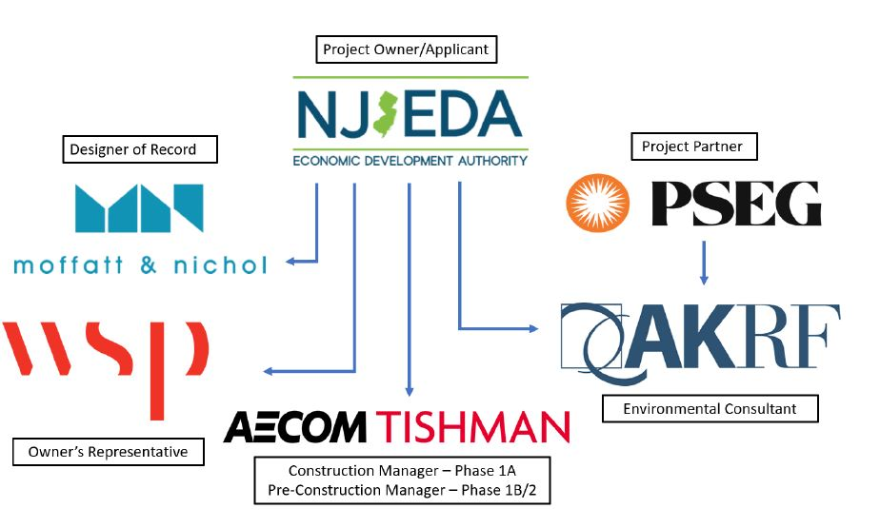
NJWP Project Tree
Partner/Landowner*
Approximately 50% of NJWP Property is leased from PSEG

Slide 6
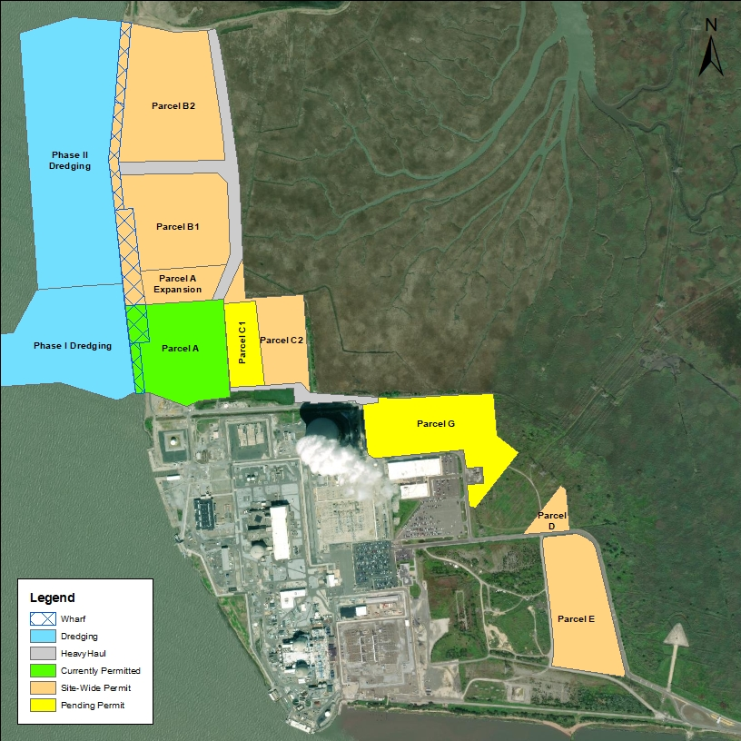
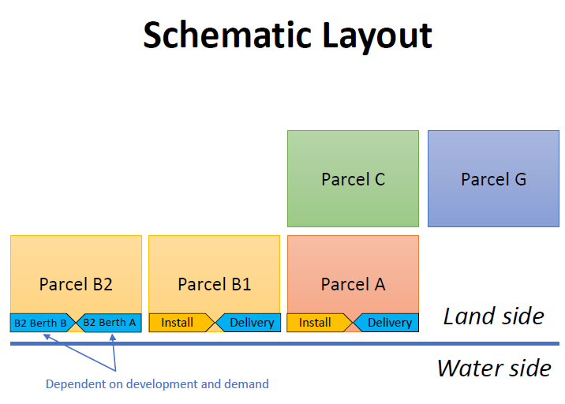
Site Overview/Parcel Layout

Slide 7
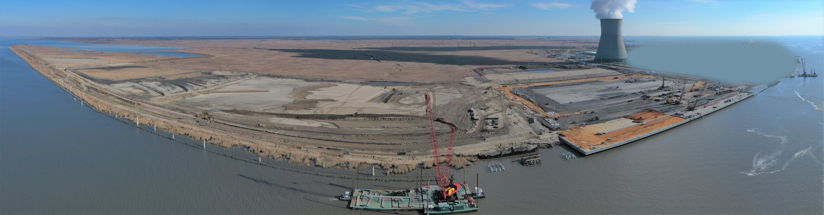
Active Construction Site Panorama
January 2024
1

Slide 8
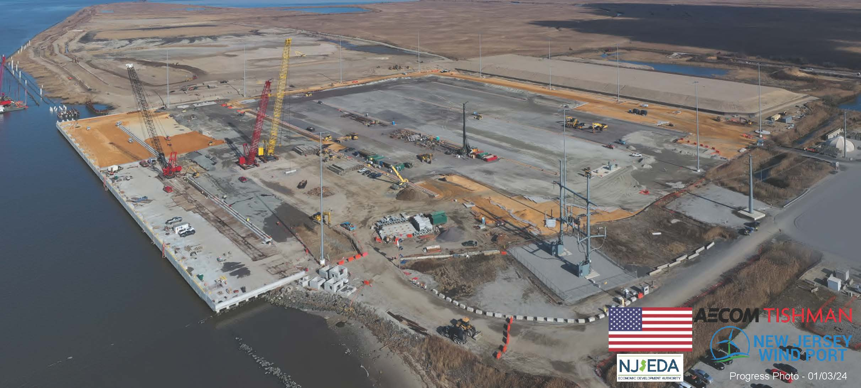
Active Construction
January 2024
2
Parcel B2
Parcel B1
Parcel C2
Parcel C1
Parcel A

Slide 9
Potential Engineering Project: Potable Water System
The NJWP will require a potable water production, storage and distribution system.
System requirements will be based on water studies completed to date, water allocation recommendations of the NJDEP, and the needs of site users.
NJEDA’s current concept is to site a water tower and distribution system in a “utility triangle” to be located north of Parcel C1 and southeast of Parcel B1.
Initial study efforts have been completed in 2023.
Permitting support efforts will be required.
The “Utility Triangle”

Slide 10
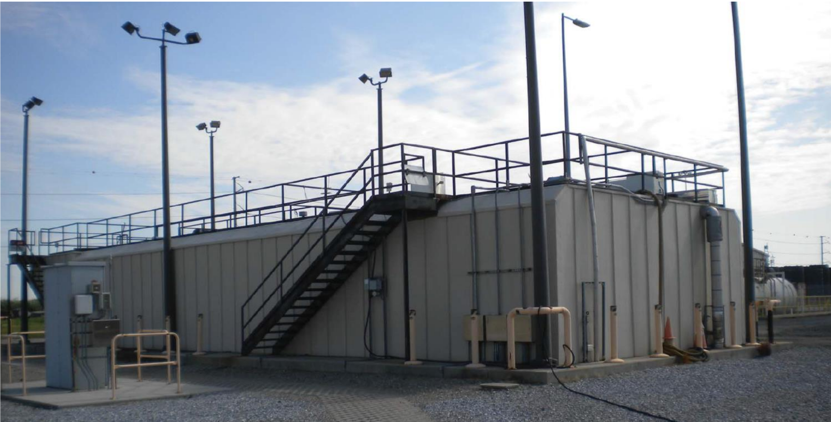
Potential Engineering Project: Sewer Treatment Plant
Phase 2 of the NJWP will require a sewage treatment plant (STP) to dispose of wastewater generated by the manufacturing facilities at the Port.
NJEDA’s current assumption is that wastewater solution will be tied into the existing PSEG STP that is part of the Hope Creek Generating Station just south of Parcel A.
The development of a wastewater solution would likely be phased, initially tying into the PSEG STP and then introducing an additional STP on land adjacent to the current one.
The expansion of the current PSEG wastewater solution would rely on the current PSEG sewer service area, permit and outfall rather than permitting a new sewer service area and outfall.
Modification or submission of new permits will be required. Support from the engineering firm will be needed.

Slide 11
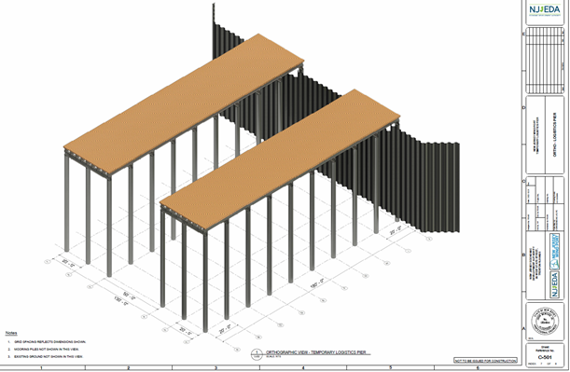
Potential Engineering Project: Logistics Pier
The NJEDA is considering creating a temporary pier to receive piles and other materials during Phase 2 construction to reduce over the road traffic.
A conceptual arrangement is being permitted as part of Phase 2 development.
Possibility that this structure could exceed temporary status and potential to evaluate for permanent uses
Twin Pier Concept
T-Shaped Pier Concept

Slide 12
Other Services
Other potential engineering and design services shall include but not be limited to:
Construction Support Services
The NJEDA may elect to solicit for additional construction inspection services in the form of an on-site Owner’s Representative.
This could include but not be limited too: Performing oversight and quality assurance of Construction Manager and their Subcontractors, interfacing with on-site stakeholders, submitting daily oversight reports, issuing non-conformance notices, etc.
Operations & Maintenance
NJEDA may require engineering and design services related to operation and maintenance activities at completed facilities at the Port.
This may include but not be limited too: Hydrographic Surveys, Aerials Surveys, Topographic Surveys, Damage Assessments, Annual Inspections, Repair Scopes, and Emergency Services.
O&M services could also include Traffic Engineering and Consulting services for access roads at the site or in direct connection. These activities include: damage assessments, repair design, traffic counts, traffic modelling, etc.

Slide 13
Other Services (cont.)
Other potential engineering and design services shall include but not be limited to:
Emergency Engineering Services
In instances where engineering services are needed on an emergency basis, e.g. a utility outage occurs or there is damage to the port that needs to be assessed and/or repaired right away, the NJEDA would want engineers to be available to provide the services listed in the scope of work on an emergency basis.
If emergency engineering services are required, the Director for the NJWP, or their designee, will solicit responses from the Qualified firms on a rotating basis starting with the highest ranked firm from the evaluation.
If the first firm solicited does not respond within two (2) hours the Director for the NJWP will proceed to the next firm in the rotation. Firms shall respond within 2 hours of the request for Emergency services and shall be onsite within eight (8) hours.

Slide 14
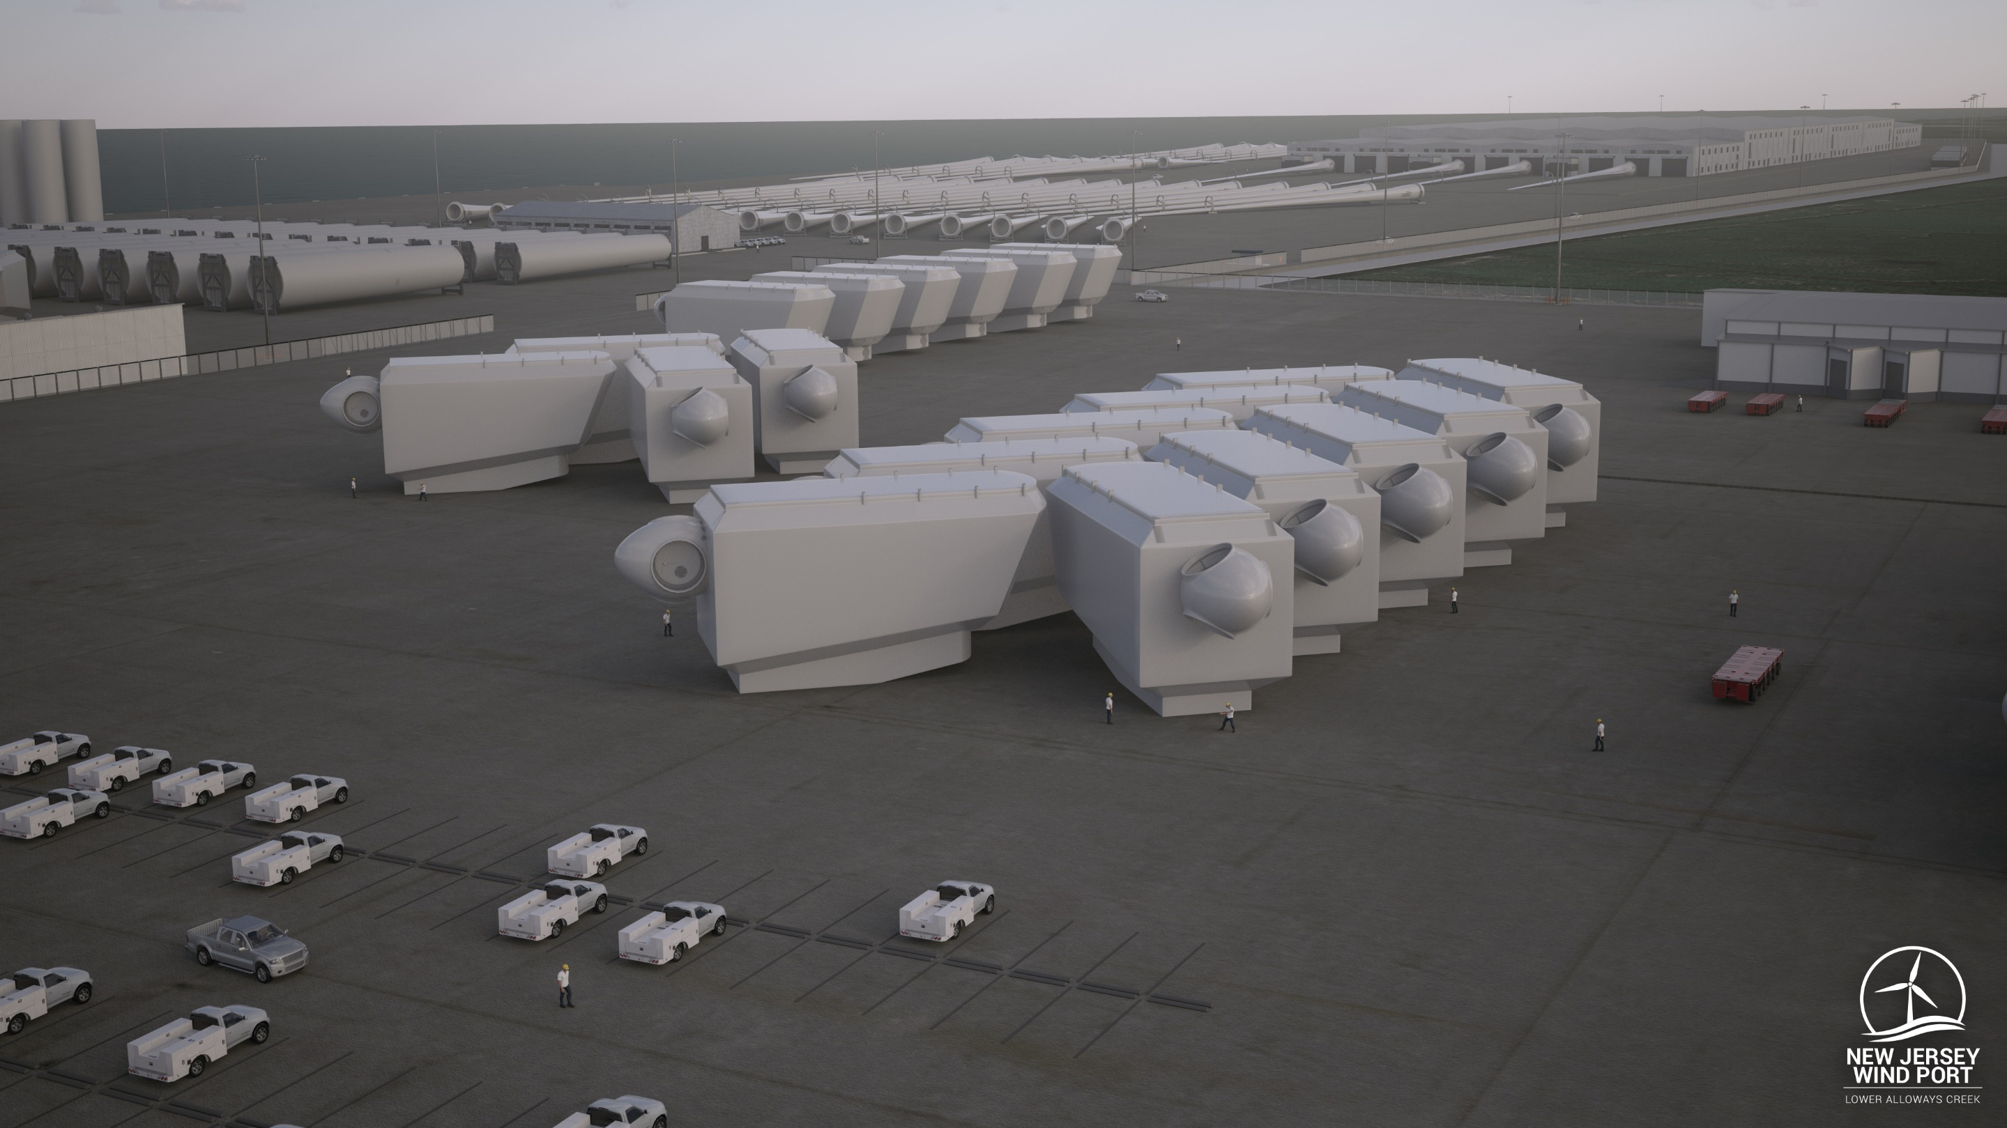
Learn more at: NJ.gov/windport Questions: njwindport@njeda.com

