Slide 1

Strategic Innovation Centers

Slide 2


Background
On January 7, 2021, Governor Murphy signed the New Jersey Economic Recovery Act of 2020 (ERA) into law. The ERA included amendments to the Authority's Economic Recovery Fund (ERF) to provide equity in innovation centers, research centers, incubators, accelerators, and other similar innovation-oriented entities.
The Governor's 2024 budget allocated an additional $20 Million for Strategic Innovation Centers bringing the total funding to $145 Million. The aim of funding strategic innovation centers is to accelerate economic recovery and drive the long-term growth of the State’s innovation economy with a focus on supporting increased diversity & inclusion within the state's entrepreneurial economy.
2
Notes:
New Jersey Economic Recovery Act - NJEDA

Slide 3



Overview: Strategic Innovation Centers (SIC)
What is a Strategic Innovation Center (SIC)?
Strategic Innovation Centers are facilities that either directly support research and development (R&D), innovation, or entrepreneurship or are aimed at solving specific problems in new and innovative ways through a combination of services such as mentorship, networking opportunities, hands-on training, business support services, education opportunities, and/or access to testing, fabrication, or manufacturing facilities and equipment. NJEDA funding will not exceed $25 million per SIC.
What do these centers look like?
Strategic Innovation Centers can be accelerators, incubators, research centers, innovative service delivery centers, or multi-tenant innovation clusters. The common purpose is to create a physical location that builds a community of entrepreneurs and innovators collaborating on a shared goal.

Slide 4













Targeted Industries
Advanced transportation and logistics
Advanced manufacturing
Autonomous vehicle and zero-emission vehicle research or development
Aviation
Clean energy
Film and digital media
Finance and insurance
Hemp processing
Information and high technology
Life sciences
Non-retail food and beverage businesses
Professional services
Other innovative industries that disrupt current technologies or business models

Slide 5



Key Characteristics of an attractive Strategic Innovations Center Partner
Are you interested in partnering with NJEDA on a Strategic Innovation Center?
Potential proposals must support a broad range of companies/businesses in a targeted industry OR support increasing diversity and inclusion within the State’s entrepreneurial economy. Proposals should also have public private partnerships and a university engagement component.
ONE TO MANY
PUBLIC PRIVATE PARTNERSHIPS
UNIVERSITIES
One Location with a single focus that will help many entrepreneurial businesses
The private sector lead must have a minimum 1:1 match with both significant experience and financial commitment. The NJEDA will be an equity partner in the project and an advisor, but not a day-to-day operator.
The SIC should have an engagement plan that includes partnerships with NJ Universities and key community partners with an emphasis on advancing diverse entrepreneurs and underserved communities.
Bring your Strategic Innovation Center ideas to NJEDA!
Notes:
Remember that each center/proposal/deal looks different → equity vs real estate etc.
SIC key points:
Strategic Innovation Centers can take many forms such as: accelerators, incubators, research centers, innovative service delivery centers, or multi-tenant innovation clusters.
Must support a broad range of companies/businesses in an ERF targeted industry OR supports increasing diversity and inclusion within the State’s entrepreneurial economy
Partner must have demonstrable experience in executing projects of sufficient scale
Partner must be a significant investor in the innovation center and leverage other sources of funding
EDA incubates innovation centers as investment opportunities for which there is an anticipated positive return such as economic development or job creation
The proposed Strategic Innovation Center Project will be located in New Jersey

Slide 6






Key Investment Considerations
  The Economic feasibility of the project.
  The degree to which the project will advance Statewide and regional strategies and objectives.
  The degree to which the project maximizes the leveraging of other sources of funds.
ELIGIBILITY CRITERIA
  The degree to which the project promotes economic development, the creation or retention of jobs, and the stimulation of private sector investment and expansion.
  Additional criteria includes supporting local and historically underserved communities, promoting and strengthen the state's position as the most diverse and inclusive innovation ecosystem in the country, and where it is located in New Jersey.

Slide 7
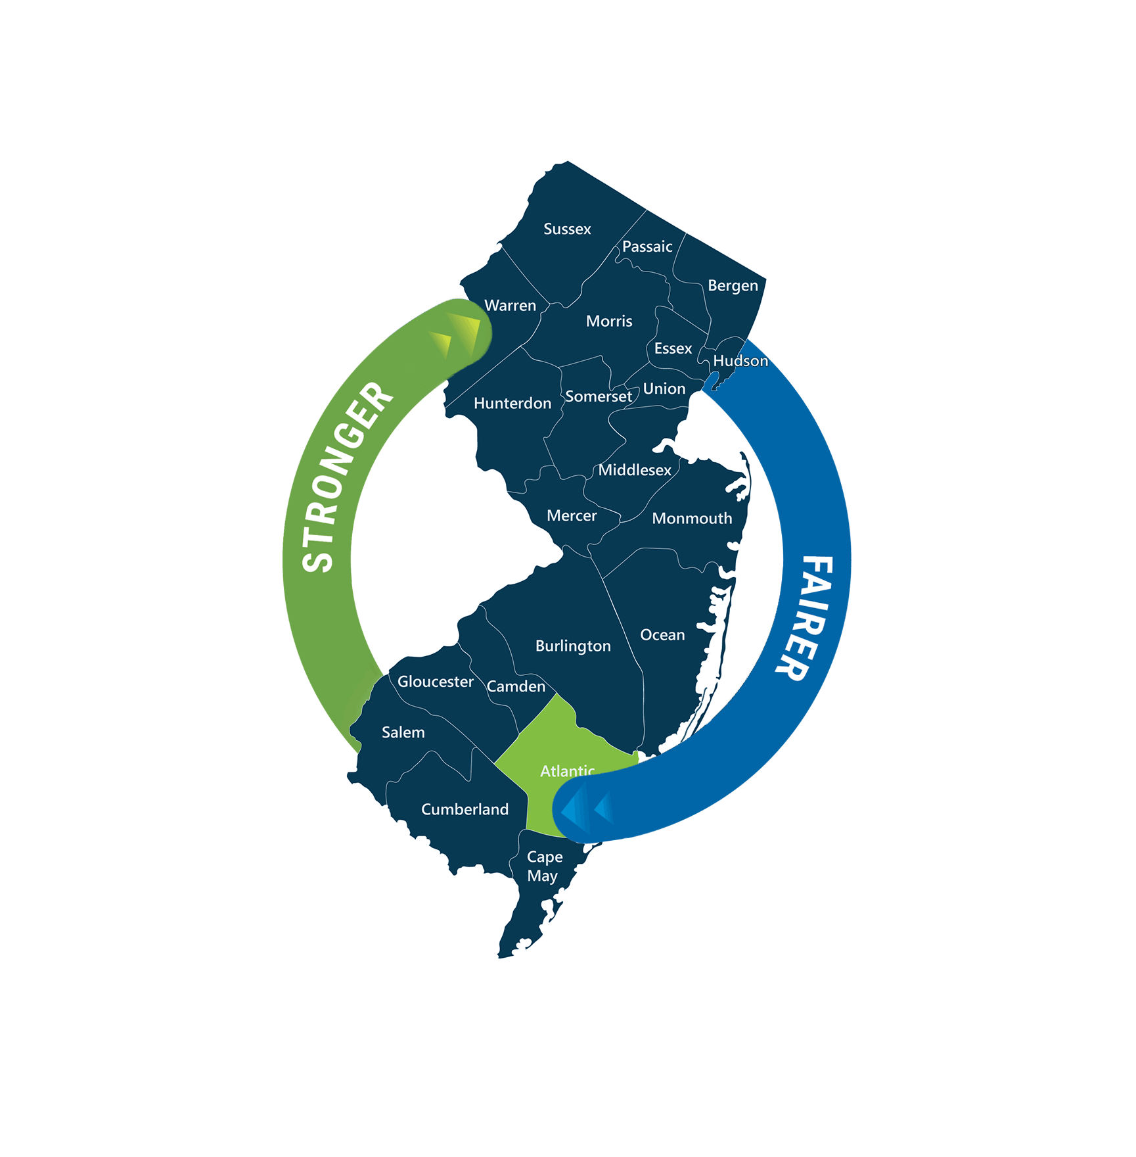
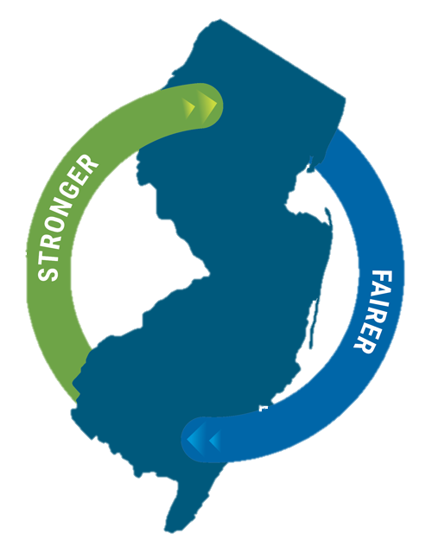


Current Strategic Innovation Center Projects
New Jersey Innovation & Technology HUB

Slide 8
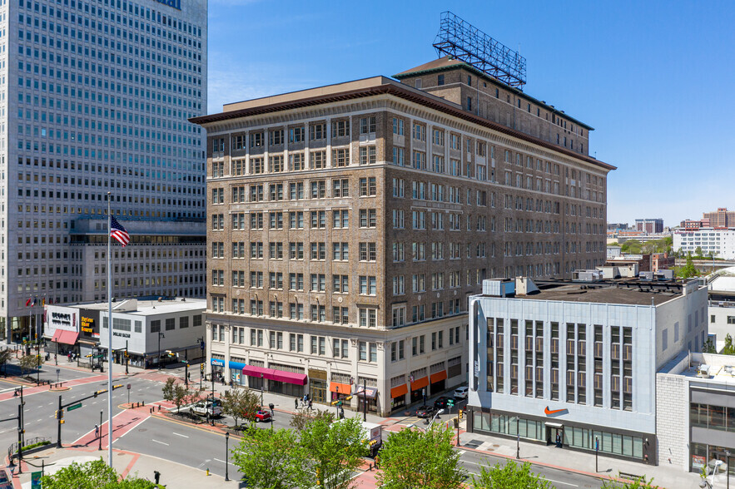
HAX
Program Highlights:
Will support 100+ early-stage companies and expected to create at least 2,500 new, high-paying jobs.
NJEDA and SOSV both invested $25M to be joint owners of HAX LLC.
SOSV has committed to mentoring at colleges, universities, local manufacturing sourcing, engagement in workforce development, and creating local advisory board.
$50M joint venture between NJEDA and globally-ranked VC, SOSV, to create “HAX LLC” studio HQ at 707 Broad St., Newark focused on decarbonization, digital manufacturing, and automated supply chain.
Notes:
6-month program includes $250K+ direct capital investment, space in and use of the state-of-the-art facility with cutting-edge fabrication//testing equipment, business development training, and networking with SOSV's global founder community.
HAX Chooses Newark HQ Location - New Jersey Business Magazine (njbmagazine.com)
"One of my administration's key strategies for building a stronger, fairer New Jersey is growing the most diverse, inclusive innovation ecosystem in the nation...Bringing HAX and the 2,500 jobs that come with this effort to Newark will help us achieve this goal“ – Gov. Murphy

Slide 9
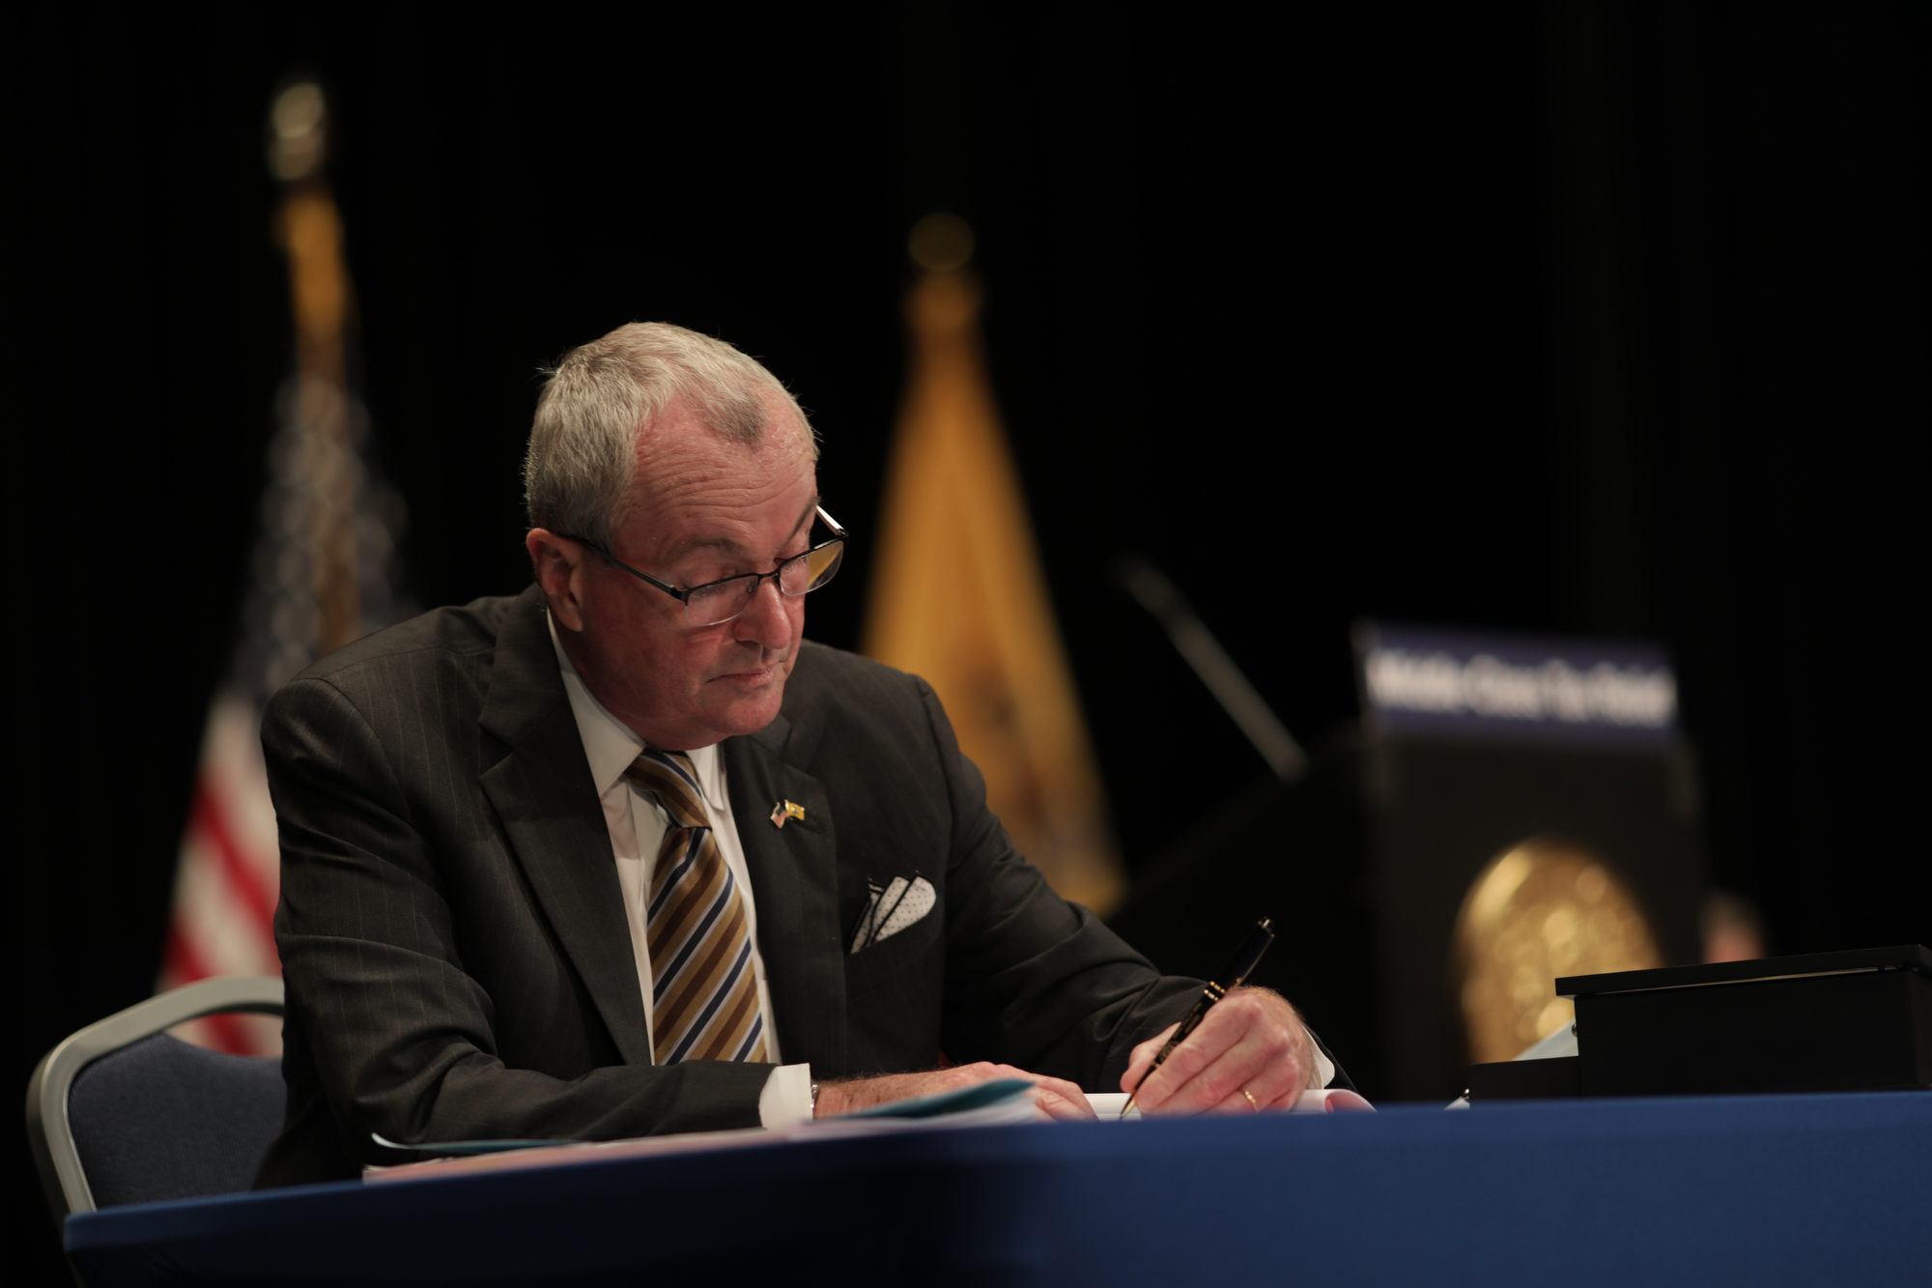

HAX
“One of my administration's key strategies for building a stronger, fairer New Jersey is growing the most diverse, inclusive innovation ecosystem in the nation...Bringing HAX and the 2,500 jobs that come with this effort to Newark will help us achieve this goal.” – Governor Murphy
SIC Alignment:
Accelerator studio located in Newark.
Targeted Industries: clean energy, advanced manufacturing
One to Many: The HAX program provides $250K on average to each of approx. 30 cohort companies every year for their 6+ month accelerator program. Startups are expected to finish the program with a scalable product. Following the program, HAX typically supports fundraising for a larger “seed round” of financing ranging between $1.5M and $5M.
Public Private Partnerships: NJEDA and SOSV both invested $25M to be joint owners of HAX LLC.
University Engagement: The HAX program has partnerships with NJIT, Rutgers, Princeton, and NJCCC. This includes collaborating on innovation/ tech events and providing learning opportunities for students.
Notes:
6-month program includes $250K+ direct capital investment, space in and use of the state-of-the-art facility with cutting-edge fabrication//testing equipment, business development training, and networking with SOSV's global founder community.
HAX Chooses Newark HQ Location - New Jersey Business Magazine (njbmagazine.com)
"One of my administration's key strategies for building a stronger, fairer New Jersey is growing the most diverse, inclusive innovation ecosystem in the nation...Bringing HAX and the 2,500 jobs that come with this effort to Newark will help us achieve this goal“ – Gov. Murphy
The HAX Program provides an average of $250,000 investment to each of their approximately 30
cohort companies every year for their 6+ month accelerator program, which focuses on technical,
product, and investment development to meet critical milestones of early-stage technology
businesses. To facilitate their go-to-market strategy, their model emphasizes hands-on
commercialization development with a full-time staff of HAX Program employees (engineers,
designers and manufacturing experts) who directly collaborate with portfolio company founders.
Startups are expected to finish the program with a scalable product, ready to transition to scaled
manufacturing, and secure their first revenues. Following the program, the HAX Program typically
Supports fundraising for a larger “seed round” of financing ranging between $1.5 million and $5
million.

Slide 10

New Jersey Innovation & Technology HUB
Program Highlights:
The HUB is estimated to create 2,000 permanent jobs and 1,200 construction jobs.
NJEDA committed $10M to this project.
The site will include the Rutgers Institute for Translational Medicine and Science as well as become the home of the Rutgers Robert Wood Johnson Medical School. Princeton University and Hackensack Meridian Health will be the HUB’s initial tenants.
Located in downtown New Brunswick, The New Jersey Innovation and Technology HUB will bring together partners, including NJEDA, in its two spaces: the Innovation Center and the CORE Partner space.
Notes:
Groundbreaking Held for NJ Innovation Technology Hub - New Jersey Business Magazine (njbmagazine.com) (job creation number is pulled from this article)
3 components:
1. The New Jersey Innovation & Technology HUB, 2. A Translational Research Facility for Rutgers University, 3. A new Medical School building for the Rutgers Robert Wood Johnson Medical School.
The New Jersey Innovation and Technology HUB is organized into two major components: the Innovation Center and the CORE Partner space. The Innovation Center will provide modern workspace designed to foster collaboration among researchers, entrepreneurs, start-up companies and others. The CORE Partner area will provide the project’s Partners—including Rutgers University, RWJBarnabas Health, Hackensack Meridian Health, NJEDA, and Middlesex County together with the facility’s initial tenants including Princeton University and Choose NJ – with collaborative office and workspace near the Innovation Center to encourage direct connections with innovators and entrepreneurs in real time.

Slide 11
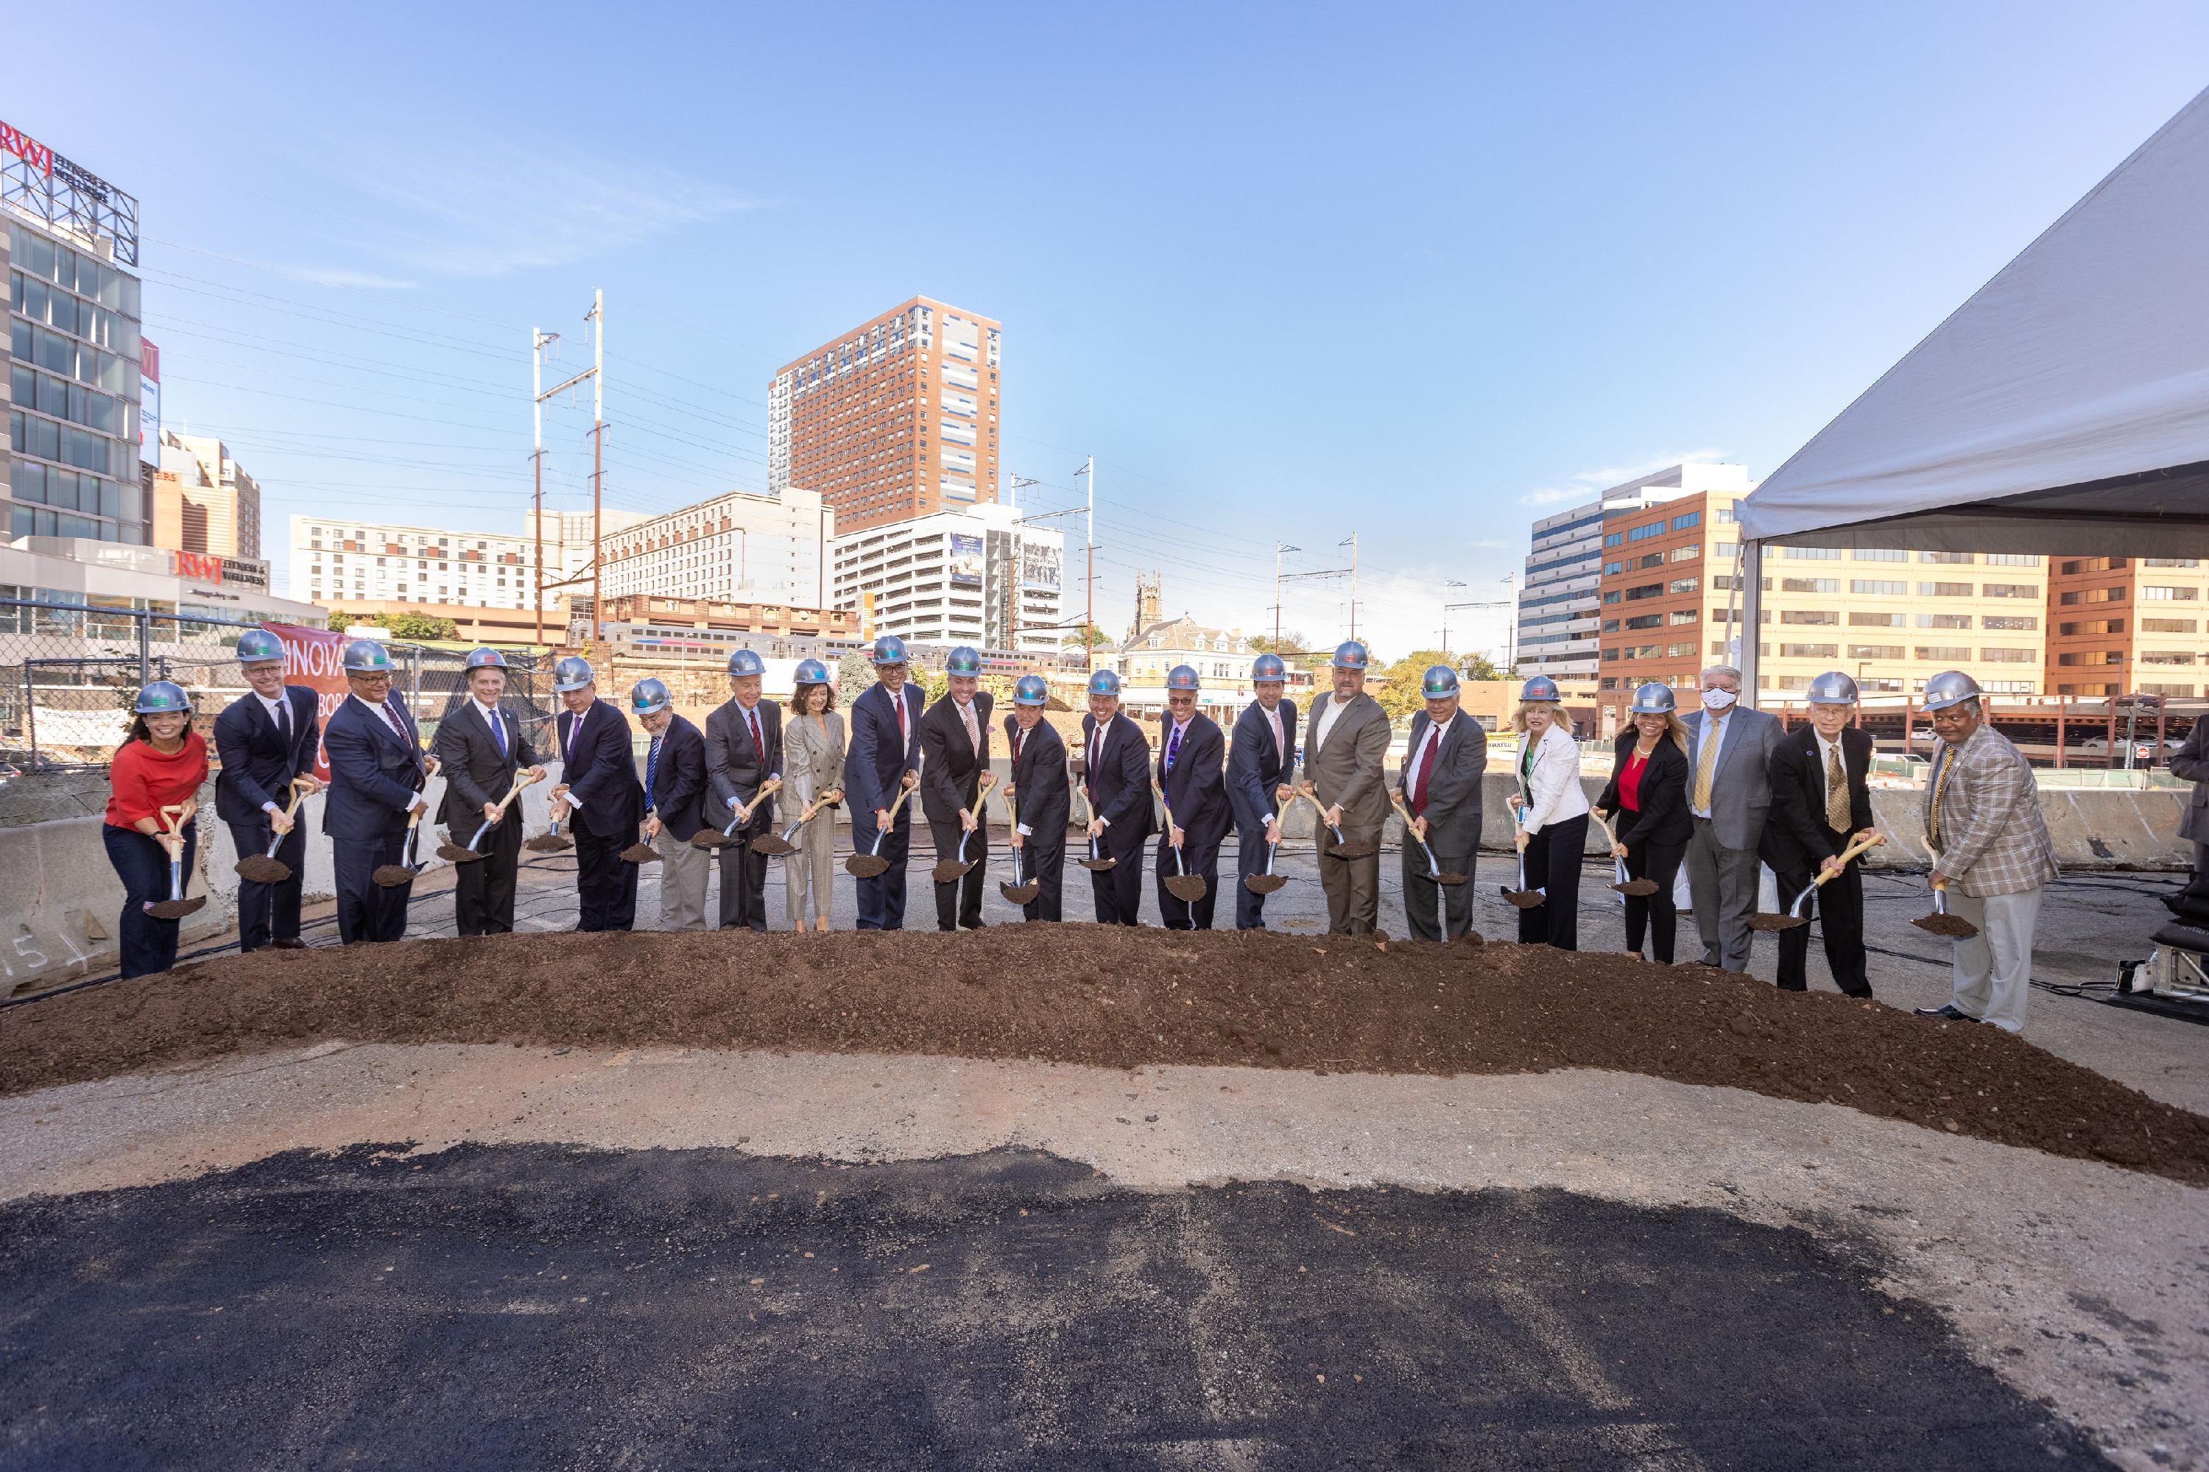
New Jersey Innovation & Technology HUB
“It will be that rare standalone center where researchers and clinicians from across the pharmaceutical and life science sectors will have immediate and daily access to academic and industry experts as they fine tune their advancements. [They will also have access] to the investors they need in order to take those advances to markets and then treat patients around the world.”
– Governor Murphy
SIC Alignment:
Multi-tenant innovation cluster in New Brunswick.
Targeted Industries: life sciences
Public Private Partnerships: The project partners are RWJBarnabas Health, Hackensack Meridian Health, NJEDA, the New Brunswick Development Corporation, Princeton University, and Middlesex County.
University Engagement: Rutgers and Princeton are core partners.
October 2021 groundbreaking in downtown New Brunswick.
Notes:
Groundbreaking Held for NJ Innovation Technology Hub - New Jersey Business Magazine (njbmagazine.com) (job creation number is pulled from this article)
Gov. Phil Murphy said the Hub will be a place where “doctors and researchers will work shoulder to shoulder on innovative treatments and solutions. It will be that rare standalone center where researchers and clinicians from across the pharmaceutical and life science sectors will have immediate and daily access to academic and industry experts as they fine tune their advancements. [They will also have access] to the investors they need in order to take those advances to markets and then treat patients around the world.”
3 components:
1. The New Jersey Innovation & Technology HUB, 2. A Translational Research Facility for Rutgers University, 3. A new Medical School building for the Rutgers Robert Wood Johnson Medical School.
The New Jersey Innovation and Technology HUB is organized into two major components: the Innovation Center and the CORE Partner space. The Innovation Center will provide modern workspace designed to foster collaboration among researchers, entrepreneurs, start-up companies and others. The CORE Partner area will provide the project’s Partners—including Rutgers University, RWJBarnabas Health, Hackensack Meridian Health, NJEDA, and Middlesex County together with the facility’s initial tenants including Princeton University and Choose NJ – with collaborative office and workspace near the Innovation Center to encourage direct connections with innovators and entrepreneurs in real time.

Slide 12








Visit www.njeda.com/strategic-innovation-centers for more information.
@NewJerseyEDA | njeda.com | 609.858.6767

Slide 13


Addendum: SIC Seed Funding Opportunity
Seed Funding to Establish Non-Profit Membership Entities
An additional SIC investment opportunity exists for those interested in an SIC partnership but perhaps not ready for the large-scale investment. The seed funding opportunity is a memorandum of understanding between NJEDA and a non-profit such as a public university that provides seed funding plus staff resources to establish innovation centers and support its associated activities.
The innovation center operates as a separate 501©(3) nonprofit entity. It is funded primarily using non-SIC investment funds through sources such as membership dues from private sector companies and other organizations within the target industry. The seed funding provided does not constitute membership in the innovation center, however, NJEDA may seek membership approval. NJEDA will also not possess interest of title in any equipment, supplies or other assets.

Slide 14


Current Facilities that benefitted from SIC Seed Funding
The eSports Innovation Center
A MOU in May 2021 committed NJEDA to provide $200,000 in funding plus staff resources to Stockton University for its esports initiative.
This includes Stockton’s establishment of an esports Innovation Center in Atlantic City.
The esports Innovation Center was incorporated in September 2021 and will be funded primarily by membership dues.
The Authority will establish a founding membership in the Center at $50,000 per year.
Sports Wagering and Fintech Workforce Development and Innovation Center
A MOU in June 2021 committed NJEDA to provide $200,000 in funding plus staff resources to New Jersey City University to support the establishment and initial activities of a Sports Wagering and Fintech Workforce Development and Innovation Center (“the Center”) in Jersey City.
The Center will be funded primarily by membership dues.
The Authority will establish a founding membership in the Center at $50,000 per year.

