Slide 1
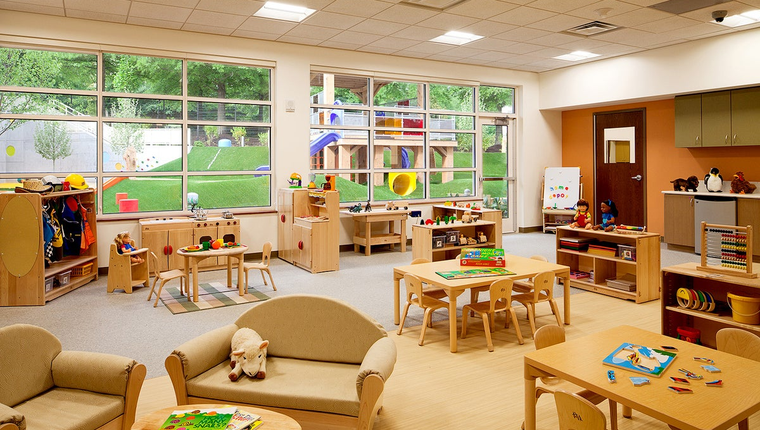
New Jersey Child Care Facilities Improvement Program—Phase 1

Slide 2
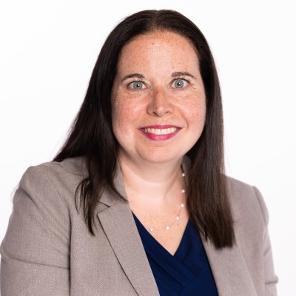
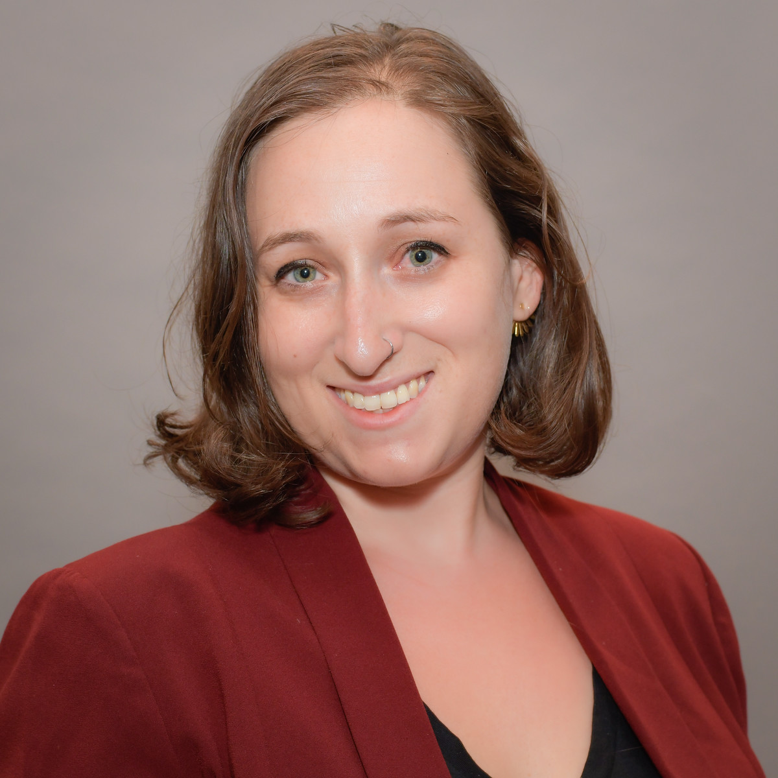
WELCOME
Tara Colton
Executive VP, Economic Security
Alex Himmel
Senior Advisor,
Child Care
Emily Apple
Program Manager, Economic Security

Slide 3
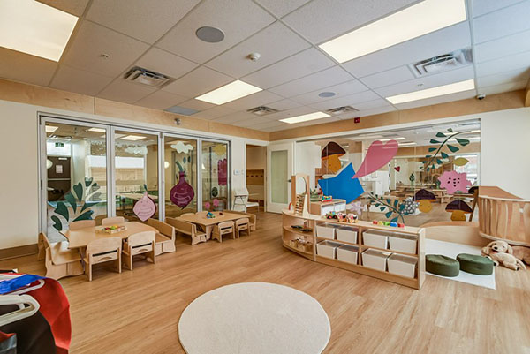
AGENDA
1
5
Housekeeping and Reminders
Contractor Requirements
2
6
Background
Application Requirements
3
7
Applicant Eligibility
Applicant Planning Resources
4
Project Eligibility

Slide 4
PART 1 HOUSEKEEPING AND REMINDERS

Slide 5
We will be using the Q&A feature to take all your questions

Slide 6
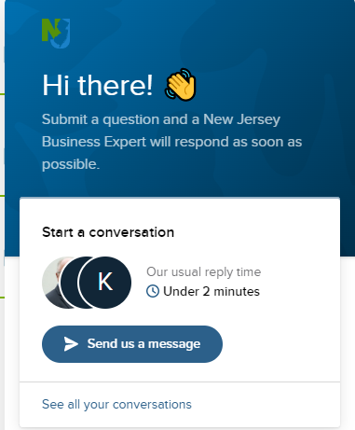
In addition to today’s webinar, there are many ways to ask questions and find more information
Visit https://www.njeda.com/child-care-improvement-program/ which has lots of resources including an FAQs that will be regularly updated
Email NJEDA at CustomerCare@njeda.com
Call NJEDA at (844) 965-1125
Use NJEDA’s Customer Care Chat at www.njeda.com
This PowerPoint presentation will be posted on our website at https://www.njeda.com/child-care-improvement-program/
A recording of the webinar will be posted at https://www.njeda.com/child-care-improvement-program/ after 9/19

Slide 7
Resources available to you
We have prepared a number of planning resources and materials, which are all posted on our website. We hope they will assist applicants with developing their improvement projects and completing their applications. Please visit https://www.njeda.com/child-care-improvement-program/ to see all of these resources. The Frequently Asked Questions (FAQs) will be regularly updated.
Frequently Asked Questions
Eligible Improvement Projects
Application Quick Start Guide
Sample Facility Improvement Project Description and Justification
Project Budget Template
Project Timeline Template
Project Idea Board
FFE Allowable Expenditures
Tips For Finding a Contractor
Landlord Certification Form (if applicable)
Religious Affiliation Form (if applicable)

Slide 8
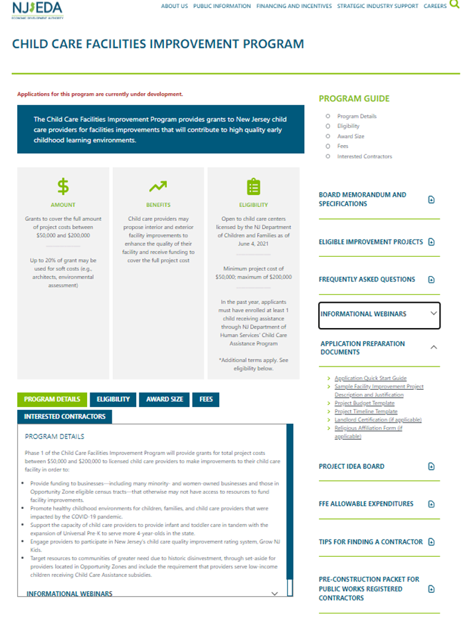
Where to find the resources on our site
These are all the resources
Please visit https://www.njeda.com/child-care-improvement-program/ to view and download all of these resources.
Remember, the FAQs will be regularly updated!
Make sure to click the V button next to APPLICATION PREPARATION DOCUMENTS to see all of the documents on that list.
FAQs
Remember to click the V button to see all documents here

Slide 9
Some key reminders: Eligibility for Phase 1 of the Child Care Facility Improvement Program is limited to providers who:
Are child care centers serving 6 or more children licensed by DCF as of June 4, 2021.
Family child care homes are NOT eligible for Phase 1 but will be eligible for future phases.
Offer care for at least 6 hours per day.
Centers that provide before-care and after-school care MAY be eligible for Phase 1, IF they offer care for at least 6 hours daily.
Must currently enroll, or have enrolled in 12 months prior to application, at least 1 child receiving assistance through DHS Child Care Assistance Program (CCAP, often referred to as “subsidy”)
Programs that are approved to accept the DHS Child Care Assistance Program but do not have at least 1 child enrolled in the last 12 months at time of application will NOT be eligible for Phase 1.
Head Start programs MAY be eligible for Phase 1, if they are also licensed centers with DCF and also enroll at least one child receiving CCAP.
Are for profit or non-profits
School districts are NOT eligible to apply directly for Phase 1.
Centers that operate programs within school buildings MAY be eligible.
REMEMBER:
The webinar will be recorded and posted on our website along with the presentation
There is a 2nd webinar scheduled for Monday, 9/19 at 6 pm

Slide 10
PART 2 BACKGROUND

Slide 11
About NJEDA
The New Jersey Economic Development Authority (NJEDA) serves as the State’s principal agency for driving economic growth. The NJEDA is committed to making New Jersey a national model for inclusive and sustainable economic development by focusing on key strategies to help build strong and dynamic communities, create good jobs for New Jersey residents, and provide pathways to a stronger and fairer economy. Through partnerships with a diverse range of stakeholders, the NJEDA creates and implements initiatives to enhance the economic vitality and quality of life in the State and strengthen New Jersey’s long-term economic competitiveness.
HELPING TO BUILD A STRONGER AND FAIRER
NEW JERSEY ECONOMY

Slide 12
Child Care Revitalization Act signed by Gov. Murphy in July 2021
The legislature passed, and Governor Murphy signed into law appropriating $100M through the federal American Rescue Plan State and Local Fiscal Recovery Fund.
$15.5M to NJ Department of Children and Families (DCF) to create WORKFORCE DEVELOPMENT SUPPORTS and conduct a CHILD CARE LANDSCAPE STUDY;
$30M to NJ Department of Human Services (DHS) to provide grants to licensed or registered child care providers or their employees for RETENTION and HIRING; and
$54.5M to NJEDA to provide technical assistance and grants for FACILITIES IMPROVEMENTS to licensed child care providers and family child care homes

Slide 13
Building on Governor Murphy’s comprehensive strategy to support the state’s vital child care sector and the crucial role of child care to the state’s long-term economic recovery, NJEDA has a growing portfolio of programs to strengthen New Jersey’s child care industry
NJEDA’s Programs to Support Child Care in NJ
FY 21 Budget: $23.3M
FY 22 Budget: $59M
FY 23 Budget: $50.5M
$23.3M COVID Small Business Emergency Grants
Emergency grants distributed to more than 1,300 child care providers, including a $10M set aside specifically for the child care sector and more than $15M distributed to child care providers located in Opportunity Zones
$54.5M Child Care Facilities Improvement Program
Facilities improvement projects for centers and home-based providers
$8M Thriving by Three Program Expanding capacity to serve infants and toddlers
$30M Child Care Facilities Fund Expansion of child care facilities program
$4.5M Technical Assistance for Child Care Providers Supporting providers’ facility and business operations needs
$12.5M Child Care Employer Innovation Pilot Exploring innovative models to engage employers in child care
Grand Total: $132.8M

Slide 14
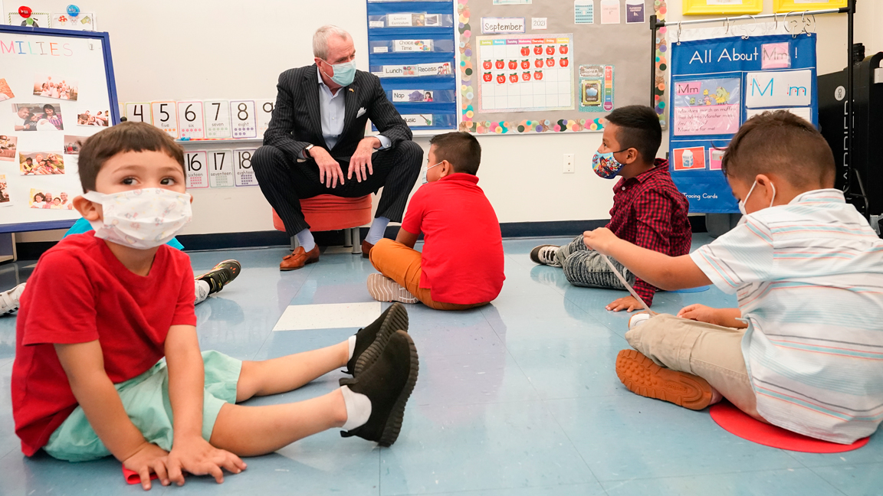
What is the New Jersey Child Care Facilities Improvement Program?
The Child Care Facilities Improvement Program is funded by the Child Care Revitalization Fund, allocating $100M of federal American Rescue Plan (ARP) funds, including $54.5 million for NJEDA to provide facility improvement grants and technical assistance to child care providers. Legislation was passed by the New Jersey State Legislature and signed into law by Governor Murphy in June 2021. Funding for Phase 1 of the Child Care Facilities Improvement Pilot Program will be supported through the ARP funding, as well as an additional $4.45 million in state funding.
Provides grants to New Jersey child care providers for facilities improvements that will contribute to high quality early childhood learning environments.
Funding for Phase 1 is $15 million with the ability to go up to $25 million based on demand
Notes:
PROGRAM GOALS
Support businesses – including many minority- and women-owned businesses and those in Opportunity Zone eligible census tracts – that normally don’t have access to fund facility improvements.
Promote child care developmentally and age appropriate environments and support providers impacted by the COVID-19 pandemic to remain viable and available to service families and children
Support childcare providers to provide infant-toddler care along with the expansion of Universal Pre-K (UPK).
Engage providers to participate in Grow NJ Kids (GNJK), New Jersey’s Quality Rating and Improvement System (QRIS).
Target resources in communities of greater need – sometimes called Opportunity Zones – and serve children receiving Child Care Assistance from the New Jersey Department of Human Services (NJDHS) Child Care Assistance Program.
The grants are to help child care providers create high quality learning environments by covering the costs of interior or exterior improvements.
Funding is to cover the full costs of the improvement project. We will dive into the eligible projects in just a little bit.

Slide 15
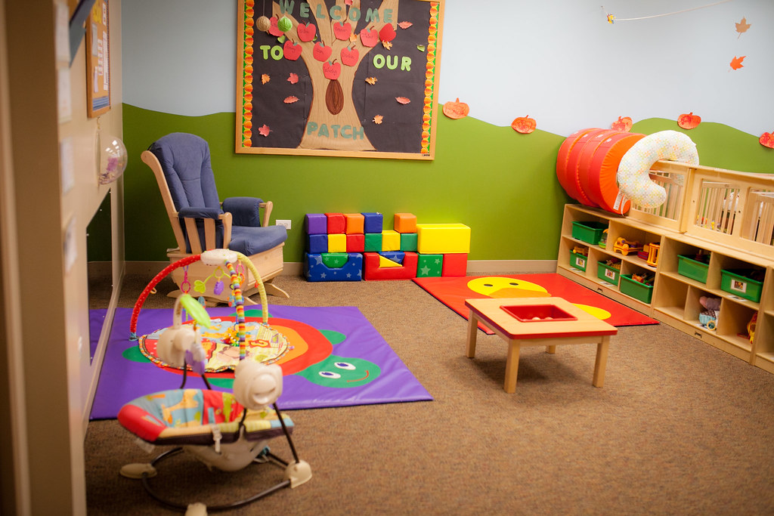
Child Care Facilities Improvement Program – Phase 1
Grants will be made for prospective (future) costs for facility improvement projects totaling $50,000 - $200,000. The funding does not need to be repaid.
Grants will also account for up to 15% of projected costs for unanticipated cost overruns
Phase 1 is only open to licensed child care centers; in future phases this will be available to registered family child care homes
Providers must currently enroll, or have enrolled in the past 12 months, at least 1 child receiving subsidy through the Department of Human Services Child Care Assistance Program
40% of funds will be set aside for applicants located in Opportunity Zone eligible census tracts
There is no cost or fee to apply for this funding

Slide 16
PART 3 APPLICANT ELIGIBILITY

Slide 17
Phase 1 Applicant Eligibility
Child care center licensed by DCF
Licensed by DCF as of June 4, 2021
Offers care for at least 6 hours per day for at least 10 months a year
Must currently enroll, or have enrolled at in 12 months prior to application, at least 1 child receiving assistance through DHS Child Care Assistance Program
For profit and non-profits
Own or lease space
Commit to enroll in Grow NJ Kids (if not already) within 1 year of award
Commit to maintain DCF license at the location of the facility improvement for 4 years
Be in good standing with NJ State agencies
Labor and Workforce Development
Environmental Protection
Treasury (Division of Taxation)
Children and Families
Human Services
Limited to 1 application per location and 2 applications per Employer Identification Number (EIN)
Registered Family Child Care Homes
After school providers (unless they offer than 6 hours of care per day)
Head Start providers (unless they have at least 1 enrolled child receiving CCAP)
School districts
Eligible to enroll children in Child Care Assistance Program but no children enrolled

Slide 18
What is the Child Care Assistance Program (CCAP)?
Under contract to the NJ Department of Human Services, Division of Family Development, the Child Care Resource & Referral agencies (CCR&Rs), administer the Child Care Assistance Program (CCAP) which helps income-eligible parents who are in school or working to pay for child care.
The CCAP program is often referred to as ‘child care subsidy’ or ‘federal subsidy.’
New Jersey’s CCR&Rs are:
Bergen County Office for Children
Burlington County CAP
Camden County Department of Children's Services
Child Care Connection
Child Care Resources
Child & Family Resources
The Children's Home Society of NJ
Community Child Care Solutions, Inc.
Community Coordinated Child Care of Union County
NORWESCAP Child & Family Res. Serv.
Programs for Parents, Inc.
Rutgers Southern Regional CCR&R
Urban League of Hudson County
4CS of Passaic County, Inc

Slide 19
PART 4 PROJECT ELIGIBILITY

Slide 20
What is considered a project?
What is a project?
All construction, all labor, all Furniture, Fixtures & Equipment and all soft costs at one location
What is an eligible use?
All the activities making up the project.
For example: Happy Kids Child Care center would like to
replace all the windows
paint all their classrooms
replace the flooring
install a shed for their outdoor toys and materials.
1
project
4
eligible uses

Slide 21
Phase 1 Project Requirements
Improvement projects must be between $50,000 - $200,000
Prospective costs only
Grant must cover the full cost of the proposed facility improvement
Up to 20% of total costs can be used for soft costs
All eligible uses outlined in a project on the application must be for a single location
All work is subject to prevailing wage and affirmative action requirements
Project should begin within 1 year of receiving the grant award and completed within 1 year of the start of construction
All quotes and work must be completed by a NJ Public Works Contractor registered with the NJ Department of Labor and Workforce Development
Projects less than $50,000
No retrospective costs or reimbursement
May not combine this grant with other funding to cover project costs
Projects cannot replace existing infant/toddler space and therefore reduce the overall number of infants and toddlers served at the facility

Slide 22
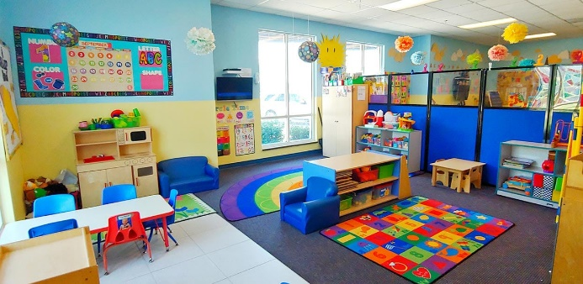
Eligible Interior Facility Improvements
Create additional classroom space in existing location by converting or adapting other rooms to classroom space
Install, repair, and/or improve:
Bathrooms with age-appropriate plumbing and child height fixtures that are in or adjacent to classrooms
Child height handwashing sinks in classrooms
Electric and lighting systems
Plumbing (e.g., leaking pipes, drainage issues)
Diaper changing areas
Nurse area, sick child area
Windows in classrooms and common areas
Flooring
Fire safety and fire protection systems
Indoor air quality systems
Doors, entrances and exits including locking mechanisms
Remediation of environmental issues
Security systems including security cameras
Kitchens and food preparation areas
Acoustics
Secure storage areas
Stable partitions and/or floor-to-ceiling walls to separate classrooms and improve acoustics
Furniture, fixtures, and equipment
Create or improve areas to serve as indoor gross motor and/or multi-purpose space
Improve egress and access within the facility, as well as egress and access to the outdoors for children with no or limited mobility

Slide 23
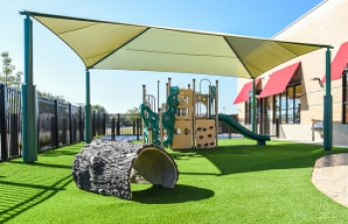
Eligible Exterior Facility Improvements
Install, repair, replace and/or improve equipment to provide children with age-appropriate, safe, engaging outdoor play areas:
Increase accessibility or meet code enforcement requirements (e.g. installing or replacing ramps)
Climbing structures (e.g., adding more cushioning)
Creating a separate space for infants
Bollards for parking lots and/or playgrounds
Covered enclosures, shade structures, awnings, outdoor furniture, storage shed
Address exterior drainage issues
Install, repair, and/or improve:
Exterior fencing, including security gates
Roofing
Decking
Sidewalks connecting classrooms
Parking areas

Slide 24
Eligible Costs
You do not have to apply for all three types of eligible costs
You could apply for: hard costs only; hard costs and FFE only; hard costs and soft costs only; or all three
You cannot apply only for soft costs since they are capped at 20% of the total grant
You are encouraged to consider several factors when deciding whether to include FFE costs through this funding
Hard Costs
Interior and Exterior Eligible Projects
Paid directly to Public Works Registered Contractor
Soft Costs
Architect fees
Permit fees
Construction management
Freight and shipping delivery
Environmental assessment
Paid directly to the vendor
Furniture, Fixtures and Equipment (FFE)
Defined as moveable items used in normal, everyday operation, excluding consumable materials.
Reimbursed to child care providers (you have to pay for it first and we pay you back)

Slide 25
Eligible Soft Costs
Architect fees
Permit fees
Construction management
Freight and shipping delivery
Environmental assessment
Capped at 20% of overall projects costs (e.g., maximum of $40,000 for a $200,000 improvement project)

Slide 26
Furniture, Fixtures & Equipment (FFE)
Applicants should carefully consider whether other funding sources like the DHS ARP Stabilization Grant or other NJEDA grants can be utilized to purchase FFE.
The intent of the NJ Child Care Facilities Improvement Program is to give child care providers funding to make facility improvements and minor renovations to their centers. This kind of funding isn’t normally available to the field
No Duplication of Benefits – you cannot use government funds twice! Sometimes this is referred to as “double dipping” and is not allowed.
Unlike other project costs, FFE will be reimbursed to the child care providers. You will have to pay for it first and then we would pay you back.
FFE is considered the moveable items for a building that have no permanent connection to the structure or utilities.
The items are expected to have a lifespan of three years at a minimum and cost no less than $100.
RESOURCE: FFE Allowable Expenditures This resource provides additional information and guidance on what is allowable at https://www.njeda.com/wp-content/uploads/2022/09/FFE-Allowable-Expenditures-FINAL.pdf
Notes:
The intent of the NJ Child Care Facilities Improvement Program is to give child care providers funding to make facility improvements and minor renovations to their centers and this kind of funding isn’t normally available to the field
Applicants should carefully consider their options to support the various elements of their proposed project, specifically as it relates to options for purchase of Furniture, Fixtures and Equipment (FFE)
Any funding for FFE purchases will be paid to child care providers on a reimbursement basis, unlike the other costs
There may be other funding sources that you can use to pay for FFE purchases, which may allow you to then use a larger share of the NJEDA funding for direct facility improvements like the DHS ARP Stabilization Grants or EDA’s Small Business Improvement grant
If you do purchase FFE, you will be required to certify that there is no ‘Duplication of Benefits’ and that no other government funds were used on the same expense. Sometimes this is referred as “double dipping” and is not allowed. For example, if you buy a $500 bookcase, you cannot use DHS ARP Stabilization funds to cover the $500 cost and then request reimbursement for $500 from NJEDA.

Slide 27
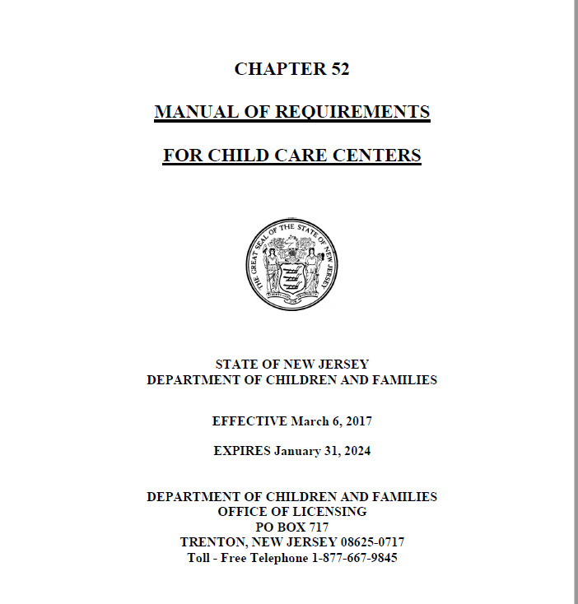
Notifying NJ DCF Office of Licensing
Please review the NJ Office of Licensing Manual of Requirements for Child Care Centers Subchapter 5: Facility Requirements to understand what may be required when undertaking a facility improvement project

Slide 28
PART 5 CONTRACTOR REQUIREMENTS

Slide 29
Contractor Requirements
At the time of the application and throughout the project, Contractor(s) working on the project must be a NJ Department of Labor (DOL) Public Works Registered Contractor and abide by New Jersey prevailing wage and affirmative action requirements.
Contractor(s) must agree to pay prevailing wage, which is set by county and by construction trade
Prevailing wage is required for any other construction contracts at this facility for the two years after an agreement is signed with NJEDA
Contractor(s) must abide by affirmative action requirements if they have 4 or more total employees
Subcontractors must also be Public Works Registered Contractors
Contractors and their subcontractors must register at SAM.GOV and are subject to a debarment check
RESOURCE: Contractor Pre-Construction Packet Guide for Public Works registered contractors to help them maintain compliance throughout the life of the project found at
https://www.njeda.com/wp-content/uploads/2022/09/Pre-Construction-Packet-2022.06.24.pdf
Notes:
The New Jersey Prevailing Wage Act is a law that sets a minimum pay rate to laborers, craftspeople, and apprentices working on public works projects for each county in the state. All NJEDA projects are subject to this requirement.
Prevailing wage is required for any other construction contracts at this facility for the two years after an agreement is signed with NJEDA.
If the contractor(s) are no longer available to work on the project after a project is approved, the child care providers are required to notify NJEDA and must find a new Public Works Registered Contractor(s). New contractor(s) will be required to submit a valid Public Works Certification to NJEDA.
NJEDA reserves the right to also conduct site visits during construction to confirm that work is being completed in accordance with eligible uses for the Program, federal guidelines, and all prevailing wage and affirmative action requirements.

Slide 30
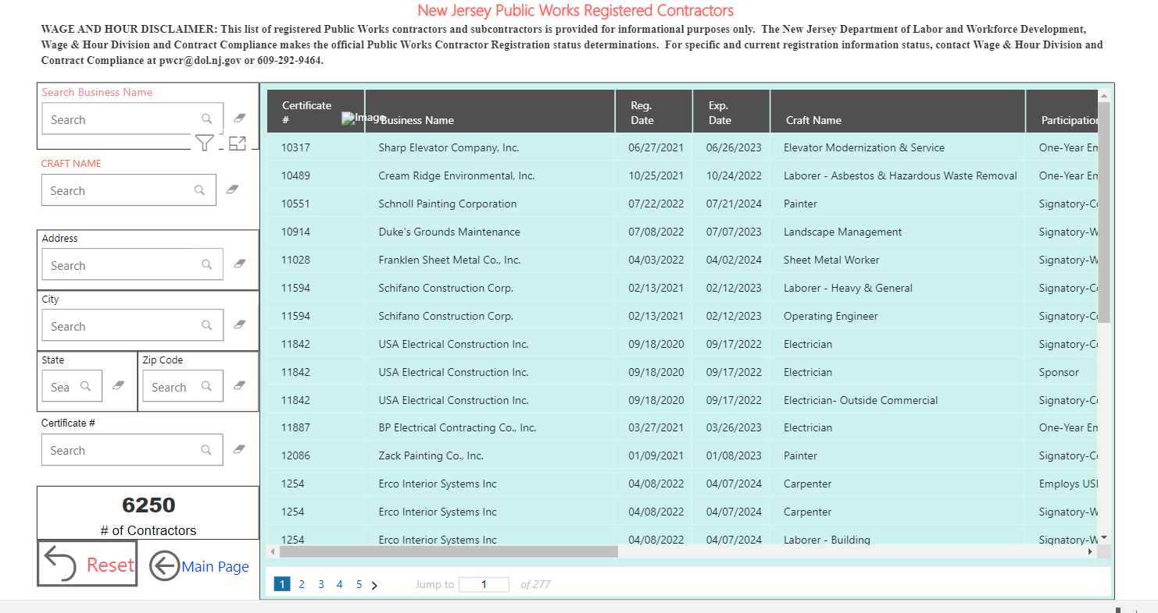
DOL Public Works Registered Contractor
Applicants are responsible for finding and identifying a Public Works Registered Contractor.
Two ways to search for a contractor are :
1
Search the DOL Public Works Registered Contractor list here
2
Search the list of Interested Public Works Registered Contractors on the Child Care Facilities Improvement page here
RESOURCE: Tips for Finding a Contractor How to navigate the DOL Public Works registered list can be found at https://www.njeda.com/wp-content/uploads/2022/09/Tips-for-Finding-A-Contractor-FINAL.pdf
Notes:
Child care providers will be responsible for finding a registered contractor(s). The Department of Labor maintains a list of about 6000 active registered contractors. A link to that list can be found on this slide.
We also recognize that many child care providers may not feel comfortable cold calling a contractor. To eliminate any barriers, NJEDA will post of a list of Public Works registered contractors who are interested in working on this grant and available to connect with providers. The list will include the contractors’ areas of expertise and how to make contact.
Additional tips on finding a contractor are available in the resource described on this slide
Public Works Contractors are accustomed to responding to bids rather than developing quotes themselves, which is what they will be doing for you. Some may have never worked with a child care facility before so we recommend you address this right away when contacting them.
Whichever avenue you choose to connect with a registered contractor, it will be helpful to have some thoughts and ideas about the kinds of things you’d like to accomplish with this funding prior to talking to them. In a moment we’ll share a resource we developed to help you gather your thoughts.

Slide 31
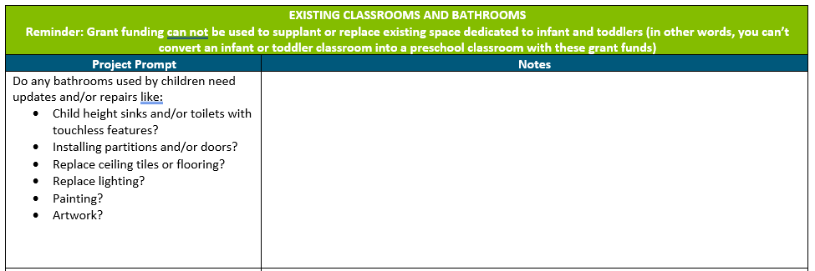
Project Idea Board
RESOURCE: Project Idea Board Tool to help applicants make decisions about proposed projects aligned to the grant’s eligible uses found at
https://www.njeda.com/wp-content/uploads/2022/09/Project-Idea-Board-FINAL.pdf
Notes:
The purpose of this “Idea Board” is to assist child care providers to make decisions about proposed facility improvement projects so they are aligned to the grant’s eligible uses, particularly those who are unsure of how to get started with your planning or are looking for help developing an improvement plan prior to speaking to a Department of Labor and Workforce Development (NJDOL) Public Works Registered Contractor. Use this resource to observe and document the needs of your facility by reviewing the Project Prompt Questions and use the Notes section to write down ideas and questions.
Some high-level questions to consider are:
What needs or areas for improvement were identified in any formal assessments like your last licensing report, Environmental Rating Scale (ECERS-3, FCCERS-3 or ITERS-3) results, and/or Grow NJ Kids assessment? Use these to help guide your decision-making process.
What ongoing health & safety issues does your facility face?
What security issues does your facility face?
What are the opportunities to upgrade systems and address energy efficiency?
The questions are not inclusive of all the different work or improvements that could be completed, so working with a Public Works Contractor will be a vital step in your planning process. You can consider using the information collected here to guide conversations with your Public Works Contractor to help make final decisions about your proposed project.
these contractors are not used to defining the scope of a project quotes – usually they are bidding on a project proposed by local or state government without any input on what the project is.

Slide 32
PART 6 APPLICATION REQUIREMENTS

Slide 33
Application
We expect the application will be released in October 2022 and will be found on the NJEDA website at https://www.njeda.com/child-care-improvement-program/
Customer Care has Spanish speaking call center staff and for all other language assistance email languagehelp@njeda.com with your name, spoken language, and telephone number
Applications will be in Microsoft (MS) Portals
Create an account at the NJEDA Online Application Center at https://programs.njeda.com/en-US/
Applications will be reviewed on a first come, first served basis from when they are initially submitted
Applications will go through several stages of review where NJEDA staff will be communicating with applicants on a rolling basis
Applications will be accepted until all funding is committed, or 3 years after the date of application launch, whichever is sooner.
Notes:
You will not be able to view the application until it is launched.
NJEDA will review applications on a first come, first served basis from when they are initially submitted, beginning from the date and time the program application is open to the public.

Slide 34
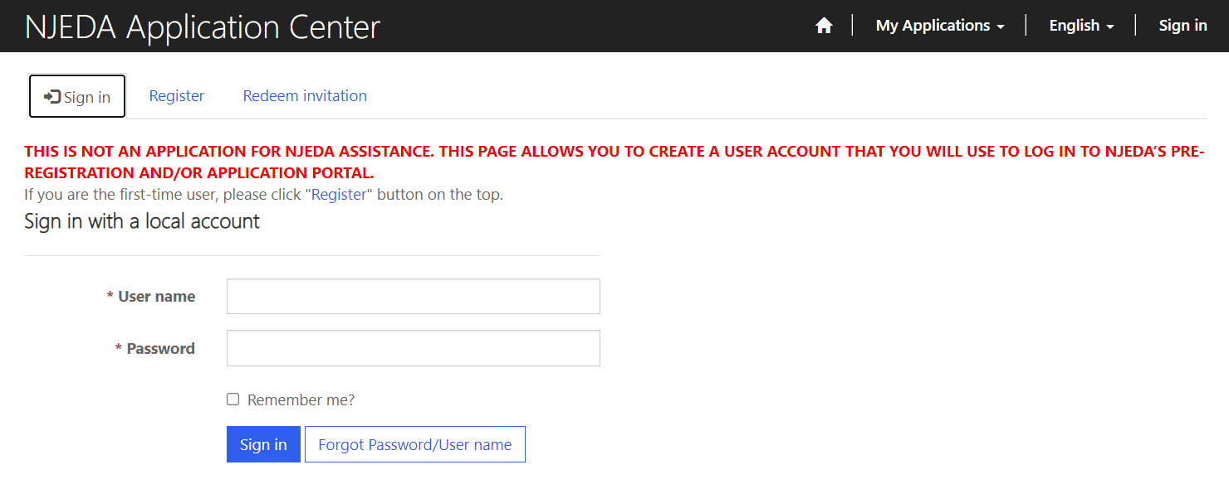
Sign Into Portal Using User Name and Password
https://programs.njeda.com
If you do not currently have a user name and password, click the Register tab at the top to create a new user name and password.
If you have a user name and password but have forgotten it, click the Forgot Password/User name button to email yourself an invitation code to reset the user name and password. Check junk/spam for this email if you do not receive it.
Once you have created or located your username and password, make sure you write it down and that it is easy for you to locate as you will need it any time you need to access the portal.

Slide 35
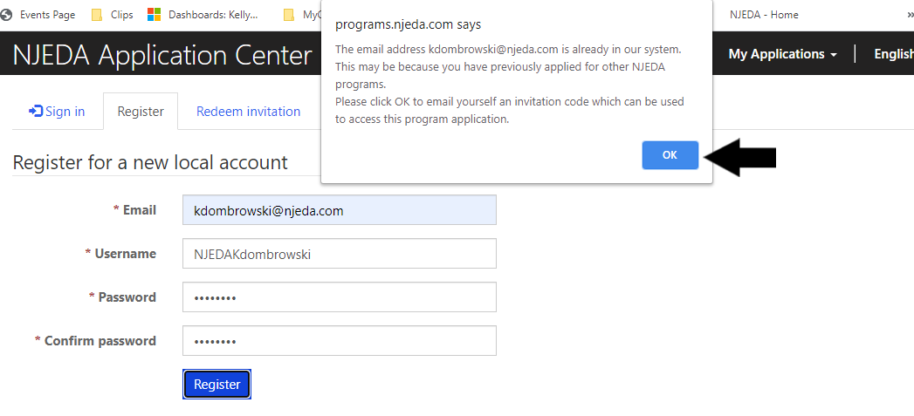
Creating a New User Name and Password
(only if you do not have one)
You will need to provide this information in order to create a profile. Make sure you write it down and that it is easy for you to locate as you will need it any time you need to access the portal.
You may receive this message when you attempt to register. This means your contact information is known to NJEDA, but you still must create a profile in this application portal. Click ok to send yourself an invitation code to create a profile in this portal. The email will be sent from crmnoreply@njeda.com Check junk/spam for this email if you do not receive it.

Slide 36
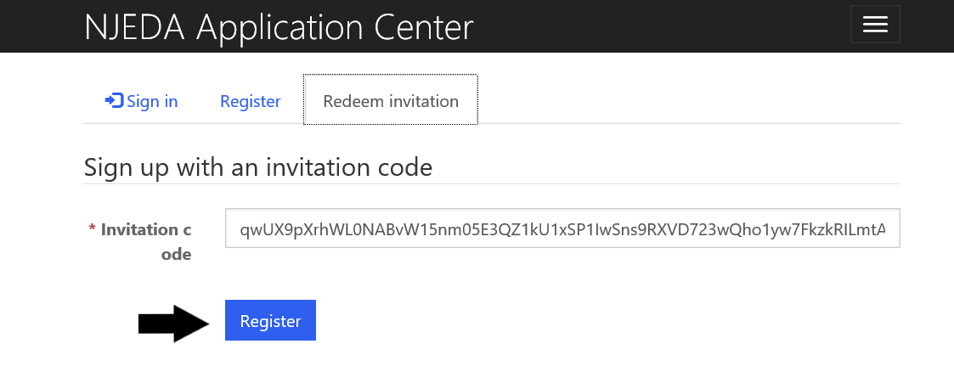
If You Were Emailed an Invitation Code
If you forgot your username and password, or if you attempted to register and your information was already known to NJEDA, then you should have received an invitation code via email. Please allow appx. 10-20 mins for that email to arrive, and check your junk or spam folders if you do not receive it. If you still haven’t received it after 20 mins, contact the NJEDA call center at
844-965-1125 for assistance.
Once you receive the invitation code, please click the link to be returned to the portal. Clicking register should allow you to complete your registration.

Slide 37
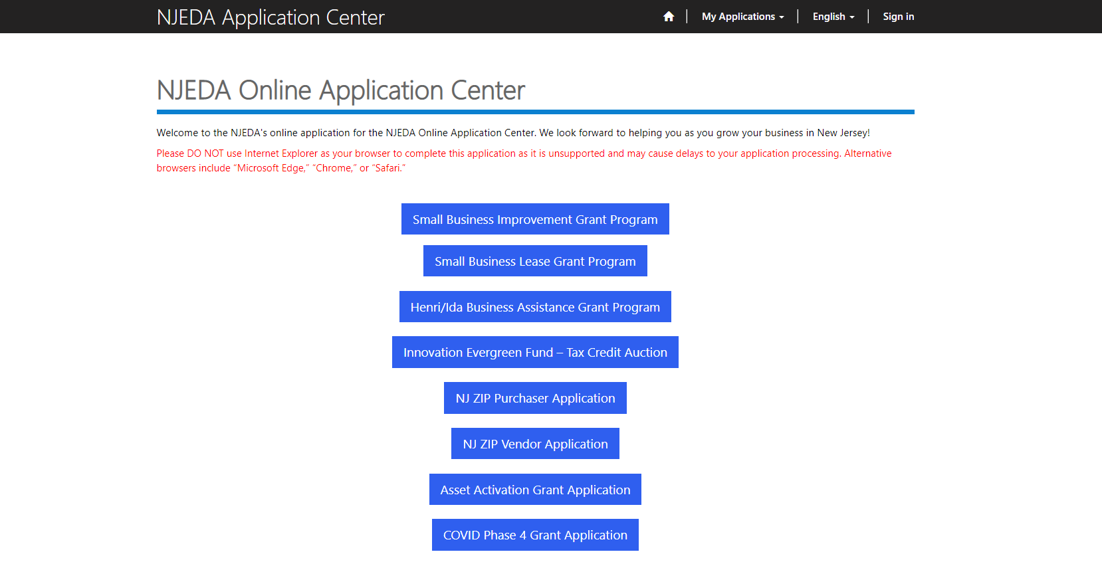
Find the Child Care Facilities Improvement application
The application will be listed here but will not be viewable until it is launched. We expect this will be in October.
Click and begin completing your application.
Notes:
You will not have to complete the full application in one attempt. Portals will allow you to save your work and when you log back in, the system will pick up where you left off during your previous session.

Slide 38
Required Application Documents
DCF License
Formation Documentation
Federal Tax ID
NJ Division of Taxation Tax Clearance Certificate
Religious Affiliation Form (if applicable)
IRS determination letter (nonprofits only)
Political/Lobbying Questionnaire
Evidence of facility ownership or copy of lease
Landlord certification (if facility is leased)
Project description and justification
Photos of space where improvements are proposed
Project budget
Project timeline
Project Design documents (if applicable)
Project costs (Hard, Soft and FFE)
Public Works registered contractor certificate
Contractor quotes
Soft Costs description (if applicable)

Slide 39
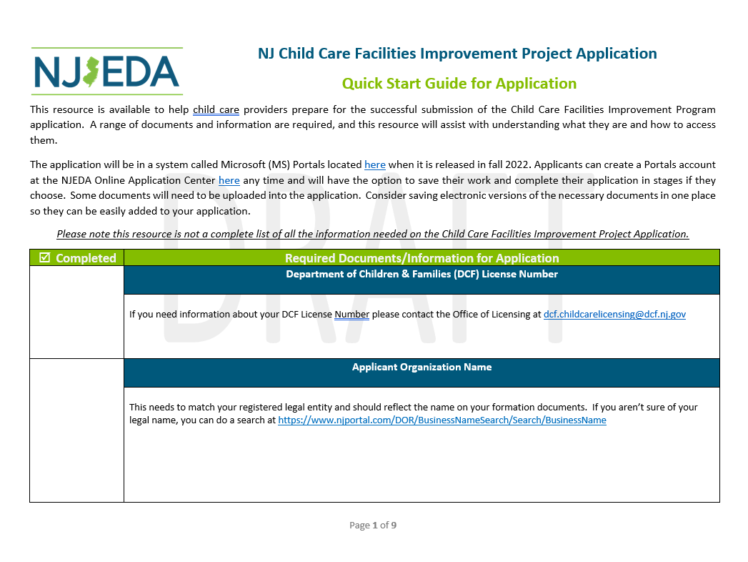
Application Quick Start Guide
RESOURCE: Application Quick Start Guide Checklist of all information and documents needed for application found at
https://www.njeda.com/application-quick-start-guide-final/
Notes:
We know there is a lot of information required for this application and wanted to create a tool to help applicants track and organize themselves.

Slide 40
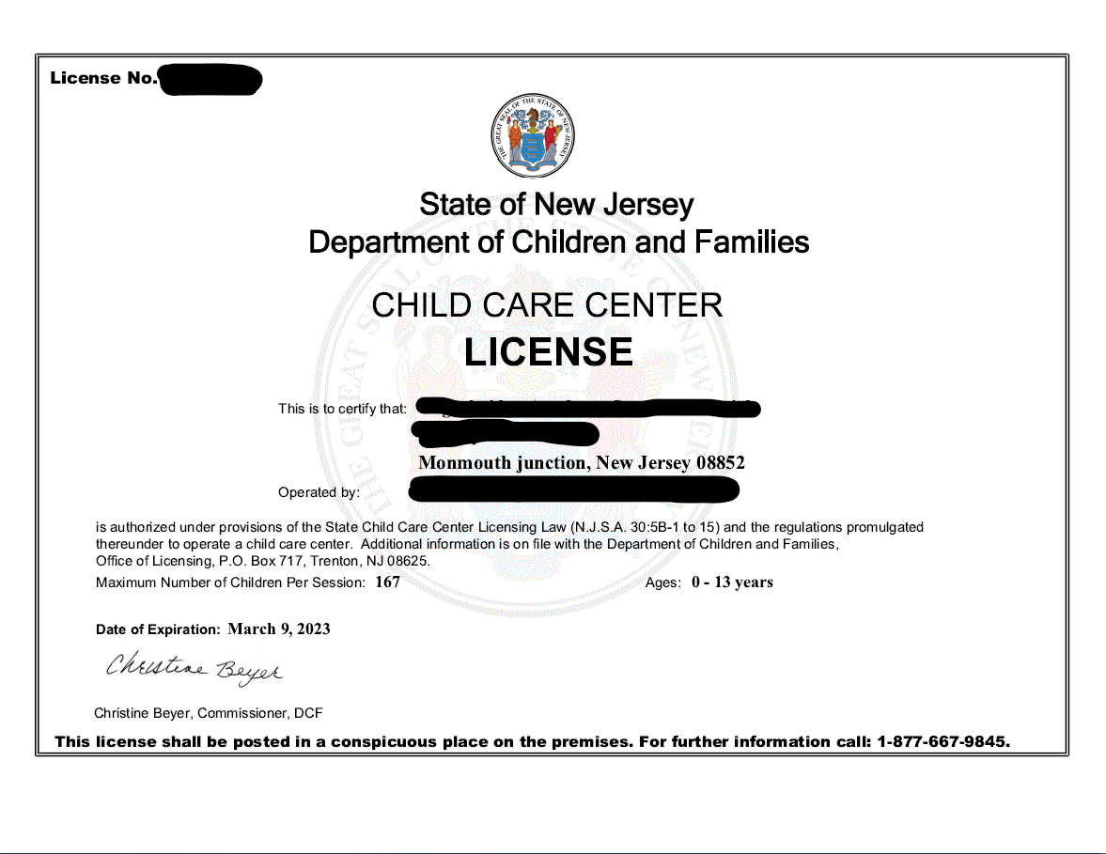
PAGE 1: DCF License
Applicants must be child care centers licensed by the NJ Department of Children and Families (DCF) as of June 4, 2021 and offering full time care for 6 hours or more per day
NJ Department of Children and Families (DCF) License Number
What is the total capacity of the project location?
Date of expiration
NJEDA will require acknowledgement from applicants that if they are approved, the applicant will maintain licensure with DCF to provide child care at the location of the facility improvement for 4 years following the execution of an agreement with NJEDA
Notes:
Your DCF L

Slide 41
PAGE 2: Primary Point of Contact
The person completing the application also serves as your primary contact for your application status
We recommend the primary point of contact be the individual filling out the application
If the person completing the application does not have legal authority, they will be prompted to complete Page 3: Authorized Representative
If the person completing the application is not the CEO/Owner they will be prompted to complete Page 4: CEO
Notes:
It is highly recommended that the primary point of contact be the individual that is currently filling out this application.
If the primary point of contact is different than the individual that is currently filling out the application, the primary point of contact should also create a user name and password on this application portal to receive all future correspondence.

Slide 42
PAGE 3: Authorized Representative
Will only show if your primary point of contact does not have legal authority to submit the application
Name of Contact
Title
Email
Phone Number
Authorized Representative Address
Would you like the authorized representative to receive email communications from NJEDA about the status of your application?
Notes:
This application includes company representations and certification and must be submitted by an individual who is legally authorized to sign documents on behalf of the applicant company.

Slide 43
PAGE 4: CEO/Owner/Equivalent
Will only show if your primary point of contact is not this representative
Name of Contact
Title
Email
Phone Number
CEO/Owner/Equivalent Address
Would you like the authorized representative to receive email communications from NJEDA about the status of your application?

Slide 44
PAGE 5: Media Contact
This page will only show if the Primary Point of Contact is not also the Media Contact. Applicants will also have the option not to designate a media contact
Would you like to designate a media contact?
Name of Contact
Title
Email
Phone Number
Media Contact Address
Notes:
NJEDA often works with an applicant company’s public relations or media relations representatives on press releases and press inquiries regarding approved projects. If you would like, please provide the contact information for the applicant company’s media contact that will support on this project.

Slide 45
PAGE 6: Applicant Organization
Provide information about the company/organization applying for the grant
Applicant Organization Name
Applicant Doing Business As (DBA)
Applicant Entity Type
Choose the organization’s entity type:
Sole Proprietorship
Partnership
General Partnership
Limited Partnership
Limited Liability Partnership
C Corporation
Subchapter S Corporation
Limited Liability Corporation
Government Body
Nonprofit Organization
Single Member LLC
Individual Investor
Enter the name of your registered legal entity. If you aren’t sure of your legal name, check it at
https://www.njportal.com/DOR/BusinessNameSearch/Search/BusinessName.
Is the applicant, or any person who controls the applicant or owns or controls more than 1% of the stock of the applicant, an officer or employee of any agency, authority or other instrumentality of the State of New Jersey?

Slide 46
PAGE 6: Applicant Organization (cont’d)
Formation documentation
Make sure this date matches with the date on your formation documents
Date Established
Mailing Address
Applicant County of Formation
Application State of Formation
Show proof of one of the following:
Sole Proprietor:
LLC: Certificate of Formation and Operating Agreement
Corporation: Certificate of Incorporation and Bylaws
Not-for-Profit: Provide a Certificate of Incorporation and Bylaws Please also provide an Exemption Determination Letter.
Out of State
UPLOAD YOUR FORMATION DOCUMENTS

Slide 47
PAGE 6: Applicant Organization (cont’d)
Information about the applicant organization
Federal Employer Identification Number (FEIN)
Applicant NJ Tax ID Number
Applicant Phone Number
Applicant Website (if applicable)
Description of applicant company
North American Industry Classification System code
Your North American Industry Classification System (NAICS) should be the same code listed on your last business tax fillings. For help visit https://www.census.gov/naics/
REMEMBER: Applicants are limited to one (1) application per location/facility and two (2) applications per Employer Identification Number (EIN)

Slide 48
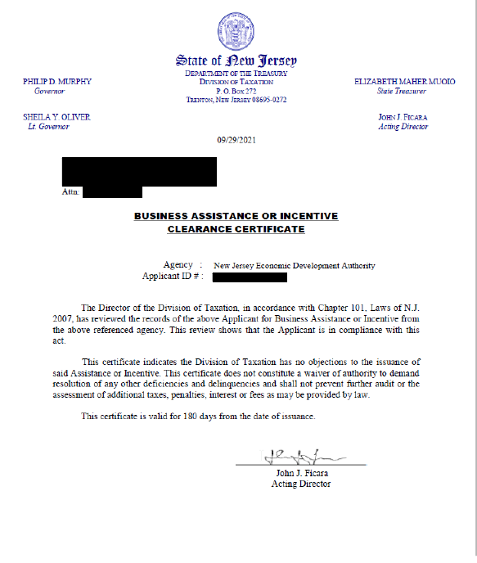
PAGE 6: Applicant Organization (cont’d)
Information about the applicant organization
UPLOAD YOUR TAX CLEARANCE CERTIFICATION FROM THE NJ DEPARTMENT OF TAXATION
Has the applicant, or relevant parties, previously received assistance from NJEDA?
Please describe the assistance previously received.

Slide 49
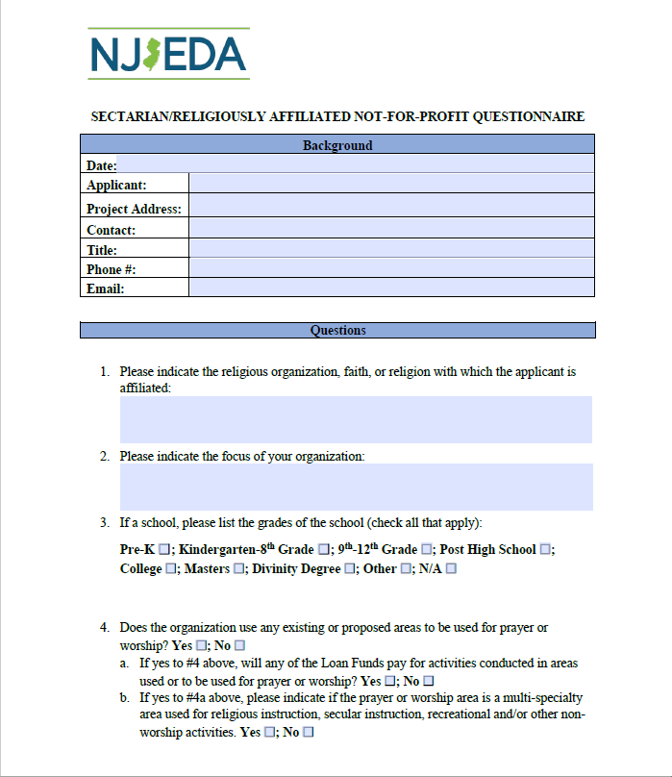
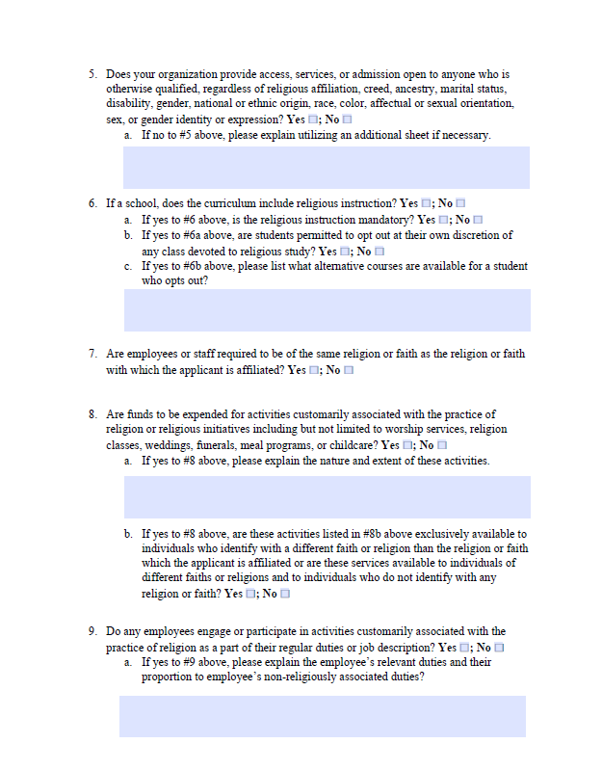
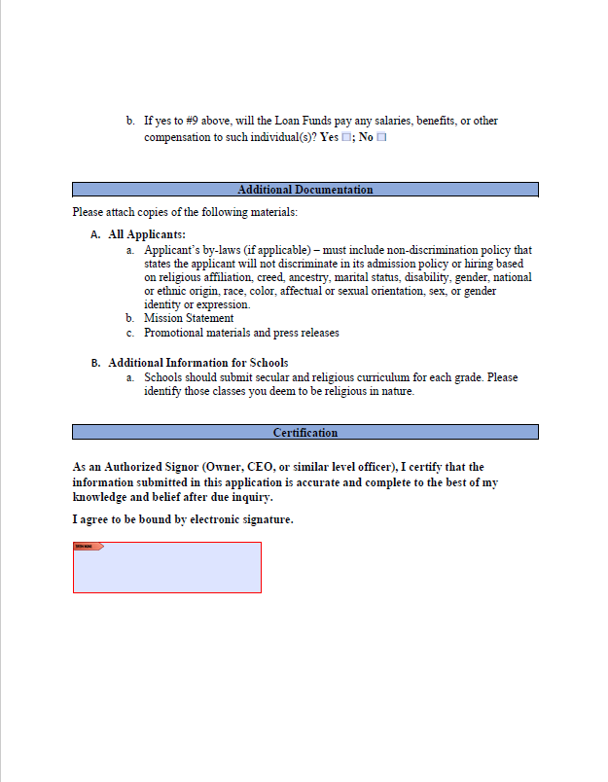
PAGE 6: Applicant Organization (cont’d)
Religiously Affiliated Form (if applicable)
Religiously affiliated providers are eligible to apply if they hold a DCF license and will need to complete this form.
They may be asked to submit additional information at the request of the NJEDA so that an eligibility determination can be made.
Is the applicant involved in religious activities or religiously affiliated?
IF YES
COMPLETE AND UPLOAD RELIGIOUSLY AFFILIATED QUESTIONNAIRE
Notes:
Religiously affiliated providers are eligible to apply if they hold a DCF license and will need to complete this form.
They may be asked to submit additional information at the request of the NJEDA so that an eligibility determination can be made.

Slide 50
PAGE 7: Diversity, Equity and Inclusion
Information about the diversity of your organization
This information is optional and will be used for tracking purposes only.
With which of the following does the majority owner of the applicant organization self-identify (if applicable)?
Please indicate the majority owner's race(s):
Please select the ethnicity or ethnicities that the majority owner most closely identifies with:
Please select which of the following State of New Jersey certifications the applicant organization currently holds:
UPLOAD THE NJ CERTIFCATIONS FOR THE APPLICANT ORGANIZATION
Please describe whether your company’s leadership team is made up of a diverse group of individuals. Please provide as much detail as possible about the composition of your leadership team as it relates to groups that have been historically underrepresented (minority, woman, veteran, LGBTQ, disabled).
Notes:
NJEDA often works with an applicant company’s public relations or media relations representatives on press releases and press inquiries regarding approved projects. If you would like, please provide the contact information for the applicant company’s media contact that will support on this project.

Slide 51
PAGE 7: Diversity, Equity and Inclusion (cont’d)
Information about the diversity of your organization
This information is optional and will be used for tracking purposes only.
Please describe whether your company’s leadership team is made up of a diverse group of individuals. Please provide as much detail as possible about the composition of your leadership team as it relates to groups that have been historically underrepresented (minority, woman, veteran, LGBTQ, disabled).
Please describe whether your company’s Board of Directors is made up of a diverse group of individuals. Please provide as much detail as possible about the composition of your leadership team as it relates to groups that have been historically underrepresented (minority, woman, veteran, LGBTQ, disabled).
Please describe any diversity initiatives, programs or plans the applicant company has established.
UPLOAD ANY DOCUMENTATION DETAILING DIVERSITY INITIATIVES, IF APPLICABLE
Notes:
NJEDA often works with an applicant company’s public relations or media relations representatives on press releases and press inquiries regarding approved projects. If you would like, please provide the contact information for the applicant company’s media contact that will support on this project.

Slide 52
PAGE 7: Diversity, Equity and Inclusion continued
Language Assistance
Is English your primary language?
If the NJEDA needs to contact you regarding your application, would you be interested in having an EDA provided interpreter in your native language?
Please identify which of the following languages is your primary language:
Español (Spanish)
粵語 (Cantonese Chinese)
廣東話 (Mandarin Chinese)
ગુજરાતી (Gujarati)
हिन्दी, (Hindi)
Italiano (Italian)
한국어 (Korean)
Po Polsku (Polish)
Português (Portuguese)
Tagalog
Other
Notes:
NJEDA often works with an applicant company’s public relations or media relations representatives on press releases and press inquiries regarding approved projects. If you would like, please provide the contact information for the applicant company’s media contact that will support on this project.

Slide 53
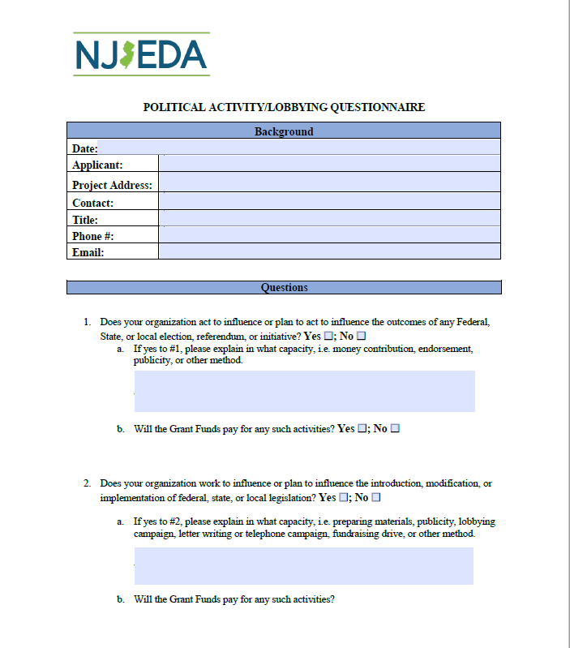
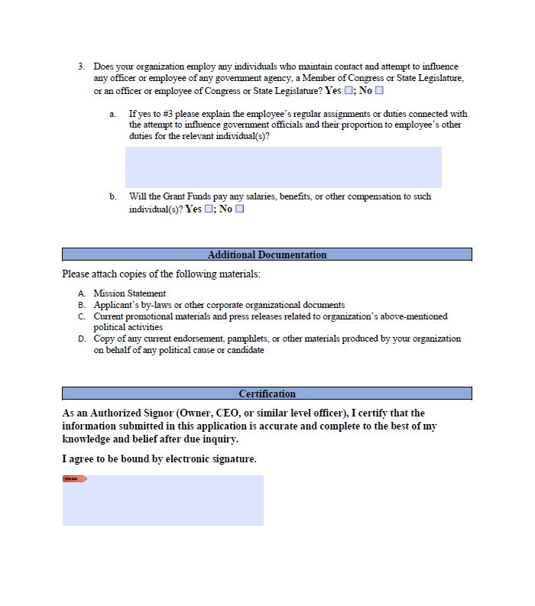
PAGE 8: Additional Applicant Information
If applicant is a nonprofit organization
If applicant is involved in political or lobbying activities
COMPLETE AND UPLOAD POLITICAL AND LOBBYING ACTIVITIES FORM
UPLOAD IRS
DETERMINATION LETTER

Slide 54
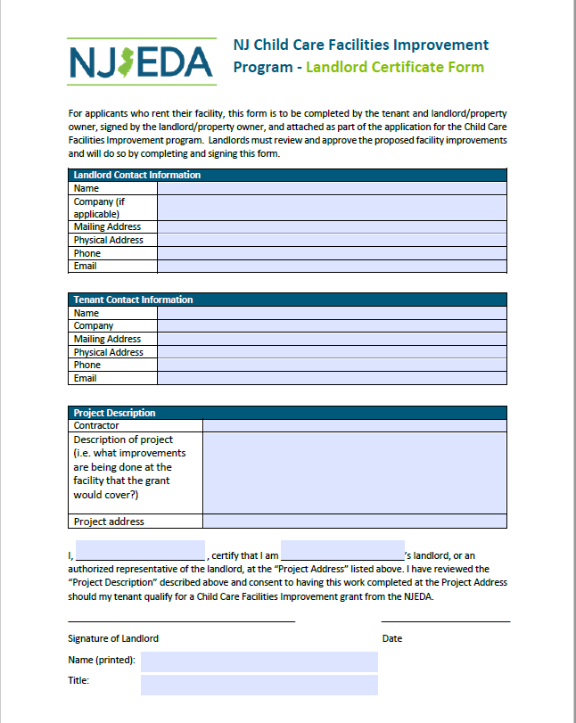
PAGE 9: Facility Information
Information on the facility location where the proposed project will take place
Name of Facility
Is this a registered Family Child Care Home?
Project location (address)
If the applicant owns the facility, they will
If the applicant leases the facility, they will
AND
UPLOAD EVIDENCE
OF OWNERSHIP
COMPLETE AND
UPLOAD LANDLORD CERTIFICATION
UPLOAD A COPY OF AN EXECUTED LEASE

Slide 55
PAGE 9: Facility Information (cont’d)
Information on the facility location where the proposed project will take place
Is the proposed project site at a licensed child care site currently enrolled in the New Jersey Department of Human Services /Department of Family Development (DHS/DFD)’s Grow NJ Kids (GNJK) quality rating improvement system?
Remember: If not already enrolled, applicants awarded this grant must enroll in GNJK within a year of executing their grant agreement and will certify this agreement.
Remember: To be eligible, applicants must currently enroll, or have enrolled in the last 12 months prior to the date of application, at least 1 child receiving assistance from CCAP
Does the applicant (the licensed child care center) currently enroll or have they enrolled in the last 12 months prior to the date of application, at least one (1) child receiving support through DHS’s Child Care Assistance Program?

Slide 56
PAGE 9: Facility Information (cont’d)
Information on the facility location where the proposed project will take place
Does your facility operate for 6 hours more a day?
What is your current capacity?
Infants (0-17 months)
Toddlers (18-35 months)
Preschool (3-5 years)
School age (over 5 years)
What is your enrollment capacity?
Infants (0-17 months)
Toddlers (18-35 months)
Preschool (3-5 years)
School age (over 5 years)
How many classrooms are there at the project site?
Infants (0-17 months)
Toddlers (18-35 months)
Preschool (3-5 years)
School age (over 5 years)

Slide 57
PAGE 9: Facility Information (cont’d)
Information on the facility location where the proposed project will take place
What is your current number of staff?
Administrative: Individuals who are responsible for the onsite day to day operations (supervising staff, designing program plans/curriculum, communicating with families), business management, and finances of a child care site. This can also include support staff such as assistant directors, office managers, clerical staff.
Teachers: Individuals responsible for care, supervision and education of children.
What are the sources of funding for this site? List all that apply.
Parent Payments
Early Head Start/Head Start
Child Care Assistance Program
NJ Public Funded Preschool
Grow NJ Kids Grants
Foundations/Other grants

Slide 58
PAGE 10: Project Information
UPLOAD PROJECT DESCRIPTION AND JUSTIFICATION
Information describing the facility improvement project
Describe why this project is necessary, including the eligible uses, any requested furniture, fixtures, and equipment (FFE), and soft costs.
What current issues and challenges at the child care center will be addressed by this project?
How will this project help to maintain or increase the quality of the learning environment? Are there specific issues that will be addressed that have been documented in formal assessments like your last licensing report, Environmental Rating Scale (ECERS-3, FCCERS-3 or ITERS-3) results, and/or Grow NJ Kids assessment?
Are there potential risks or challenges to the facility if the project is not awarded funding? If so, please describe. If not, please write ‘not applicable’ in your response to question #4.
If applicable: Will this project increase access for more children to be enrolled in the facility, and if so, please describe, including the estimated number of additional children that can be enrolled and the age groups that you anticipate enrolling with this increased capacity? Please describe why increased access is important for your community. [Note: increasing access is not a requirement of this program. If this question does not apply to your project, please write ‘not applicable’ in your response to question #5]
What factors may impact your project timeline, including but not limited to winter heating needs or relocation? What is the plan to manage these elements?

Slide 59
Sample Project Information Descriptions
To help guide your planning, we’ve created two sample descriptions of project narrative applications.
You can review them at https://www.njeda.com/sample-project-description-final/
These can also be found under the ‘APPLICATION PREPARATION DOCUMENTS’ section on our website.
These are just meant to serve as examples. Please put your narrative in your own words!

Slide 60
Project Information (cont’d)
Information describing the facility improvement project
Be sure the lighting in the space is good so images come out clear and represent the true condition of the space, equipment or project need
Take photos from multiple angles
Photos should complement your description of Proposed Improvements and budget
UPLOAD PHOTOS OF THE SPACE(S) WHERE THE FACILITY IMPROVEMENT(S) WILL TAKE PLACE

Slide 61
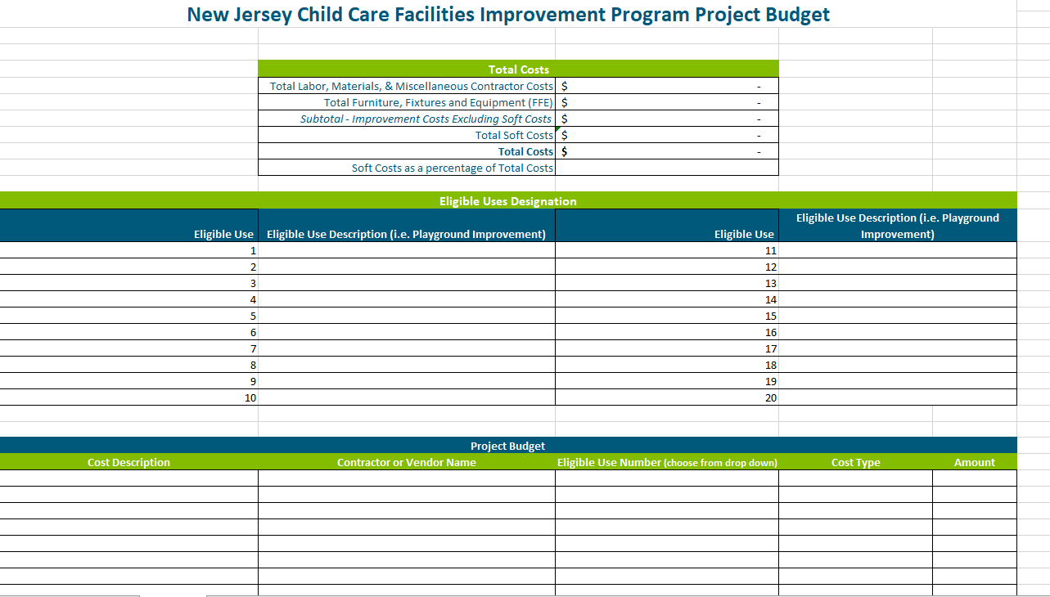
Project Budget
UPLOAD PROPOSED BUDGET FOR THE FACILITY IMPROVEMENT
Total project costs must be between $50,000 - $200,000
Soft costs are capped at 20% of the total grant request and limited to: Architect fees, permit fees, construction management, freight & shipping, and environmental assessments
RESOURCE: Project Budget Template Template to develop your project’s budget found at
https://www.njeda.com/child-care-facilities-improvement-budget-phase-1-7-20-22/
Notes:
Budgets must be between $50,000 and $200,000 for all project cost
Consult and work with your Public Works Registered Contractor(s) to develop this budget accounting for everything needed to complete your project. Do not forget to include installation fees if this kind of work is required.
Make sure your budget accounts for New Jersey prevailing wage labor costs based on the County where the project is located. Consult and work with your Public Works Registered Contractor(s) to ensure this is factored into any project estimates offered.

Slide 62
Project Budget (cont’d)
As you enter information into this section and categorize the costs, it will automatically calculate costs and populate them in the Total Costs table.
Remember: These costs should match the quote you submit with your application
The amounts calculated here should match the costs you enter in your application for:
Improvement costs excluding soft costs
Total Soft costs
Total Project costs
Remember: Soft costs may not exceed 20% of your total project costs

Slide 63
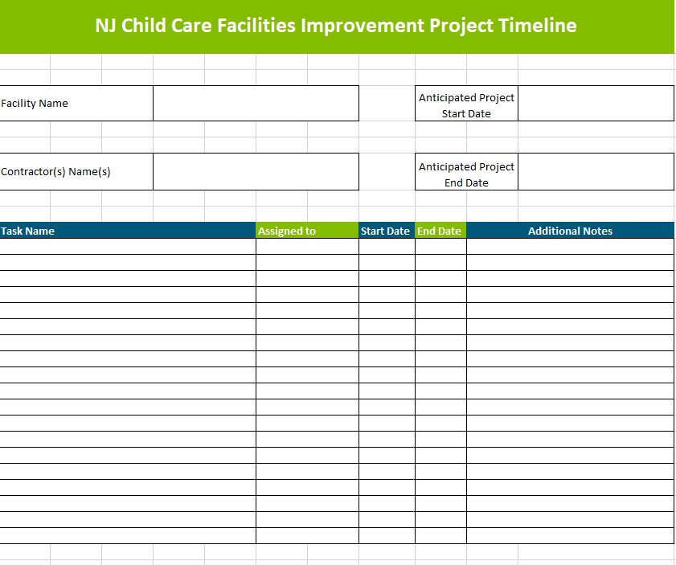
Project Timeline
UPLOAD PROPOSED TIMELINE FOR THE FACILITY IMPROVEMENT
Develop in collaboration with your Public Works registered contractor
Projects must be started within 1 year of executing an agreement with NJEDA
Projects must be completed withing 1 year of construction start
RESOURCE: Project Timeline Template Template to develop your project’s timeline found at
https://www.njeda.com/cc-facilities-improvement-project-timeline-template/
Notes:
Consult and work with your Public Works Registered Contractor to develop this timeline for everything needed to complete your project.

Slide 64
Project Information (cont’d)
Information describing the facility improvement project
IF APPLIABLE, UPLOAD PROJECT DESIGN DOCUMENTS e.g. ARCHITECTUAL RENDERINGS OR DRAWINGS MADE BY CONTRACTOR
Remember: Total cost of improvements excluding soft cost should match the amount captured in your budget template
Total cost of improvements EXCLUDING soft costs (i.e. architect fees, permit fees, construction management, freight and shipping delivery, and environmental assessment

Slide 65
Project Information (cont’d)
Information describing the facility improvement project
Does this project include the purchase of Furniture, Fixtures and Equipment?
UPLOAD ALL DOCUMENTATION REGARDING FFE
Documentation can be a formal bid from a vendor and/or printouts/screenshots with prices from online retailers(s) for items to be purchased
Remember:
Applicants should carefully consider their options to support the various elements of their proposed project, specifically as it relates to options for purchase of Furniture, Fixtures and Equipment (FFE)
Purchases will be reimbursed
Applicants will be required to certify that there is no ‘Duplication of Benefits’ and that no other government funds were used on the same expense.
Remember: If the installation cost is more than $2000, Public Works Registered contactors must abide by NJ prevailing wage and affirmative action requirements

Slide 66
PAGE 11: Contractor Information
Identify the DOL Public Works registered contractor who provided your quote
Applicants will be able to add multiple Public Works Registered Contractors by using the search feature linked to the DOL Public Works Registered Contractor List
Contractor’s Primary Point of Contact
Contractor’s Primary Point of Contact email
Contractor’s Primary Point of Contact Phone Number
Contractor’s Business Address
Description of the improvements to be completed by each contractor
UPLOAD CONTRACTOR QUOTE AND THEIR DOL PUBLIC WORKS CERTIFICATION
Quotes must abide by NJ prevailing wage rates

Slide 67
PAGE 12: Soft Costs
Soft costs are capped at 20% of total costs and are limited to: architect fees, permit fees, construction management, freight and shipping delivery, and environmental assessments
Do you have any soft costs as part of your total project budget?
UPLOAD BRIEF DESCRIPTION OF YOUR SOFT COSTS
Remember: Total soft costs and total project costs should match the amount captured in your budget template
Enter total soft costs
Enter total project costs (total improvement costs from Project Information page + soft costs)

Slide 68
PAGE 13: Duplication of Benefits
External funding sources may not be used to fund projects outlined in this application nor will it reimburse applicants for costs incurred prior to the award.
Have you applied for any other COVID-19 assistance?
Including but not limited to: NJEDA Grant and/or Loan Program, New Jersey Department of Human Services ARP Child Care Stabilization Grant, New Jersey Department of Human Services Hiring and Retention Bonus Grant ,New Jersey Department of Human Services Child Care Emergency Assistance Grant, SBA, EIDL, SBA EIDG, other State or Local Municipality, or Insurance
If yes
Will the COVID-19 assistance funding be used for the project identified in this application?
What program(s) have you applied to or received funding for?( Check all that apply.)
NJ DHS ARP Child Care Stabilization Grant
NJ DHS Hiring and Retention Grant
NJ DHS Child Care Emergency Assistance Grant
Other Program/Funding Source
Program Information including purpose of funds
Notes:
Previously receiving DHS ARP Stabilization Grants or DHS ARP Hiring and Retention Bonus Grants administered by the NJ DHS Division of Family Development does not impact your eligibility as an applicant for this grant. Remember any future funds you receive through NJ DHS cannot be combined with or used to support the same costs that NJEDA is paying for.
.Receiving prior grants from the NJEDA does not impact your eligibility as an applicant for this grant.

Slide 69
PAGE 14: Legal Questionnaire
External funding sources may not be used to fund projects outlined in this application nor will it reimburse applicants for costs incurred prior to the award.
Has Applicant, or any officers or directors of Applicant, or any Affiliates of Applicant, been found or conceded or admitted to being guilty, liable or responsible in any Legal Proceeding, or conceded or admitted to facts in any Legal Proceedings that demonstrate responsibility for any of the following violations or conduct? (Any civil or criminal decisions or verdicts that have been vacated or expunged need not be reported.)
To the best of your knowledge, after reasonable inquiry, are Applicant, or any officers or directors of Applicant, or any Affiliates, a party to pending Legal Proceedings wherein any of the offenses or violations described in questions 1-10 above are alleged or asserted against such entity or person? With respect to laws banning or prohibiting discrimination or harassment in the workplace, please provide only information pertaining to any class action lawsuits.
UPLOAD COPIES OF DOCUMENT(S) REFLECTING THE FINAL RESOLUTION
Notes:
Documentation to submit with your application must include:
The case name and court/administrative agency (including jurisdiction and venue) in which such matters were tried or are pending;
The charges or claims adjudicated or alleged; and
Final resolution (e.g., final judgments, verdicts, plea bargains, consent orders, administrative findings, or settlement agreements).

Slide 70
PAGE 15: Prohibited Activities in Russia-Belarus
External funding sources may not be used to fund projects outlined in this application nor will it reimburse applicants for costs incurred prior to the award.
Complete a certification that applicant is not engaged in prohibited activities in Russia or Belarus

Slide 71
PAGE 16: Certification of Application
Affirmation the information included in the application has been completed to the best of the applicant’s knowledge to be true and complete
Complete certification to the following statements:
I affirm, represent, and warrant that the information contained in this application and in all associated attachments submitted herewith is to the best of my knowledge true and complete and that the funding applied for herein is not for personal, family, or household purposes.
I understand that if such information is willfully false, I am subject to criminal prosecution under N.J.S.A. 2C:28-2 and civil action by the NJEDA which may at its option terminate its financial assistance.
I authorize the New Jersey Department of Law and Public Safety to verify any answer(s) contained herein through a search of its records, or records to which it has access, and to release the results of said research to the NJEDA.
I authorize the NJEDA to provide information submitted to it by or on behalf of the applicant to any bank or State agency which might participate in the requested financing with the NJEDA.
I certify my understanding that an electronic signature of this Application and any Approval Letter or Agreement shall be a binding on the parties.
I certify that the firm is not in default with any other program administered by the State of New Jersey.

Slide 72
PART 7 APPLICANT PLANNING RESOURCES

Slide 73
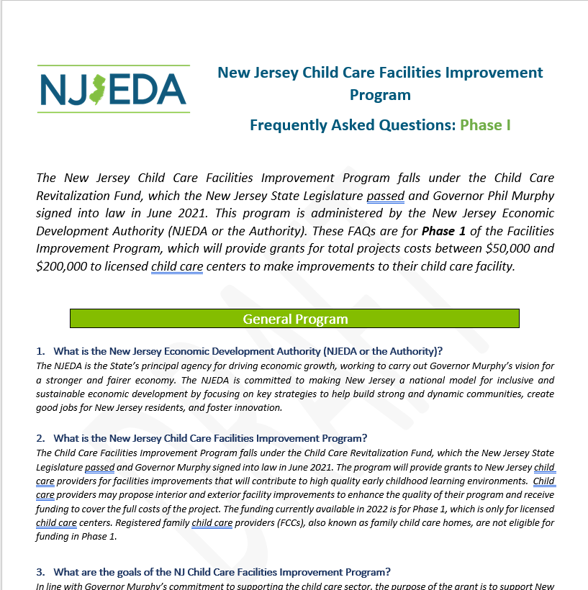
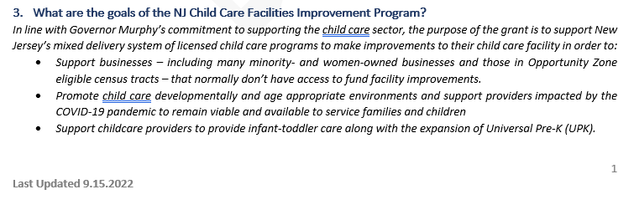
Frequently Asked Questions (FAQ)
Located on NJEDA website at https://www.njeda.com/wp-content/uploads/2022/09/FAQ-Phase-1.pdf
Will be updated following these webinars and regularly moving forward.
Check the footer for the date of the last update

Slide 74
All resources can be found at https://www.njeda.com/child-care-improvement-program/
1
Application Quick Start Guide
5
Project Description example
Checklist of all information and documents needed for application
Two examples of how to write a project description
2
FFE Allowable Expenses
6
Budget Template
Provides additional information and guidance on what is allowable
Template to develop your project’s budget
3
Project Idea Board
7
Timeline Template
Tool to help applicants make decisions about proposed projects aligned to the grant’s eligible uses
Template to develop your project’s timeline
4
Tips for Finding a Contractor
8
Contractor Pre-Construction Checklist
How-to navigate the DOL Public Works registered list
Guide for Public Works registered contractors to help them maintain compliance throughout
the life of the project

Slide 75
Language Assistance
The following materials will be translated into Spanish
Application
FAQs
All Applicant Planning resources and materials
If you require assistance in a different language, please send NJEDA your name, spoken language, and telephone number to languagehelp@njeda.com to receive assistance completing the application.

Slide 76
Questions following the webinar
CustomerCare@njeda.com
(844) 965-1125
NJEDA Customer Care Chat
www.njeda.com

Slide 77
THANK YOU

